Slide 1
Why Rural Matters 2015-16: Understanding the Changing Landscape Appalachian Higher Education Network Conference 2017 Presenter: Robert Mahaffey, Executive Director Rural School and Community Trust
Rural School and Community Trust www.ruraledu.org

Slide 2
Why Rural Matters Report
Every two years, beginning in 2001
Gauges and Indicators
Content
Narrative
State pages
Gauge maps
Indicator charts

Slide 3
What Is “Rural”?
Current Urban-Centric Locale Codes and Handbook Option Set (Handbook Element #0839 Locale Codes):
Rural, Fringe: Census-defined rural territory that is less than or equal to 5 miles from an urbanized area, as well as rural territory that is less than or equal to 2.5 miles from an urban cluster.
Rural, Distant: 5-25 miles from an urbanized area, or 2.5-10 miles from an urban cluster.
Rural, Remote: More than 25 miles from an urbanized area and more than 10 miles from an urban cluster.
“Urban Cluster” = 25,000-50,000 “Urban Area” = 50,000+

Slide 4
Why Rural Matters 2015-16 Daniel Showalter, Ph.D. Robert Klein, Ph.D. Jerry Johnson, Ed.D. Sara L. Hartman, Ph.D.

Slide 5
Data Sources
Common Core of Data (NCES)
Nation’s Report Card – NAEP Data (NCES)
American Community Survey (U.S. Census)
EDFacts (U.S. Department of Education)
Office for Civil Rights (U.S. Dept of Ed)

Slide 6
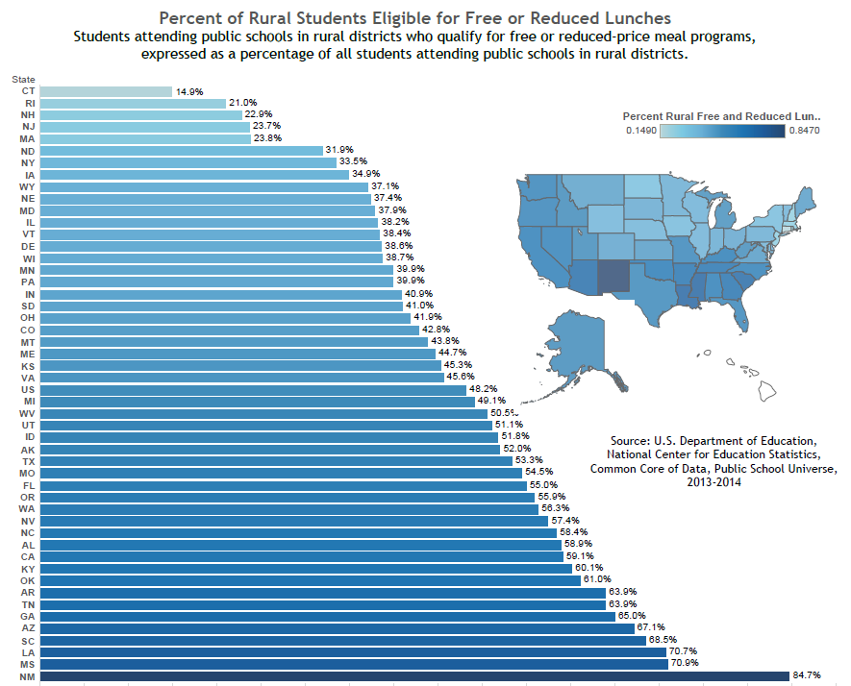
A Caution About Averages: Example Using Poverty Rates in Rural Pennsylvania
Rural PA
39.9% Poverty Rate

Slide 7
A Caution About Averages: Example Using Poverty Rates in Rural Pennsylvania
Rochester 65.1%
Brownsville 64.8%
Purchase Line 63.8%
Panther Valley 61.7%
Albert Gallatin 61.3%
Turkeyfoot Valley 61.2%
Overall poverty rate for rural PA: 39.9%

Slide 8
Sample Indicator Results
Percent Rural Mobility
State | Percent | Rank
Nevada | 17.3% | 1
Oregon | 14.3% | 2
Washington | 11.7% | 16
Mississippi | 10.7% | 23
New Jersey | 5.6% | 50

Slide 9
Sample Indicator Results
Instructional Dollars per Transportation Dollars
State | Dollars | Rank
West Virginia | $6.54 | 1
New Jersey | $7.16 | 2
Virginia | $8.62 | 11
Tennessee | $13.86 | 43
Vermont | $17.39 | 48
Alaska | $25.81 | 49

Slide 10
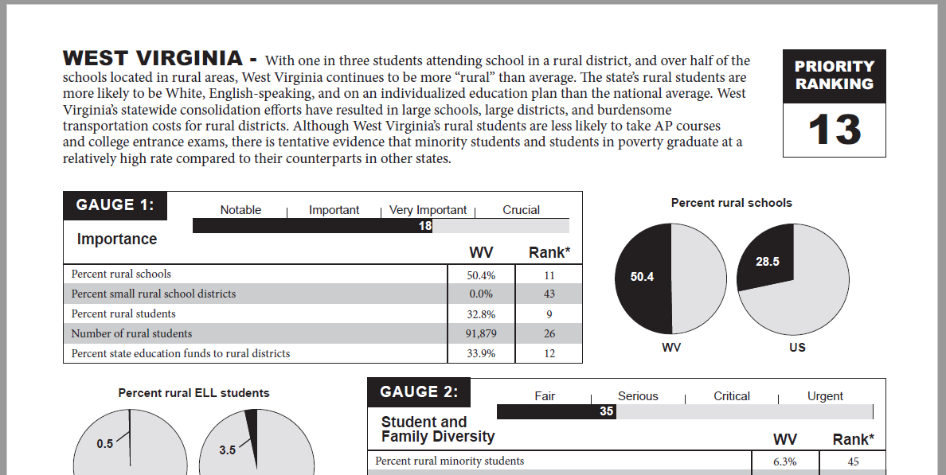
Example State Page

Slide 11
Importance Gauge
Percent rural schools
Percent small rural districts
Percent rural students
Number of rural students
Percentage of state education funds to rural districts

Slide 12
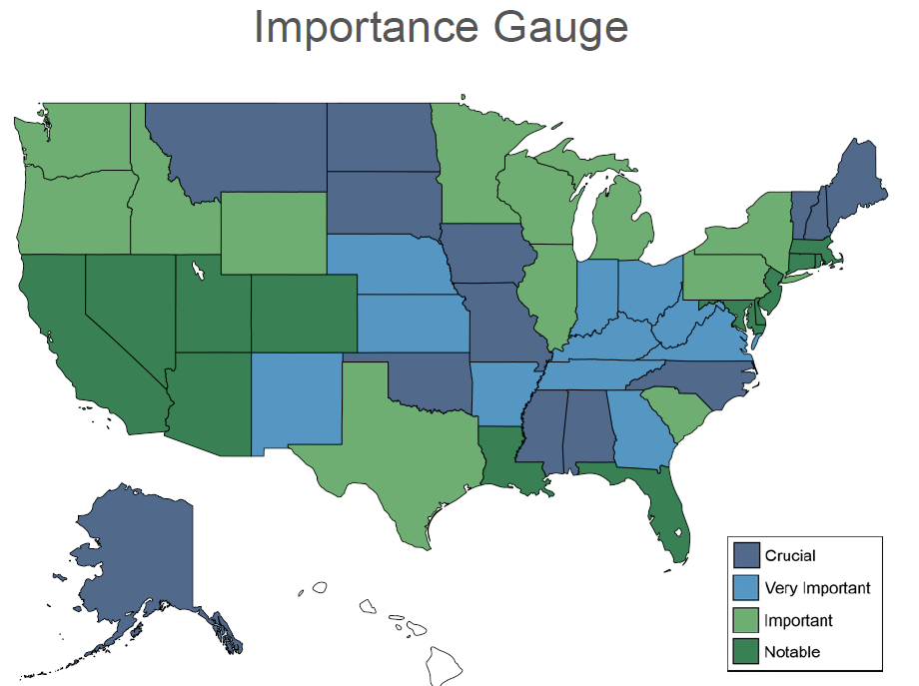

Slide 13
Student and Family Diversity Gauge
Percent rural minority students
Percent rural students eligible for subsidized meal programs
Percent rural ELL students
Percent rural IEP students
Percent rural mobility

Slide 14
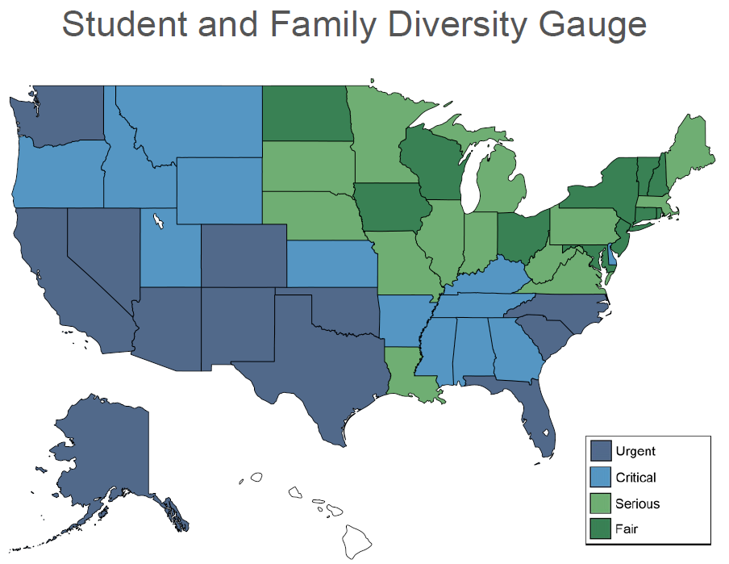
Student and Family Diversity

Slide 15
Educational Policy Context Gauge
Rural instructional expenditures per pupil
Ratio of instructional to transportation expenditures
Median organizational scale (x 100)
State revenue to schools per local dollar
Rural salary expenditures per instructional FTE

Slide 16
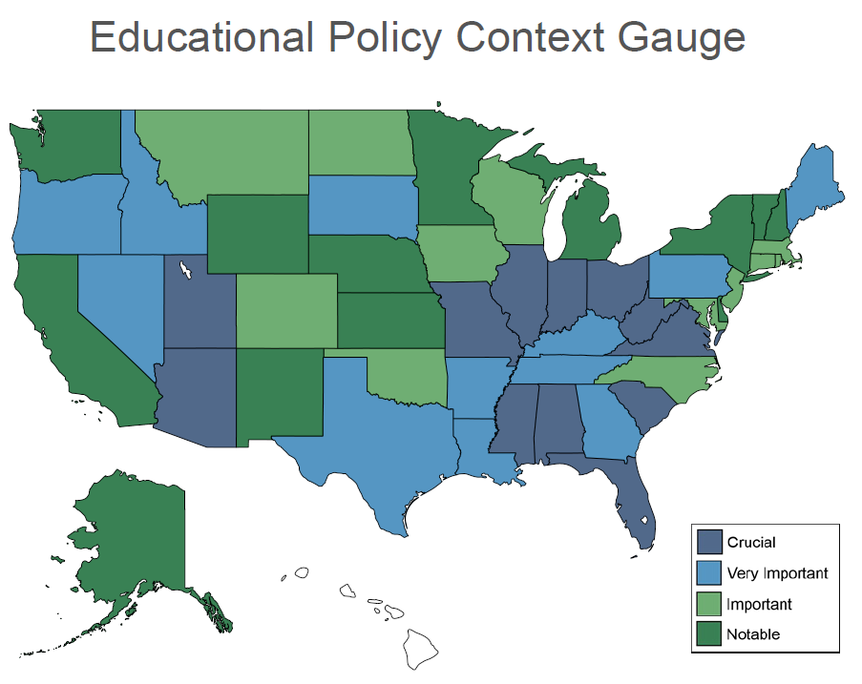
Educational Policy Context

Slide 17
Educational Outcomes Gauge
Rural Grade 4 NAEP scores (math)
Rural Grade 4 NAEP scores (reading)
Rural Grade 8 NAEP scores (math)
Rural Grade 8 NAEP scores (reading)
Rural Grade 8 NAEP scores (science)

Slide 18
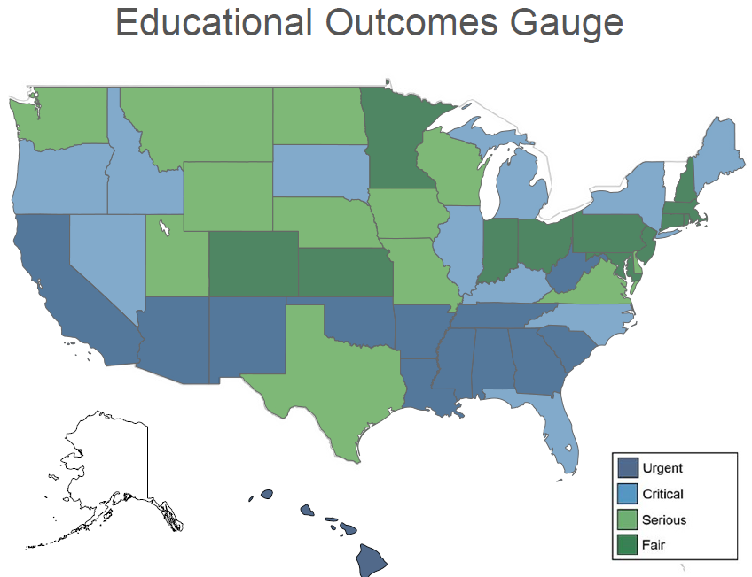
Educational Outcomes

Slide 19
College Readiness Gauge
Overall graduation rate in rural districts
Graduation rate for rural minority students
Graduation rate for free and reduced meal eligible students
Percent rural upperclassmen taking AP courses
Percent rural upperclassmen who took ACT/SAT

Slide 20
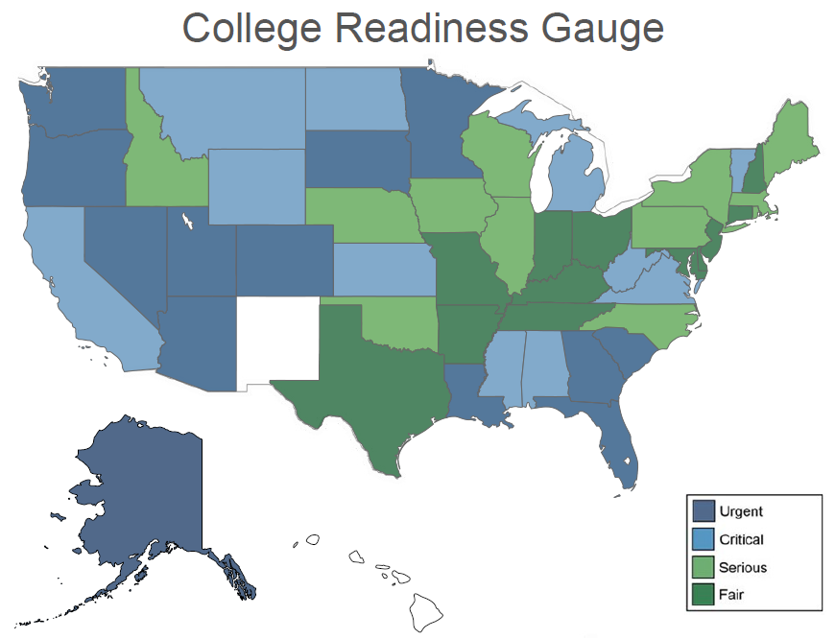

Slide 21
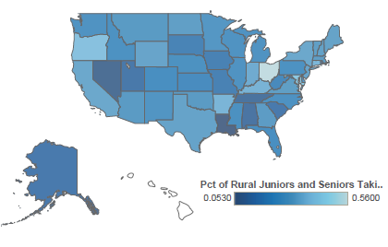
Advanced Placement Courses

Slide 22
Early Childhood Education
Positive Changes:
New Head Start performance standards
Preschool for All Initiative
Food Insecurity – School gardens & school-located food banks
Reasons for Continue Advocacy:
High levels of opioid/heroin addiction
High levels of rural child poverty
High-stakes testing measures
Access to quality, affordable child care
Need to increase rural preschool enrollment

Slide 23
STEM Education
STEM Ed is a key indicator of:
Future of national primacy,
Students’ readiness for post-secondary opportunities, and
Socio-cultural markers for individual intelligence.
WRM 16-17 STEM report focuses on
Teachers
Preparation, Professional Development, Recruitment and retention.
Students
Achievement, Access to STEM Learning and Opportunities
Exemplars of Promising Practices

Slide 24
ESSA
Rural Implications from ESSA as passed in December 2015
General Programs
Involvement provisions
Geographic diversity provisions
Definitions of need
Set-asides
Waivers/specialized consideration
Rural-specific Programs
Changes underway in 2017

Slide 25
English Language Learners
Definition
250,000 (3.5% of all rural students)
Reclassification
Challenges and ideas
Parents
Teachers
School Counselors
Administrators
Notes:
250,000 ELLs in rural districts, compared to 821,000 rural children who speak a language other than English at home
Half who enter kindergarten with basic/int English reclassified by 4th grade.
Par: communication
Tchrs: learning all pedagogy specific to students
Counselors: isolation, assessment
Administrators: testing, embrace diversity as a positive

Slide 26
Why Rural Matters: Priority Rankings Across Reports
2003
1. Mississippi
2. Alabama
3. Kentucky
4. North Dakota
5. South Dakota
2005
1. Mississippi
2. New Mexico
3. Kentucky
4. Louisiana
5. Alabama
2007
1. Mississippi
2. Alabama
3. Arizona
4. North Carolina
5. Oklahoma
2009
1. Alabama
2. Arizona
3. Mississippi
4. Oklahoma
5. New Mexico
2011-12
1. Mississippi
2. Alabama
3. Arizona
4. South Carolina
5. Louisiana
2013-14
1. Mississippi
2. Alabama
3. South Carolina
4. North Carolina
5. Arizona
2015-16
1. Mississippi
2. Arizona
3. Alabama
4. South Carolina
5. South Dakota

Slide 27
Questions?

Slide 28
Thank you!
Daniel Showalter (daniel.showalter@emu.edu)
Robert Klein (kleinr@ohio.edu)
Jerry Johnson (jerry.Johnson@ucf.edu)
Sara L. Hartman (hartmans@ohio.edu)
Robert Mahaffey, RSCT Executive Director (robert.mahaffey@ruraledu.org)
Alan Richard, RSCT Board Chair
(alanricharddc@gmail.com)
Rural School and Community Trust (www.ruraledu.org)

