Slide 1
Making College Home- One Course at a Time
Freshman Seminar

Slide 2
Jennifer Wilson-Kearse
US 1530 Breaking Cycles and How we got here
Sense of Belonging- pg. 49
This American Life- 40:05

Slide 3
Three Strands:
Flight Behavior
Naked Roommate- Intro to Campus
Growth Mindset

Slide 4
Flight Behavior
Rural v. Urban
NYC Travel
Service

Slide 5
Naked Roommate
Introduction to College
Assessment- Activity
Student Panel

Slide 6
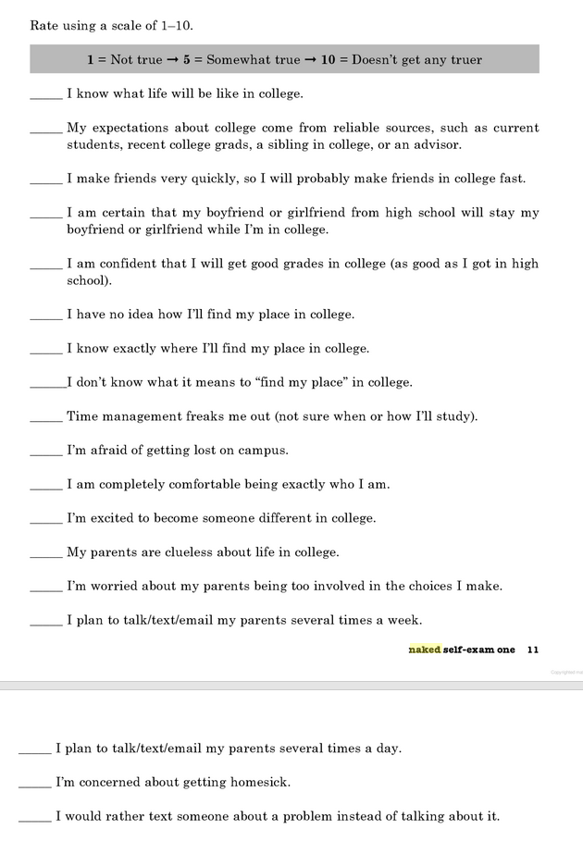

Slide 7
Growth Mindset
https://www.youtube.com/watch?v=JC82Il2cjqA
The role of non-cognitive factors and context
CCSR

Slide 8
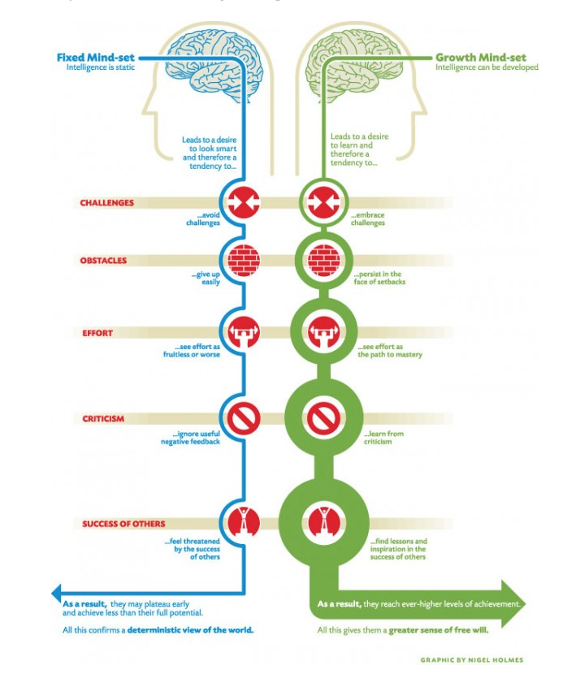

Slide 9
Growth Mindset
https://www.youtube.com/watch?v=ELpfYCZa87g

Slide 10
Growth Mindset
Struggle
Crumpled paper

Slide 11
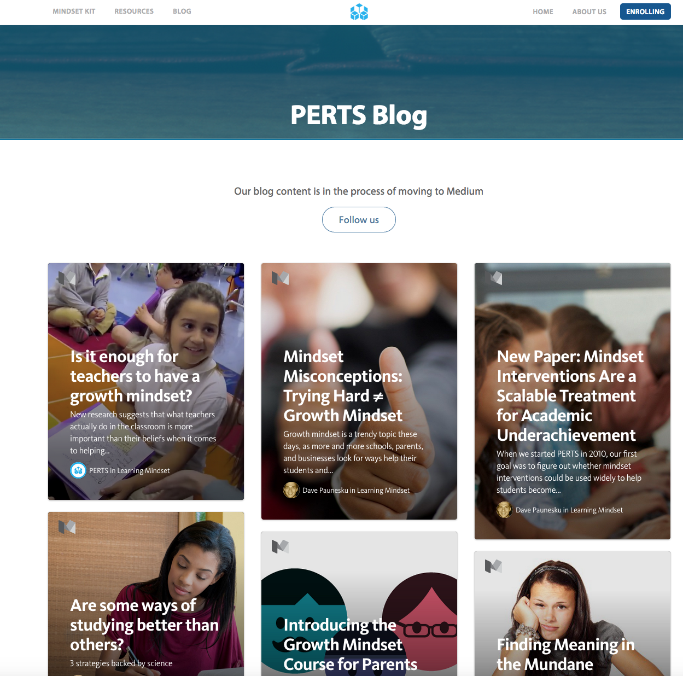

Slide 12
Unfortunately, the questions is not just how to prepare students but also how to create contexts that better support academic success. Thus, the responsibility for college readiness rests not just on students and the high schools developing cognitive skills and non-cognitive skills, but also in postsecondary institutions being ready to support students in attaining a degree and high schools helping students make informed decisions
QUESTIONS
828-262-8016 or wilsonkearsejj@appstate.edu

