Slide 1
Industry and Education Collaboration: Preparing a Stronger Workforce
AHE Network Conference – June, 2017

Slide 2
Overview of Presentation
Introductions
Presenters
Workforce Solutions for North Central PA
Clarion Sintered Metals
Penn State DuBois
Q and A and Discussion

Slide 3
Introduction – What is a WDB?
Part of the Public Workforce System: a network of federal, state, and local offices that support economic expansion and develop the talent of the nation’s workforce.
State and local WDBs serve as connectors between the U.S. Department of Labor and more than 2,500 local American Job Centers that deliver services to workers and employers.
The WDBs’ role is to develop regional strategic plans and set funding priorities for their area.
Think of your local WDB as your link to the public workforce system.
WDBs facilitate partnerships between local businesses with similar training needs.
-

Slide 4
What is a WDB?
WDBs also rely on labor market information to develop sector strategies that focus resources on a particular high growth industry for their area, often involving skill training for local businesses.
More than 50 percent of each WDB’s members must come from the business community. In addition, WDBs are required to have representation from local community colleges and other training providers, as well as elected officials and workforce program leaders. This ensures that current skill needs of local businesses are communicated to relevant training programs.

Slide 5
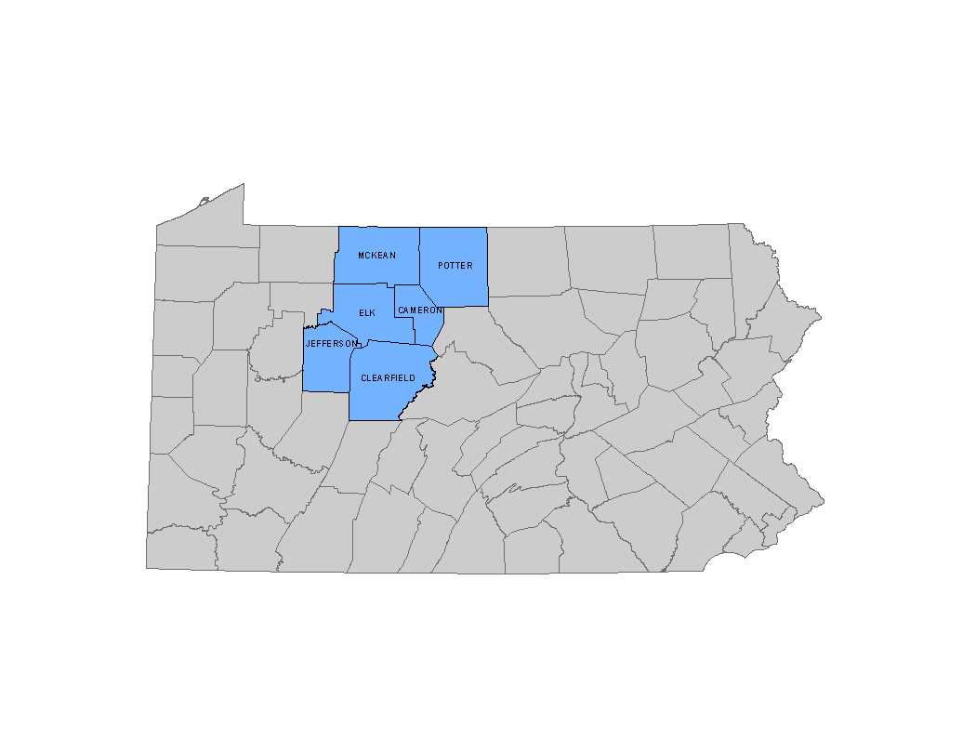
Workforce Solutions – North Central Workforce Development Board
Sq . Mi - 5,100
Pop -224,000
43 people per square mile
Roughly the size of the state of Connecticut

Slide 6
Workforce Solutions
MISSION
Mission: Workforce Solutions serves as the premier facilitator of an innovative workforce development system that meets the changing human capital needs of our employers and provides resources for our job seekers that maximizes their career potential and focuses on the customers’ needs.
Create and Implement Workforce Policies
Business, Job Seekers, and our youth
Intermediary – Connector – Convener
Industry and their workforce skills
North Central PA CareerLink® system
Developing the Workforce of Tomorrow
Industry Partnerships

Slide 7
The Partnership Begins
Manufacturing Industry Partnership Meeting – June 2016
Discuss common training needs with multiple employers from the industry.
Die Setter Training - #1 Need
Submit funding application request to PA Labor and Industry – August 2016
Receive award of $200,000 for incumbent worker training
$144,000 committed to Die Setter Training
Meet with employer to develop the Request for Quotes – October 2016
Procurement Process begins – November 2016
Review Proposals
Initial award made to Penn State Dubois – February 2017

Slide 8
Mary Lou Geyer Training Coordinator Clarion Sintered Metals Ridgway, PA 15853 Phone: 814-776-5792 Ext. 792 mgeyer@clarionsintered.com

Slide 9
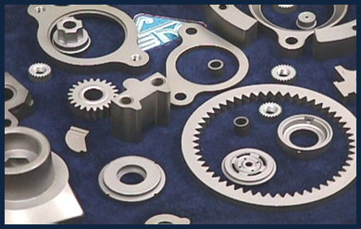
Established in 1984, Clarion Sintered Metals was founded on the principle of developing long-term relationships with our customers. Clarion Sintered is one of the largest privately owned powdered metal companies in the world.

Slide 10
Clarion Sintered Metals, one of the largest – and last – privately-owned powder metal companies in the world, is the largest manufacturer of powder metal ride control components in North America. With two manufacturing facilities and over 300 associates, Clarion Sintered Metals provides their customers with robust manufacturing process and advances in technology not seen elsewhere in the industry.

Slide 11
Carolyn Jacobson, Ph. D.
Director of Outreach, Penn State DuBois
1 College Place
DuBois, PA 15801
Phone: 814-375-4722
Email: cmj5371@psu.edu

Slide 12
The Partnership Continues
December 13, 2016 – Proposal submitted
January 10, 2017 – Revisions requested
January 26, 2017- Revisions due
February 21,2017– Award received!

Slide 13
Hammering out the Curriculum
March 3 - Industry Roundtable
Representatives from 7 powdered metal companies
Workforce Solutions representatives
Potential instructors
Penn State DuBois Outreach

Slide 14
Some Challenges
Videos
Finding a press
Tooling
Powder
Plant tour
Still looking for a multi-action press

Slide 15
We’ve Launched!
Classes started May 23 with 20 students
Waiting list prior to first day of class
13 classes
77 hours of instruction
Module II will start July 25
Module III planned for September 19

