Slide 1
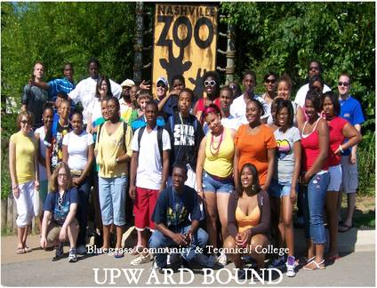
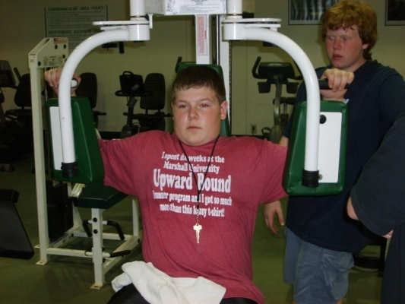
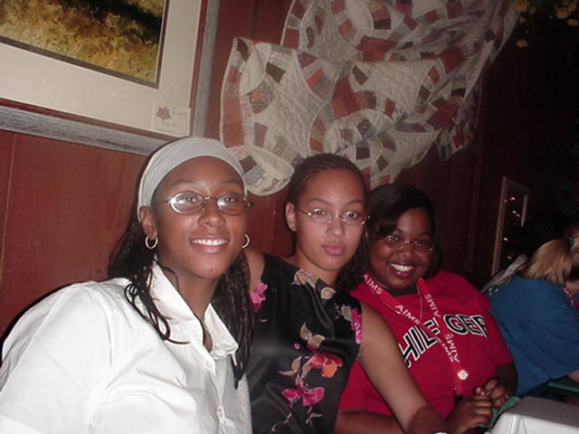
Getting to Know Your TRIO Programs in Appalachia
Appalachian Higher Education Network
June 23, 2016- Kingsport, TN

Slide 2
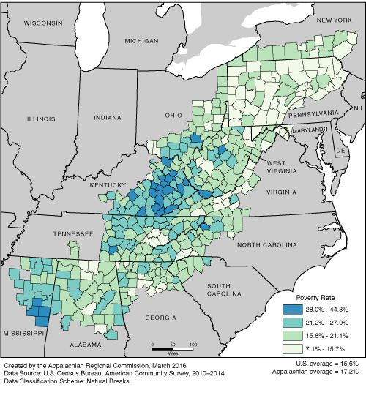
Poverty Rates in Appalachia, 2010–2014

Slide 3
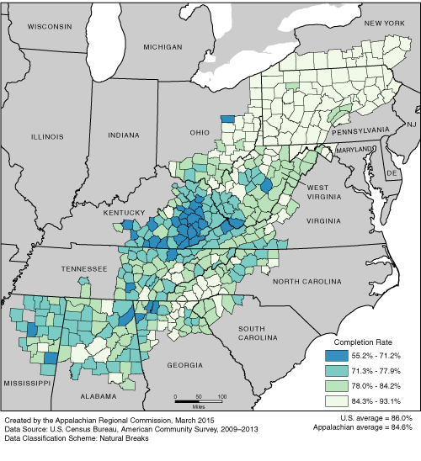
High School Completion Rates in Appalachia, 2009–2013

Slide 4
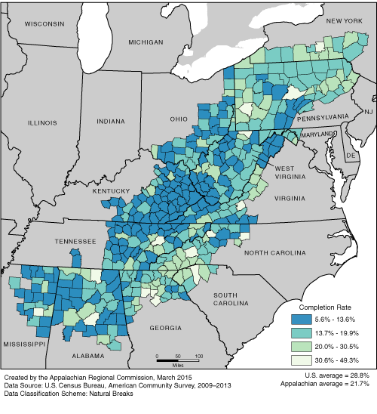
College Completion Rates in Appalachia, 2009–2013

Slide 5
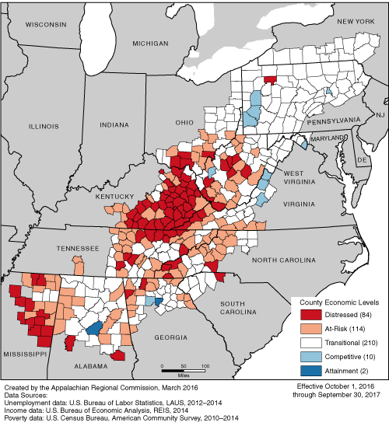
County Economic Status in Appalachia, FY 2017

Slide 6
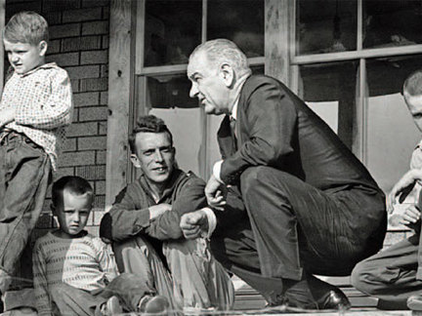
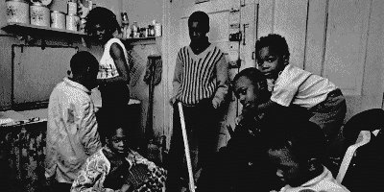
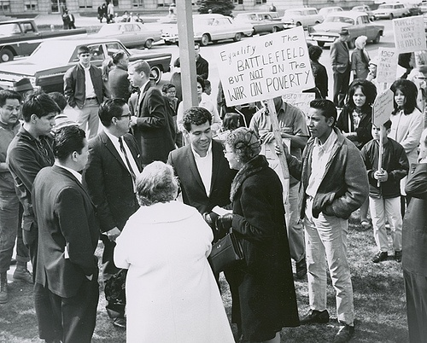
The History of the TRIO Programs:
The federal TRIO programs have been in existence since 1965 as part of Lyndon B. Johnson’s War on Poverty. This war started on two fronts: the inner cities and Appalachia. Kentucky, North Carolina, South Carolina, Tennessee and West Virginia were among the states included in the initial pilot programs for Upward Bound, one of the first TRIO programs. Since that time, TRIO has expanded to seven different programs to assist students and adults pursue and complete postsecondary education.
Notes:
TRIO programs were authorized by Congress under the Higher Education Act in 1967, re-authorized under Higher Education Opportunity Act 2008.

Slide 7
The Mission of the TRIO Programs
The Federal TRIO Programs are a series of programs designed to assist low-income students and adults to continue their secondary education and enter college, persist in their studies, graduate, and eventually become productive participants in America’s economic and social life.
These programs are:
⬥ Educational Opportunity Centers  Student Support Services  Talent Search  Upward Bound  Veteran’s Upward Bound  Upward Bound Math and Science  Ronald E. McNair Post-Baccalaureate Achievement
Notes:
PELL Institute-”Straight from the Source What Works for First-Generation College Students” Jennifer Engle, Adolfo Bermeo, Colleen O’Brien (p.5, December 2006).
“Overall, first-generation students say it is the relationships and trust they developed with pre-college program staff that allowed them to be receptive to the messages and services that these programs have to offer. ….’leap of faith’ to go to college.”
2. (p.14) Out of 100 HS graduates only 12% of those students whose parent have a HS diploma or less will earn a bachelor’s degree. 58% of students whose parents have a BA or higher earn a bachelor’s degree.

Slide 8
Overview of the Individual Federal TRIO Programs

Slide 9
Upward Bound,
Upward Bound Math/Science
(Upward Bound was the first TRIO program. The pilot program started in 1964. Upward Bound Math/ Science began in 1990. Both programs were reauthorized under the Higher Education Opportunity Act of 2008.)
Upward Bound provides fundamental support to participants in their preparation for college entrance. The program provides opportunities for participants to succeed in their precollege performance and ultimately in their higher education pursuits. Upward Bound serves: high school students from low-income families; and high school students from families in which neither parent holds a bachelor's degree. The goal of Upward Bound is to increase the rate at which participants complete secondary education and enroll in and graduate from institutions of postsecondary education.
Notes:
The first of the TRIO programs. Pilot programs began in 1965.
Pell Institute “National Studies find TRIO PROGRAMS Effective at Increasing College Enrollemnet and Graduation” :
50% more like to attain a bachelor’s degree (21.1% vs. 14.1% control group)
19% more likely to attain any postsecondary degree or credential (49.3% vs. 41.5% control group)
22% more likely to apply for student financial aid (75.0% vs. 61.7% control group)

Slide 10
Upward Bound
[Upward Bound (UB) focuses on low-income students in the high school grades to prepare and motivate them for higher education.]
UB provides high school students with:
Instruction in literature, composition, mathematics, laboratory science, and foreign language (mandatory)
Opportunities to study on a college campus after school, on Saturdays, and during the summer
Study skills, remedial instruction, tutoring, mentoring, and exposure to cultural components
Academic advising, career/personal counseling
Notes:
Became part of TRIO in 1965.
Pell Institute “National Studies find TRIO PROGRAMS Effective at Increasing College Enrollement and Graduation” :

Slide 11
Upward Bound
Projects MUST provide instruction in:
math, laboratory science, composition, literature, and foreign language
Information on the full range of Federal Student Financial Aid programs and benefits
Guidance and assistance on secondary school reentry, alternative education programs, or entry into general educational development programs or postsecondary education

Slide 12
Upward Bound Programs and Annual 2015/2016 Funding
 | Programs | Students Served | 2015/2016 Funding $ | Programs Statewide | Students Served | 2015/2016 Funding $
AL | 18 | 1442 | $6,187,568 | 28 | 2618 | $9,357,170
GA | 3 | 255 | $1,071,653 | 20 | 1601 | $6,791,805
KY | 6 | 531 | $2,300,888 | 14 | 1098 | $4,668,718
MD | 2 | 159 | $647,486 | 11 | 865 | $3,795,115
MS | 1 | 56 | $250,000 | 7 | 859 | $2,587,884
NY | 4 | 315 | $1,323,368 | 29 | 2406 | $10,270,568
NC | 2 | 145 | $617,446 | 20 | 1480 | $6,258,375
OH | 5 | 334 | $1,431,010 | 28 | 2213 | $9,522,560
PA | 10 | 909 | $3,731,070 | 19 | 1627 | $6,875,458
SC | 1 | 65 | $262,500 | 14 | 1208 | $5,130,643
TN | 11 | 803 | $3,536,889 | 17 | 1227 | $5,352,591
VA | 6 | 417 | $1,813,754 | 13 | 927 | $4,158,743
WV | 10 | 772 | $3,403,880 | 10 | 772 | $3,403,880
TOTAL | 79 | 6203 | $26,577,512 | 230 | 18,186 | $78,173,430

Slide 13
Upward Bound Math and Science
The Upward Bound Math and Science program is designed to strengthen the math and science skills of participating students. The goal of the program is to help students recognize and develop their potential to excel in math and science and to encourage them to pursue postsecondary degrees in math and science, and ultimately careers in the math and science profession.
UBMS provides students with special emphasis in:
Instruction - mathematics, science, computer technology
Opportunities to study on a college campus after school, on Saturdays, and during the summer
Mentoring with mathematicians and scientists engaged in research and teaching
Notes:
Became part of TRIO in 19
Pell Institute “National Studies find TRIO PROGRAMS Effective at Increasing College Enrollement and Graduation” :

Slide 14
Upward Bound Math and Science
Program services include:
summer programs with intensive math and science training
exposure to university faculty members who do research in mathematics and the sciences
participant-conducted scientific research under the guidance of faculty members or graduate students, who are serving as mentors
Exposure to academic programs and cultural events
Information on postsecondary education opportunities
Assistance in preparing for college entrance exams

Slide 15
UBMS Programs and Annual Funding
 | Programs | Students Served | 2015/2016 Funding $ | Programs Statewide | Students Served | 2015/2016 Funding $
AL | 2 | 123 | $512,500 | 2 | 123 | $512,500
GA | 0 | 0 | $0 | 5 | 320 | $1,351,501
KY | 3 | 186 | $775,000 | 5 | 312 | $1,300,000
MD | 1 | 68 | $303,206 | 4 | 273 | $1,179,614
MS | 0 | 0 | $0 | 1 | 63 | $262,500
NY | 0 | 0 | $0 | 3 | 183 | $7,625,000
NC | 1 | 63 | $262,500 | 5 | 303 | $1,262,491
OH | 1 | 63 | $262,500 | 5 | 314 | $1,334,534
PA | 3 | 173 | $800,514 | 6 | 336 | $1,563,014
SC | 1 | 55 | $250,000 | 3 | 188 | $811,886
TN | 3 | 181 | $797,034 | 3 | 181 | $797.034
VA | 1 | 50 | $250,000 | 2 | 115 | $512,500
WV | 1 | 50 | $250,000 | 1 | 50 | $250,000
TOTAL | 17 | 1012 | $4,463,254 | 5 | 303 | $18,762,574

Slide 16
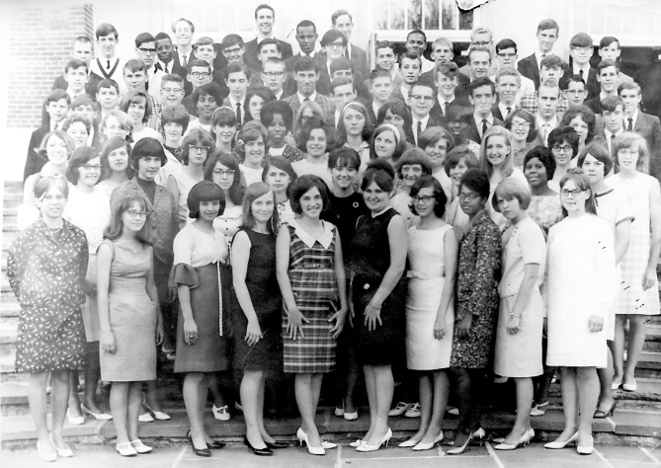
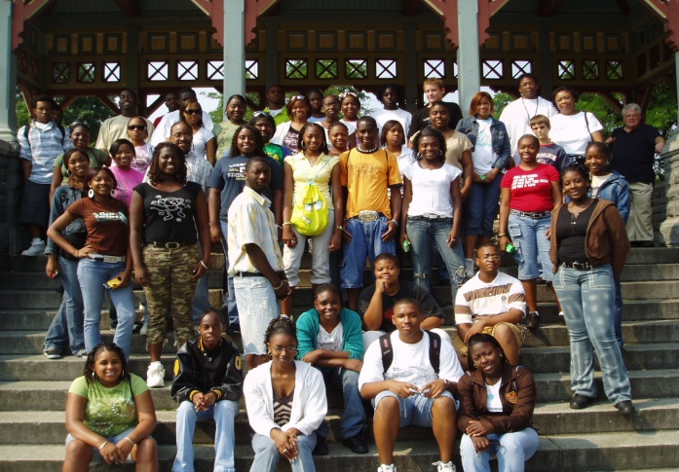
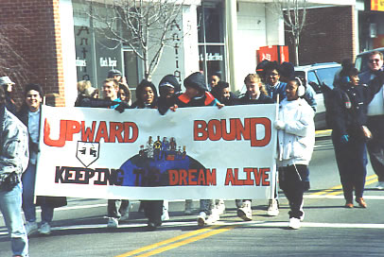
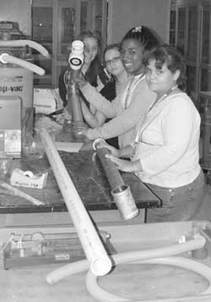
Faces of Upward Bound and Upward Bound Math and Sciences:

Slide 17
Talent Search
(Talent Search was first established in 1965, was one of the original three TRIO programs and was reauthorized under the Higher Education Opportunity Act of 2008.)
The Talent Search program identifies and assists individuals from disadvantaged backgrounds who have the potential to succeed in higher education. The program provides academic, career, and financial counseling to its participants and encourages them to graduate from high school and continue on to and complete their postsecondary education. The program publicizes the availability of financial aid and assist participant with the postsecondary application process. Talent Search also encourages persons who have not completed education programs at the secondary or postsecondary level to enter or reenter and complete postsecondary education. The goal of Talent Search is to increase the number of youth from disadvantaged backgrounds who complete high school and enroll in and complete their postsecondary education.

Slide 18
Talent Search
Program services include:
information on postsecondary institutions
guidance on and assistance in secondary school reentry, alternative education programs for secondary school dropouts
Exposure to college campuses
Special activities for sixth, seventh, and eighth graders
Assistance in completing college admissions and financial aid applications
Tutorial services
services designed to improve the financial and economic literacy of students

Slide 19
Talent Search Programs and Annual Funding
 | Programs | Students Served | 2015/2016 Funding $ | Pro15grams State11wide | Students Served | 2015/2016 Funding $
AL | 8 | 5560 | $2,366,305 | 18 | 13,599 | $5,845,503
GA | 0 | 0 | $0 | 15 | 10,807 | $4,728,316
KY | 4 | 3207 | $1,392,224, | 11 | 8145 | $3,588,671
MD | 0 | 0 | $0 | 3 | 2025 | $830,540
MS | 1 | 835 | $384,216 | 7 | 4953 | $2,153,697
NY | 1 | 664 | $305,684 | 15 | 10,735 | $4,672,741
NC | 3 | 2039 | $870,877 | 12 | 8089 | $3,516,344
OH | 1 | 825 | $303,097 | 12 | 9053 | $3,757,367
PA | 5 | 4228 | $1,755,707 | 10 | 7761 | $3,303,041
SC | 1 | 850 | $391,367 | 8 | 6239 | $2,682,556
TN | 7 | 4555 | $2,015,489 | 12 | 7642 | $3,392,776
VA | 5 | 3425 | $1,565,057 | 6 | 4230 | $1,934,994
WV | 3 | 1725 | $731,459 | 3 | 1725 | $731,459
TOTAL | 39 | 27,913 | $12,081,475 | 132 | 95,003 | $41,138,005

Slide 20
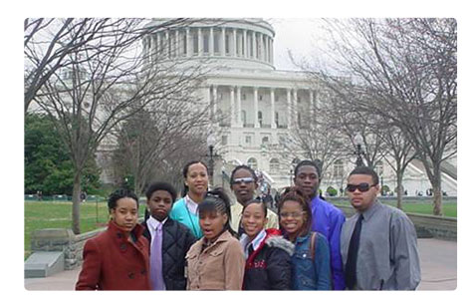
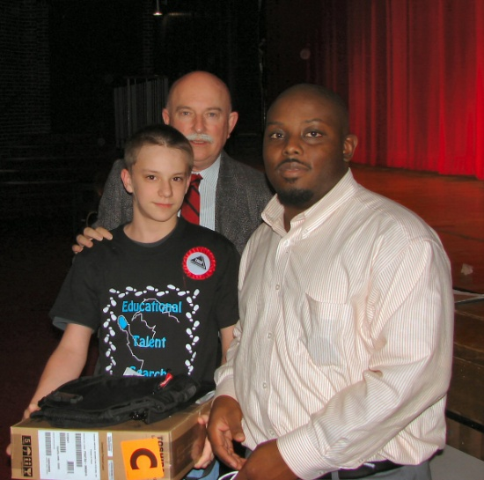
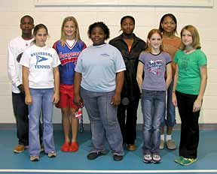
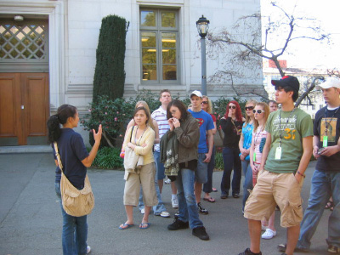
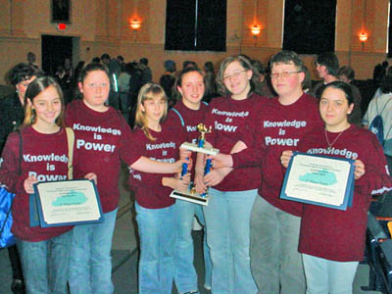
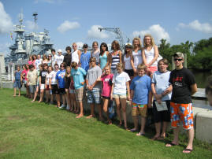
Faces of Talent Search:

Slide 21
Educational Opportunity Center
(Educational Opportunity Centers were first established in 1972 and reauthorized under the Higher Education Opportunity Act of 2008. )
The Educational Opportunity Centers program provides counseling and information on college admissions to qualified adults(and high school seniors not served by another TRIO program) who want to enter or continue a program of postsecondary education. The program also provides services to improve the financial and economic literacy of participants. An important objective of the program is to counsel participants on financial aid options, including basic financial planning skills, and to assist in the application process. The goal of the EOC program is to increase the number of adult participants who enroll in postsecondary education institutions.

Slide 22
Educational Opportunity Center
Eligibility requirements for EOC participation:
At least two-thirds served must be both low-income and potential first-generation college students
The remaining one-third can be low-income, first-generation, or anyone needing services
Types of Services Provided:
Academic, personal and/or career counseling
Information on postsecondary education
Admission and financial aid counseling
Assistance with admissions and financial aid applications and enrollment processes
Academic Advising
Referrals to necessary services
Referrals to GED/secondary education services

Slide 23
EOC Programs and Annual Funding
 | Programs | Students Served | 2015/2016 Funding $ | Programs Statewide | Students Served | 2015/2016 Funding $
AL | 1 | 5097 | $1,172,518 | 1 | 5097 | $1,172,518
GA | 0 | 0 | $0 | 3 | 4108 | $1,037,976
KY | 2 | 2505 | $679,511 | 4 | 5932 | $,,439,955
MD | 0 | 0 | $0 | 3 | 5089 | $1,419,747
MS | 0 | 0 | $0 | 2 | 2000 | $460,000
NY | 0 | 0 | $0 | 5 | 7433 | $1,988,253
NC | 1 | 1000 | $230,000 | 4 | 6175 | $1,369,577
OH | 2 | 2262 | $589,384 | 6 | 8279 | $2,051,934
PA | 1 | 1000 | $263,047 | 3 | 4233 | $1,126,890
SC | 1 | 1942 | $576,303 | 4 | 5495 | $1,476,970
TN | 4 | 4506 | $1,174,700 | 5 | 5692 | $1,548314
VA | 0 | 0 | $0 | 3 | 4913 | $940,170
WV | 3 | 3551 | $887,170 | 3 | 3511 | $887,170
TOTAL | 15 | 21,863 | $ 5,572,633 | 46 | 68,267 | $16,919,474

Slide 24
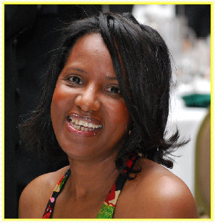
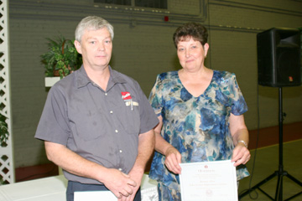
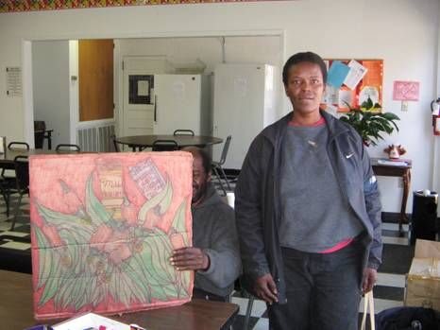
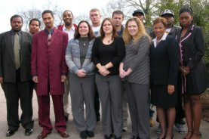
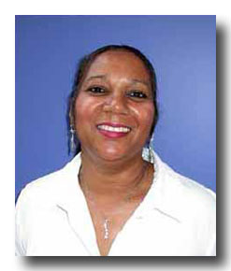
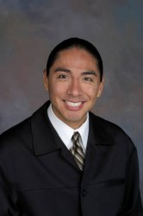
Faces of EOC:

Slide 25
Veterans Upward Bound
(Veterans Upward Bound was first established in 1972 and reauthorized under the Higher Education Opportunity Act of 2008. )
Veterans Upward Bound is designed to motivate and assist veterans in the development of academic and other requisite skills necessary for acceptance and success in a program of postsecondary education. The program provides assessment and enhancement of basic skills through counseling, mentoring, tutoring and academic instruction in the core subject areas. The primary goal of the program is to increase the rate at which participants enroll in and complete postsecondary education programs.

Slide 26
Veterans Upward Bound
VUB assists Veterans by providing:
Intensive basic skills development
Short-term remedial courses
Securing resources from the Veterans Administrations, veterans associations, and state/local agencies
Information and assistance on the admissions and student financial aid opportunities
Education or counseling services designed to improve the financial and economic literacy of participants
Assistance in preparing for college entrance exams

Slide 27
Veterans Upward Bound Programs and Annual Funding
 | Programs | Students Served | 2015/2016 Funding $ | Programs Statewide | Students Served | 2015/2016 Funding $
AL | 2 | 250 | $525,153 | 2 | 250 | $525,153
GA | 0 | 0 | 0 | 1 | 125 | $250,000
KY | 0 | 0 | 0 | 1 | 125 | $278,881
MD | 0 | 0 | 0 | 1 | 125 | $243,929
MS | 0 | 0 | 0 | 0 | 0 | 0
NY | 0 | 0 | 0 | 1 | 125 | $249,997
NC | 0 | 0 | 0 | 1 | 125 | $245,086
OH | 0 | 0 | 0 | 2 | 256 | $524,341
PA | 0 | 0 | 0 | 1 | 160 | $358,696
SC | 1 | 130 | $250,000 | 1 | 130 | $250,000
TN | 2 | 275 | $576,382 | 2 | 275 | $576,382
VA | 1 | 125 | $250,000 | 1 | 125 | $250,000
WV | 1 | 158 | $355,500 | 1 | 158 | $355,500
TOTAL | 7 | 938 | $1,957,035 | 15 | 1979 | $4,107,965

Slide 28
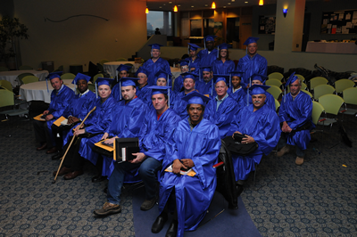
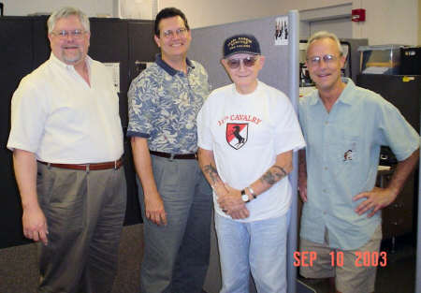
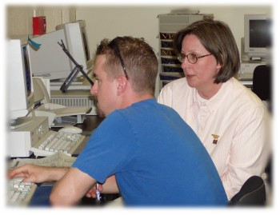
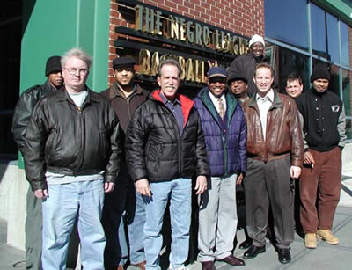
Faces of Veterans Upward Bound:

Slide 29
Student Support Services
(Student Support Services were first established in 1968. Initially, it was called Special Services for Disadvantaged Students. Upward Bound, Talent Search and Student Support Services made up the original TRIO Programs. It was reauthorized under the Higher Education Opportunity Act of 2008.)
Through a grant competition, funds are awarded to institutions of higher education to provide opportunities for academic development, assist students with basic college requirements, and to motivate students toward the successful completion of their postsecondary education. Student Support Services (SSS) projects also may provide grant aid to current SSS participants who are receiving Federal Pell Grants (# 84.063). The goal of SSS is to increase the college retention and graduation rates of its participants.

Slide 30
Student Support Services
Types of Services:
Instruction in basic study skills
Tutoring and Supplemental Instruction
Academic, personal and financial aid counseling
Financial aid and admission counseling for graduate and professional school enrollment
Career counseling and mentoring
Exposure to cultural activities
assist students enrolled in two-­year institutions
advice and assistance in postsecondary course selection

Slide 31
Student Support Services Programs and Annual Funding
 | Programs | Students Served | 2015/2016 Funding $ | Programs Statewide | Students Served | 2015/2016 Funding $
AL | 16 | 3655 | $5,602,875 | 28 | 6610 | $10,346,802
GA | 5 | 720 | $1,127,583 | 16 | 2325 | $3,716,512
KY | 10 | 1717 | $2,755,788 | 24 | 4180 | $6,344,652
MD | 3 | 590 | $772,929 | 15 | 3055 | $4,281,717
MS | 2 | 360 | $525,030 | 10 | 1816 | $2,815,927
NY | 4 | 885 | $1,144,063 | 43 | 9227 | $12,010,341
NC | 6 | 1070 | $1,744,056 | 35 | 6160 | $9,543,460
OH | 5 | 1065 | $1,490,530 | 24 | 4770 | $6,890,008
PA | 15 | 2721 | $4,020,739 | 24 | 4336 | $6,481,877
SC | 5 | 1035 | $1,499,270 | 27 | 4655 | $6,925,031
TN | 9 | 1709 | $2,434,759 | 18 | 3151 | $4,529,160
VA | 8 | 1785 | $2,585,462 | 21 | 4335 | $6,096,158
WV | 8 | 1790 | $2,313,060 | 8 | 1790 | $2,313,060
TOTAL | 96 | 19,102 | $28,016,144 | 293 | 56,410 | $82,294705

Slide 32
Ronald E. McNair Post-Baccalaureate Achievement
(The McNair Scholars program was first established in 1986 in honor of Challenger astronaut Ronald E. McNair and was reauthorized under the Higher Education Opportunity Act of 2008.)
Through a grant competition, funds are awarded to institutions of higher education to prepare eligible participants for doctoral studies through involvement in research and other scholarly activities. Participants are from disadvantaged backgrounds and have demonstrated strong academic potential. Institutions work closely with participants as they complete their undergraduate requirements. Institutions encourage participants to enroll in graduate programs and then track their progress through to the successful completion of advanced degrees. The goal is to increase the attainment of Ph.D. degrees by students from underrepresented segments of society.

Slide 33
Ronald E. McNair Post-Baccalaureate Achievement
Types of projects:
Academic/graduate school counseling
Financial assistance (i.e., fellowships, graduate and teaching assistantships)
Research/scholarly opportunities to provide effective doctoral studies preparation (including publications/ presentations)
Summer internships, tutoring, Seminars/other educational activities (i.e., conference presentations)
Mentoring programs involving HE institution faculty members or students
Exposure to cultural events/academic programs not usually available to project participants
mentoring programs involving faculty members at institutions of higher education

Slide 34
McNair Programs and Annual Funding
 | Programs | Students Served | 2015/2016 Funding $ | Programs Statewide | Students Served | 2015/2016 Funding $
AL | 2 | 56 | $476,551 | 2 | 56 | $476,551
GA | 0 | 0 | $0 | 1 | 29 | $254,573
KY | 1 | 25 | $220,000 | 2 | 53 | $445,000
MD | 0 | 0 | $0 | 2 | 61 | $528,996
MS | 0 | 0 | $0 | 2 | 54 | $472,001
NY | 2 | 65 | $469,686 | 14 | 425 | $3,319,576
NC | 0 | 0 | $0 | 2 | 50 | $435,597
OH | 0 | 0 | $0 | 4 | 112 | $897,121
PA | 2 | 60 | $525,279 | 2 | 60 | $525,279
SC | 0 | 0 | $0 | 2 | 57 | $453,723
TN | 1 | 29 | $252,000 | 1 | 29 | $252,000
VA | 0 | 0 | $0 | 0 | 0 | $0
WV | 2 | 55 | $471,998 | 2 | 55 | $471,998
TOTAL | 10 | 290 | 4 | 36 | 1041 | $8,532,415

Slide 35
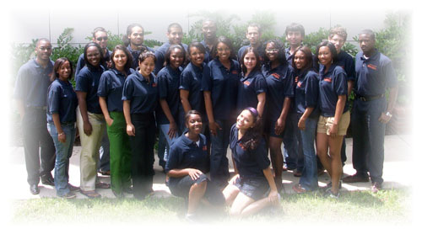
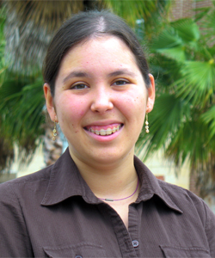
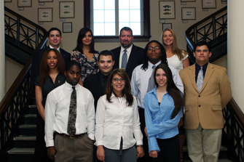
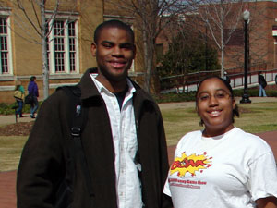
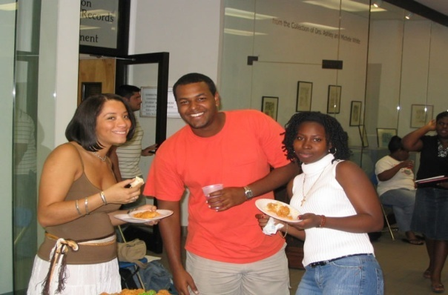
Faces of McNair Scholars:

Slide 36
The Federal TRIO Programs
Nationally, we have thousands of professionals serving in 2831 programs.
Our TRIO professionals assist over 788,449 first-generation/low-income students and adults annually in achieving their educational goals.
The US Department of Education provides $834,095,936 in grants to these TRIO programs.
In Appalachian Region, there are hundreds of professional members committed to our students and adults. We serve in 263TRIO programs and assist over 71,741 students and adults. The U.S. Department of Educations funds these programs through grants totaling $81,083,567.

Slide 37
TRIO Programs and Funding:
Appalachian Region National
 | Total Programs | Students Served | Total Funding | Total Programs | Students Served | Total Funding
UB | 79 | 623 | $26,577,512 | 813 | 61,361 | $263,412,463
UBMS | 17 | 1012 | $4,463,254 | 162 | 10,034 | $43,050,368
TS | 39 | 27,913 | $12,081,475 | 449 | 310,199 | $134,520,595
EOC | 15 | 21,863 | $5,572,633 | 126 | 189,733 | $46,606,423
VUB | 7 | 938 | $28,016,144 | 49 | 6566 | $13,548,241
SSS | 96 | 19,102 | $2,415,514 | 1081 | 206,263 | $297,256,676
McNair | 10 | 290 | $2,415,514 | 151 | 4293 | $35,701,197
TOTAL | 263 | 71,741 | $81,083,567 | 2831 | 788,449 | $834,095,936

Slide 38
Let’s Keep Working Together…
The Federal TRIO Programs in Alabama, Georgia, Kentucky, Maryland, Mississippi, New York, North Carolina, Ohio, Pennsylvania, South Carolina, Tennessee, Virginia and West Virginia are proud of our collaborations and partnerships with schools, colleges, universities, government and community agencies, organizations, and businesses. And we are very proud to participate in the
Appalachian Higher Education Network.
Let us continue to enhance each others’ efforts so that :
all of our students and adults succeed in school
and that higher education becomes the reality
and not just a dream.

Slide 39
On Behalf of the Council for Opportunity in Education, the Association for Equality and Excellence In Education Inc, Educational Opportunity Assocation the Mid-Eastern Association of Educational Opportunity Program Personnel, the Southern Association of Educational Opportunity Program Personnel and all of our TRIO Programs---
Thank You for your Great Work with all of our students.

Slide 40
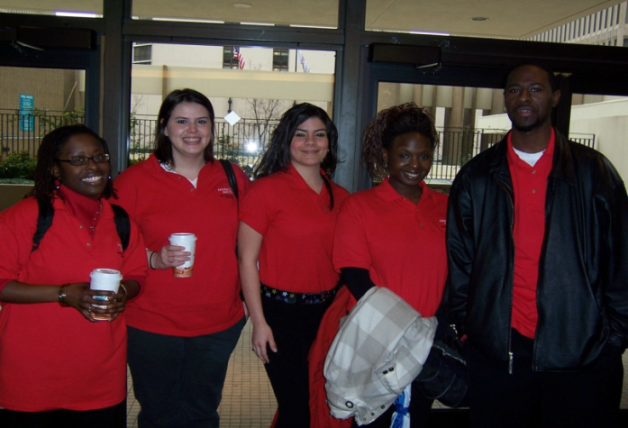
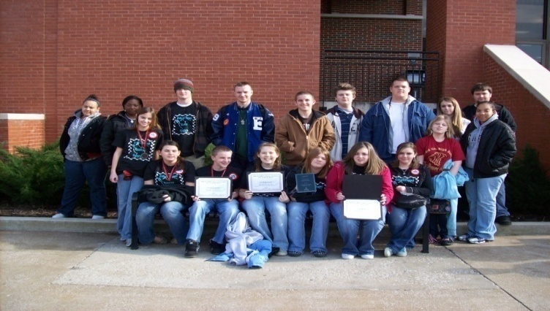
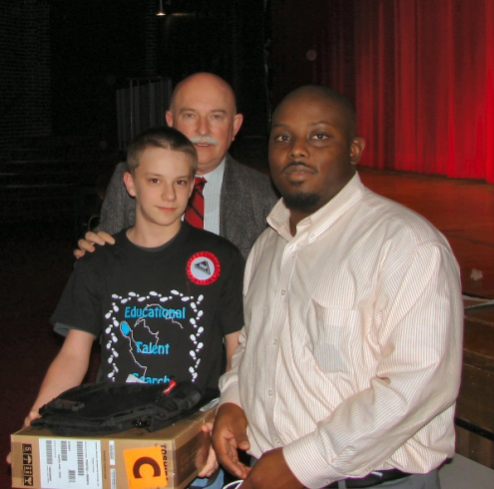
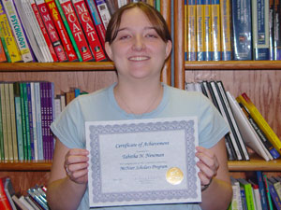
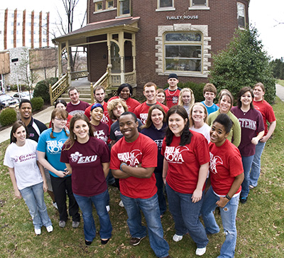
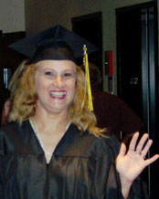
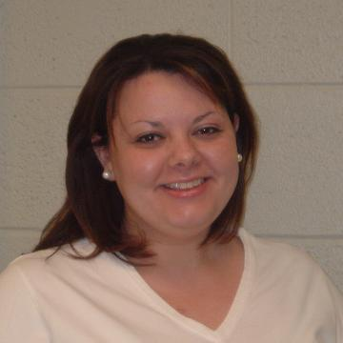
Faces of TRIO:

