Slide 1
The Promise of Rural Collaboratives
Appalachian Higher Education Network Conference
June 27, 2017

Slide 2
Contact Information
Brad Mitchell
Managing Director, Pursuits and Partnerships
Battelle for Kids
bmitchell@bfk.org
© 2016, Battelle for Kids. All Rights Reserved.

Slide 3
Lily Tomlin Collaboration Wisdom
We are all in this together, by ourselves.

Slide 4
Collaboration Inside Scoop
Collaboration
Collaboration
Collaboration
Collaboration
Collaboration
Collaboration

Slide 5
3 “Duh” Big Lessons
Lasting change comes from within
Each participant gets more than they give
Trust is the currency that matters most
© Battelle for Kids. All Rights Reserved.

Slide 6
Collaboration is Place Based
Let your fiction grow out of the land beneath your feet.
-Willa Cather

Slide 7
Cognitive Cocktail
What does the American public think about public education?
What does the American public think about rural education?
What do people living in rural America think about public education and their schools?

Slide 8
Forces that Shape the Narrative
Changing demand for education and workforce skills
Growing challenges to student well being
Shifting equity and excellence accountability to local control
Emerging adaptive teaching and learning technologies
Increasing educator and other resource shortages
Growing push for greater personalization and privatization
Increasing income inequality gaps, decreasing social mobility and growing political gridlock
Diminishing trust in legitimacy of the American Dream and public education
© 2017, Battelle for Kids. All Rights Reserved.

Slide 9
Core Story of Rural Education Collaboration
Avoid Two Traps
-Fatalism (Brain Drain)
-Rugged individualism (Cowboy)
Advance Three Frames
-Good for the country (Fairness)
-Remodeling Job (DIY)
-Networks that work for you (Co-op)

Slide 10
Fairness Frame: Commission on Country Life (1908)
- Economic decline, talent drain and loss of agrarian American values
- 120,000 Surveys/40 Hearings
- 3 Findings
Organization: Support effective rural partnership and cooperation in order to be on same level as organized interests in which they do business, an agrarian economy
Education: Design new country schools which teach children as much outdoors and indoors, an agrarian education
Connection: Build new links to each other, cities and the world, an agrarian network
- “Where the community at large is not prosperous it is impossible to develop a high average personal and community ideal.” T. Roosevelt
- 25,000 appropriation for report dissemination denied in Congress

Slide 11
Remodeling Frame: Rosenwald Schools (1917-1932)
Matching grant, multi-sector approach
4,977 Schools, 217 Teacher Homes, 163 Shop Buildings
883 Counties, 15 States
3 Year Gap Closed to One Year Gap (5th to 8th grade attainment)
Design for daylight, town meetings and skill-based learning

Slide 12
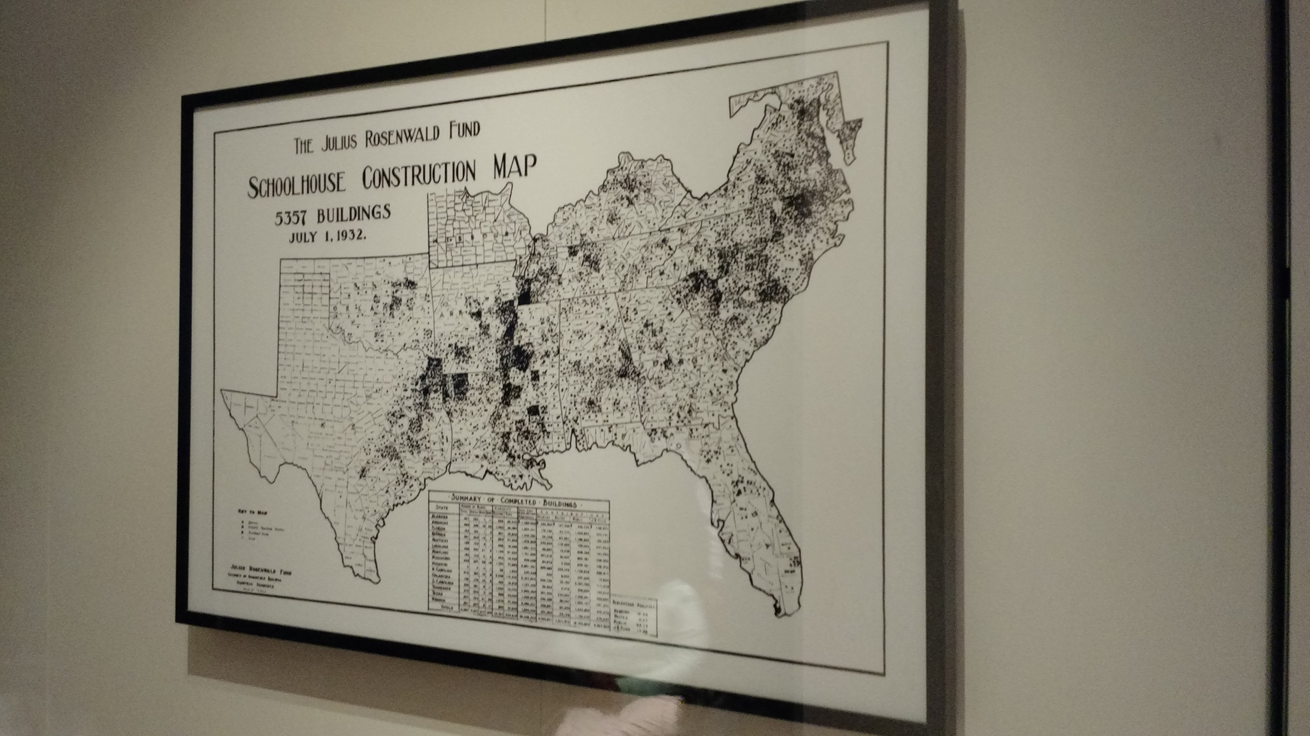

Slide 13
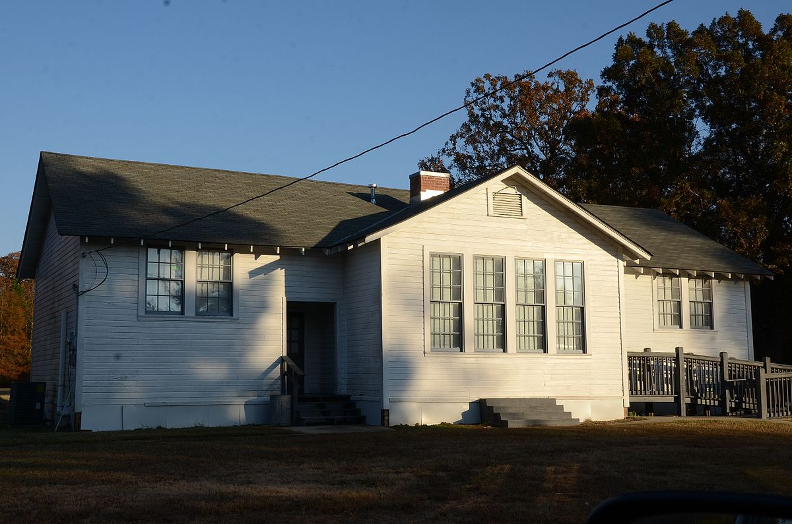

Slide 14
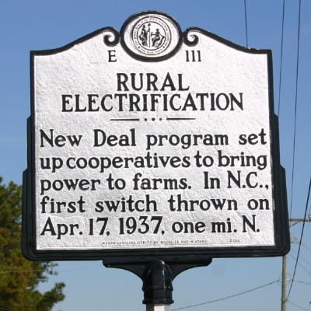
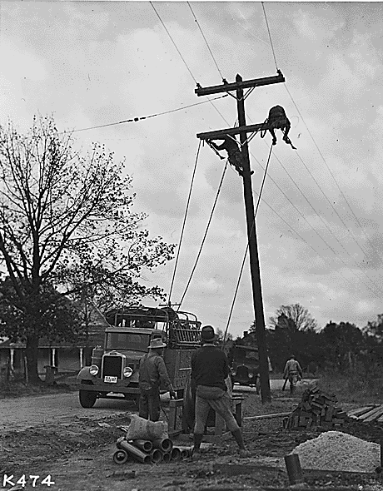
1930’s - Rural Electrification – Networks that Work for Us
Notes:
The 1920’s continues to see manufacturing growing at a major rate in urban areas while iron and wood begins to decline. The Depression brings the New Deal and the TVA and the REA. The Tennessee Valley is the first to benefit from the REA. This lays the tracks for the next macroeconomic shift in rural Tennessee.
Memphis is still the major producer of Cottonseed (Americans are now huge consumers of cooking oils). Soybean oil arrives on the scene during WWII and begin to rival cottonseed oil.

Slide 15
Rural Electrical Co-op Principles (Rochdale)
-Open voluntary membership
-Democratic control
-Honest business practices
-Advance common good
-Cooperation among cooperatives
-Education

Slide 16
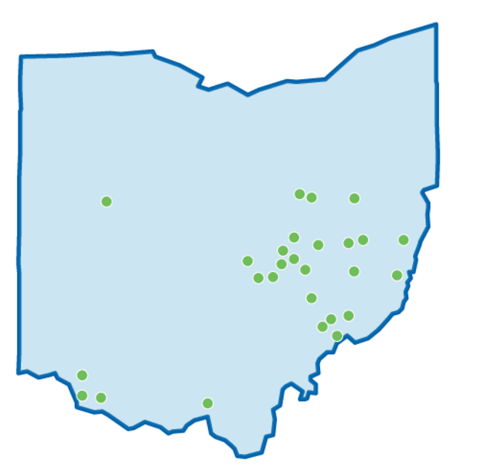
The Ohio Appalachian Collaborative Story
Established in 2010 with 21 rural districts
Expanded in 2013 to serve 27 rural districts impacting:
98 school buildings
3,200 teachers
48,000 students—52% living in poverty
© 2015, Battelle for Kids. All Rights Reserved.

Slide 17
Be better able to secure and leverage resources for high priority innovations
Be better able to grow, support , keep and share educator and student talent
Strengthen student opportunity, educational quality and economic prosperity
Be better able to connect education, work and economic development
Colorado Rural Education Collaborative Strategy (48 Districts)

Slide 18
Publications
© 2016, Battelle for Kids. All Rights Reserved.

Slide 19
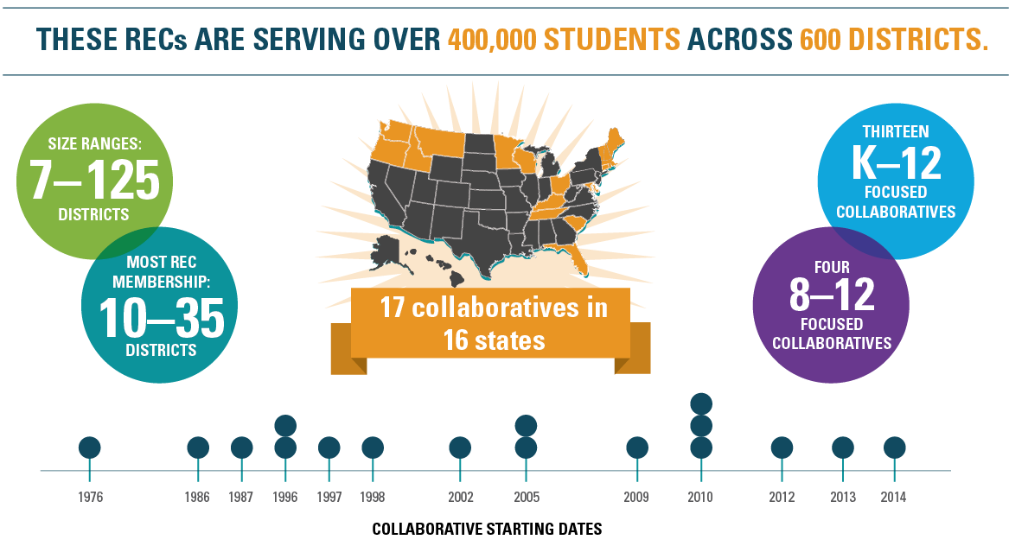

Slide 20
Rural Collaborative Network Members
Colorado Rural Education Collaborative
Eastern Shore of Maryland Educational Consortium
Heartland Educational Consortium
Kentucky Valley Educational Cooperative
New England Secondary Schools Consortium
North East Florida Educational Consortium
Northwest RISE Network
Ohio Appalachian Collaborative
Panhandle Area Educational Consortium
Rural Alliance for College Success
Rural Schools Collaborative
Vermont Rural Partnership
Western Maine Education Collaborative
Wisconsin Rural Schools Alliance
© 2017, Battelle for Kids. All Rights Reserved.

Slide 21
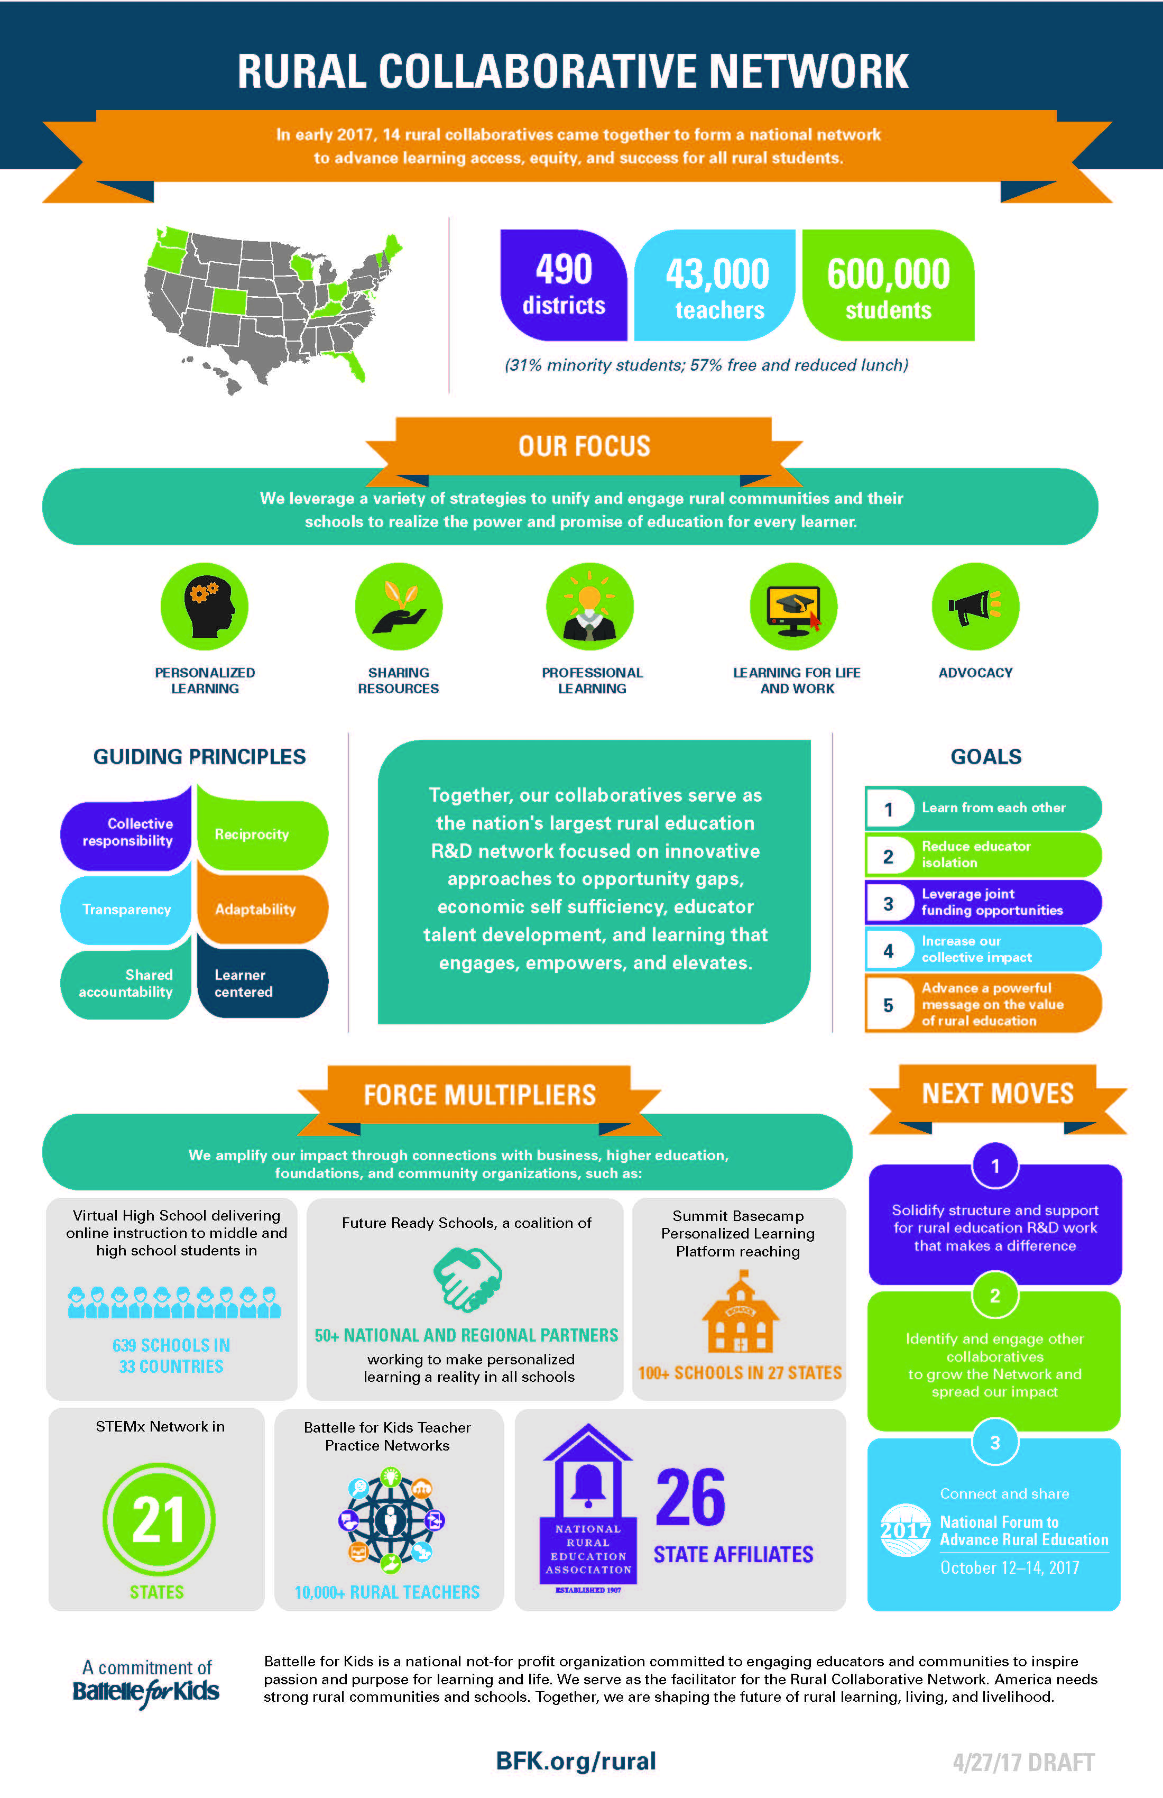
© 2017, Battelle for Kids. All Rights Reserved.

Slide 22
Rural Collaborative Rules:
Make it easier to make connections
Do not duplicate existing efforts and relationships, strengthen them
Keep it simple for partners to participate
Let student, educator and community needs guide action
Make relationships mutually respectful and beneficial
Leverage voice, capacity and resources
Use a third party honest broker

Slide 23
Mutual Adaptation
RAND® Corporation study in 1970’s of federal programs supporting innovative practices in public schools
Examined 293 local projects funded by four federal programs in 18 states
Today, this “change agent” study is still widely recognized and highly valued

Slide 24
Ineffective Strategies | Effective Strategies*
Reliance on outside consultants Packaged management approaches One-shot, pre-implementation training Pay for training Formal, summative evaluation Comprehensive, system-wide projects | Concrete, teacher-specific and extended training Classroom assistance from local staff Teacher observation of similar projects in other classrooms, schools or districts Regular project meetings that focus on practical issues Teacher participation in project decisions Local development of project materials Principals’ participation in training *especially when applied in concert
Berman, P., & Walling McLaughlin, M. U.S. Office of Education, Department of Health, Education, and Welfare. (1978). Federal programs supporting educational change, Vol. VIII: Implementing and sustaining innovations. Retrieved from RAND Corporation website: http://www.rand.org/pubs/reports/2006/R1589.8.pdf

Slide 26
Let us put our minds together and see what life we can make for our children -Sitting Bull
Thank You
© 2016, Battelle for Kids. All Rights Reserved.

Slide 27
© 2016, Battelle for Kids. All Rights Reserved.

Slide 28
The Challenge
In a year-long study of 787 elementary classrooms across 400 U.S. school districts, researchers found:
Most instructional time spent on practice of basic skills with opportunities to develop critical thinking, deep reading, or complex problem-solving take up less than 5 percent of classroom time.
In schools with middle to upper middle class students, about 47 percent were in classrooms with engaged and interesting instruction.
Students in schools serving mostly low-income children, 91 percent were in classrooms marked by basic, uninteresting teaching.
Pianta, P. C., Belsky, J., Houte, R., & Morrison, F. (2007). Opportunities to Learn in America's Elementary Classrooms. Science, 315 (5820), 1795-1796.

Slide 29
Student Voice
In 2015–2016, more than 2,000 teachers surveyed more 7,500 classes
Survey Items: Future Goals | % Strongly Agree
I am excited about reaching my goals in this class. | 52.3%
This teacher builds on my strengths in this class. | 52%
This teacher makes me excited about my future. | 49.3%
This teacher knows about my interests. | 40%
© 2017, Battelle for Kids. All Rights Reserved.

Slide 30
Rural Opportunity Dynamics
Rural Community Development | Rural Education | Rural Economic Development
Health care access and cost | Limited health education | Contentious healthcare policy
Water access and cost | Talent pipeline not well planned or developed | Nonexistent/contentious water policy
Energy access and cost | Talent pipeline not well planned or developed | Nonexistent/contentious energy policy
Corporate versus locally owned farming | Talent pipeline not well planned or developed | Global demand for agricultural commodities
Internet connectivity, adoption and use gaps | Limited access to emergent learning technologies and opportunities | Economies of scale and market access dilemmas
Barriers to and/or lack of new and entrepreneurial local leadership | Talent pipeline not well planned or developed for value chains tied to urban demand | Successful American cities make up 3% of landmass and generate 85% of GDP
Educators make too much money | Market barriers to attract, retain and leverage highly effective educators | Collective educator income and tax revenue often main source of local wealth

Slide 31
Rural Opportunity Dynamics
Rural Community Development | Rural Education | Rural Economic Development
Social inclusion and equity stresses | College/career readiness and rising college costs | Government debt and retrenchment of services
Globalization displaces the power of place. The rural high school is less a stage for community sports pride and more a platform for winning a global jobs war. | Only 17% of rural Americans hold a postsecondary credential with labor market value. We are overlooking the significance of developing middle level skills. | Most available good jobs demand middle level skills
More boomers leaving cities | Public service pension costs | Loss of pension plans
Intergenerational clashes | College loan bubble | Farmland mortgage bubble
Rural-urban poverty gap grows | More rural students | Rural brain drain
Low community aspirations Fear of brain drain Apathy | Empower students to see value and own their learning | Low workethic and high substance abuse often bigger problems then academic preparation

Slide 32
Collaborative Checklist—Organizational Factors
Have a clear strategic design and work plan
Be nimble enough to exercise a “just in time” response to unexpected issues or opportunities
Projects Become Platforms
Home grown, peer to peer, evidence based, scalable and sustainable
Continuously evaluate what is and isn’t working
Assign a person or organization to coordinate the collaborative
Essential to keeping it focused and moving forward
Technology is an essential means of communication
Technology reduces the feeling of isolation among collaborative members and minimizes travel and face-to-face meetings

Slide 33
Collaborative Checklist—Relational Factors
Bring the right partners together around a clear purpose and a common mindset
Desirability: Do people want it?
Feasibility: Can we make it happen?
Viability: Can we sustain it?
Trust, personal relationships, and strong communication are essential
Shared goals and collective responsibility toward achieving those goals are key
Have community managers support activities and make decisions at all levels
Notes:
Relational Factors: 1,2, 7, 8
Organizational Factors: 3,4,5,6
Bottom Line: 9

Slide 34
Make Education Work for Rural Students and Communities
Connected Self Interest = wealth creation, community identity and school viability
Synchronized Assets = one dual enrollment/blended learning network that connects 27 LEAs, 2 ESCs and 9 IHEs involving 48,000 students, 3,800 educators, 100 schools and 45 communities around education for local benefit (essentially a rural school network leveraging the power of limitless learning).
Favorable Economics = secure $3.6m annual college cost savings, use cost savings through shared services to feed STEM education, and double % of young Appalachians with postsecondary credential holding labor market value.

Slide 35
Persistent
Prosperity
Integrated investment strategy
Collaborative leadership is the norm
Flipped
Prosperity
Integrated strategy around demand driven value chains
Networked co-ops
Boom
Prosperity
Shared strategy to minimize crowding out effects
New intermediaries

Slide 36
What Can We Learn From Prosperous Rural Places?
A strong commitment and capacity for community leadership to build local wealth through systemic changes driven by collaborative partnerships among government, private business, education, healthcare, social institutions and individuals.
(Mallory Rahe and Andrew Isserman, University of Illinois, 2008)

Slide 37
Resources for Rural Communities
U.S. Department of Education
Rural Education Achievement Program (REAP)
U.S. Department of Agriculture
Community Facilities and Rural Housing
Distance Learning and Telemedicine grant and Community Connect
U.S. Department of Health and Human Services
Native Language Preservation
U.S. Department of Transportation
Rural Transportation Assistance Program (state formula grant, no local match)
Council on Foundations
Community Foundations Locator

Slide 38
National Association of State Boards of Education
Report Recommendations:
Leverage capacity and professional training to translate technological access into high-quality learning.
Help rural communities form partnerships with local organizations as part of broader economic and community development strategies and publicly recognize communities whose students are benefiting from such partnerships.
Allow for increased flexibility by providing more funding, greater flexibility, and incentives for districts to build stronger connections between each other and with service providers to build capacity and save money.
Proactively develop a comprehensive strategy to recruit, train, and retain the teachers, principals, and educational support staff needed to ensure all its students are provided an excellent education.

