Slide 1
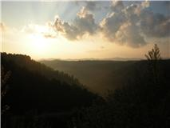
Country Roads Take Me…?: College Pathways Among Rural Students and the Role of Family
Appalachian Higher Education Network 2016
Sarah Elizabeth Beasley, Ph.D.

Slide 2
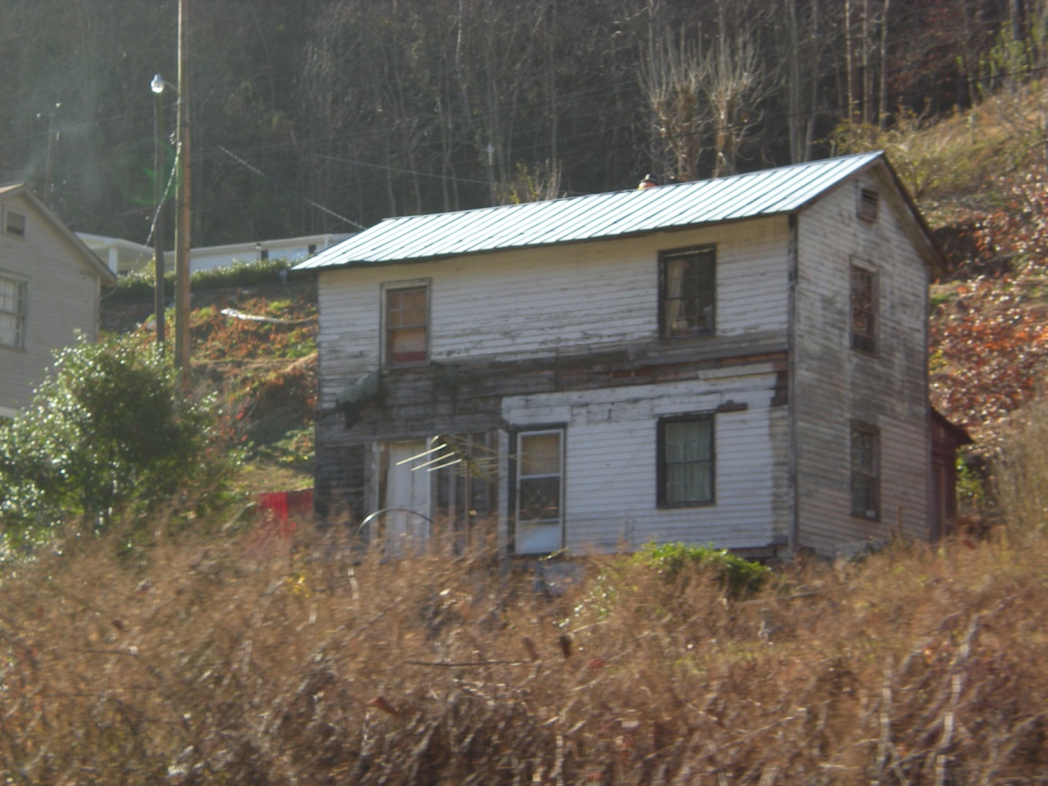
Why Rural?
Urban bias
25% of public school children in rural school districts (12 million+)
Only 17% of rural adults have a college degree
Rural students (18-24 yr olds) less likely to attend college than their suburban and urban counterparts (31% vs. 42% vs. 46%)
Rural community decline
Rural poverty
Coal company house, Isaban, WV

Slide 3
Rural youth more likely to…
Live in counties with no college
Have little access to college information
Have lower educational aspirations
Have parents who did not attend college
Have parents that are less likely to encourage higher education (rural student perception)
Have fewer highly educated role models
Notes:
Summary of some of the existing rural literature

Slide 4
Rural youth more likely to…
Fewer educational resources in the home
View higher education as a private good
Hold individualistic goals over community-oriented ones if they attend college
Be less attached to living in their home community if they are college-bound (likely depends on 2-yr vs. 4-yr)
Notes:
Summary of some of the existing rural literature

Slide 5
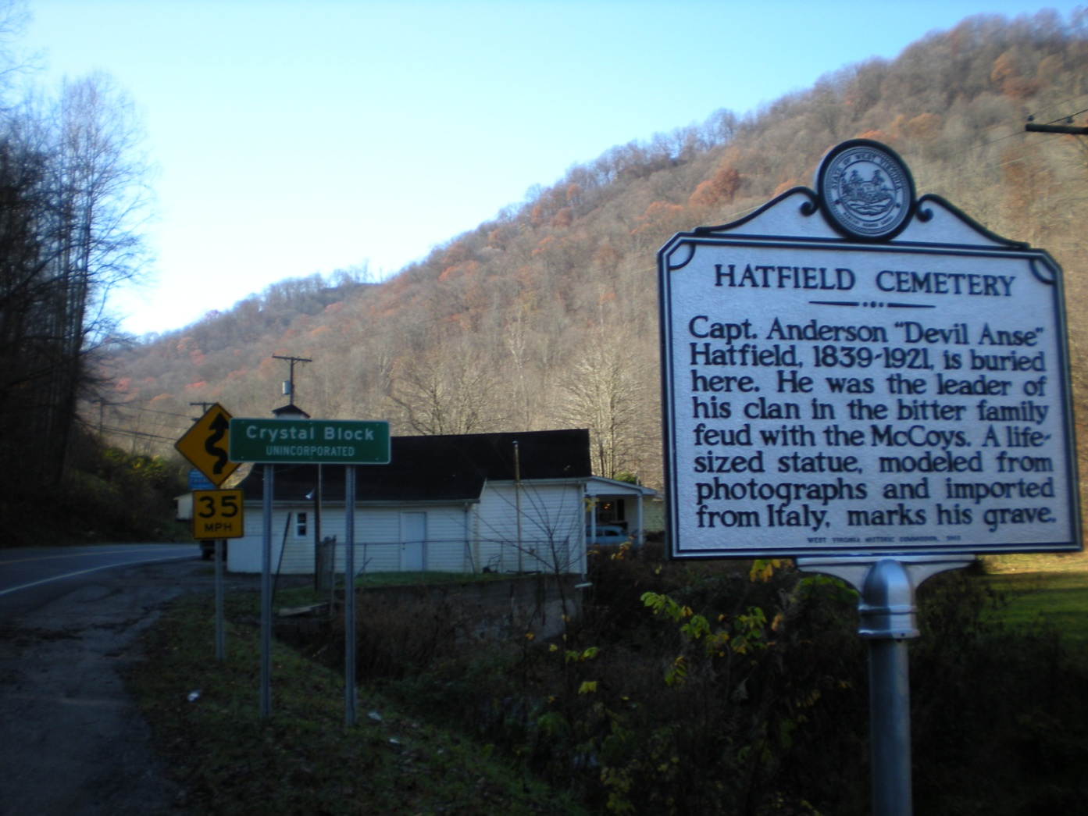
Purpose of the Study
Examine the college pathways (college access and success) of rural, first-generation, low-SES students.

Slide 6
Social Ecological Overview of Mingo County
Rural, high poverty
College-going rates higher than predicted
Community college, no 4-year college
PA
MD
OH
KY
VA

Slide 7
“A family has a life of its own which is more than the roles of its members. It begins and ends almost imperceptibly, so it’s rather arbitrary where one draws the line circumscribing a family’s existence” (Spradlin, 1978, p. 22)

Slide 8
Findings: Family
Attachment to Family
Four-year/two-year
Pressure to stay
Mingo County native, Bob Maguire (on left), visiting family cemetery in Newtown, WV.

Slide 9
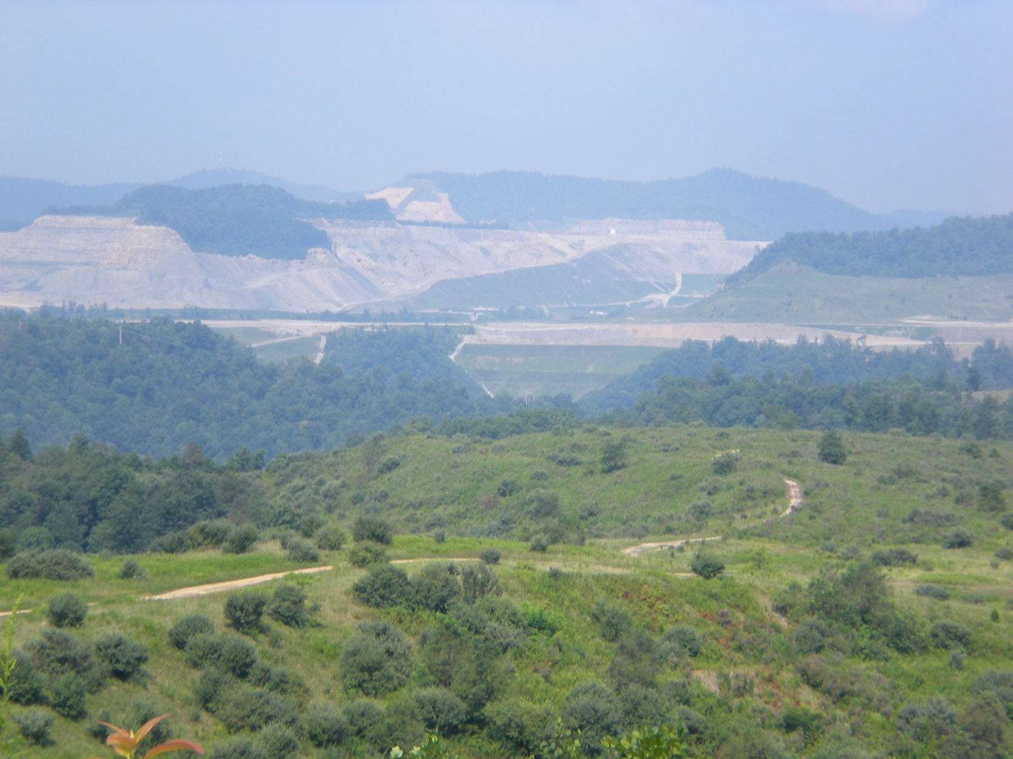
Findings: Family cont.
Family Legacies
Gender norms
Increased pressure to carry on legacies
Mountain top removal site near Gilbert, WV.

Slide 10
Findings: Family cont.
Parental Encouragement and Support
Financial
Encouragement
Help with Applications
Education as a Priority
Cultural Capital

Slide 11
Findings: Family cont.
Do Better Than Parents
Success for Others

Slide 12
Findings: Leaving & Returning/Staying
I think most of ‘em sticking around here, like the guys, you’ll see them going off [inaudible] and going in the coal mines and going in the ground [inaudible] or doing something like timber and stuff. That’s pretty much all that’s open around here. And then the girls that normally don’t go to college from up around here pretty much after a few years you see ‘em married off, and have families, which is not a bad thing, you know? But that’s normally how [the] pattern. It’s kinda like if you don’t take your chance and get out when you can, you never find the opportunity again. It’s like once you get sucked in, you’re here for good (student interview).
Notes:
Lack of economic opportunity; majoring in fields that will allow them to stay in area.; gender norms;
“it doesn’t’ matter where you go as long as you go somewhere.”>>>Learning to leave; another man said you are given a map with your h.s. diploma;
Conflicted over decision

Slide 13
Don’t Ignore the “Stayers”
They [the teachers and school employees]…try to, they push it [college] for everybody, but when they push it and if you show interest or not, that determines how much they push from there because they give everybody the first effort. [B]ut if you show no interest, “Aaa, I’ll never leave Gilbert,‟ they just sort of, you know, they put you in a group, and they give you that same attitude. You can’t pound something in somebody’s head if that’s what their family puts in their mind, if that’s what they see, you’re not going to change it.

Slide 14
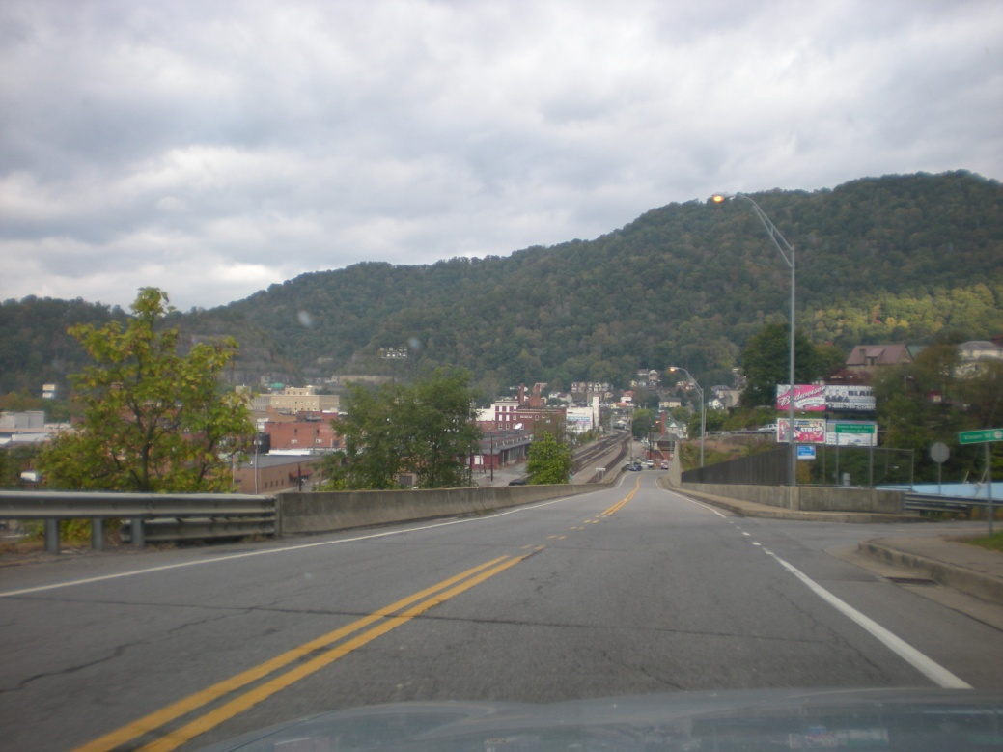
Conclusion
Policy and Practical Implications
Williamson, WV, county seat of Mingo County.

Slide 15
Discussion Questions
What dilemmas and barriers do rural students face in attaining a college degree? Discuss why.
Do you think rural students face an either/or choice between family/community vs. higher education? Please explain.
What are you currently doing to promote college-going among rural students at your school or institution or to support rural students in college?
Other ideas for promoting rural college access and success? Or ideas for overcoming some of the barriers discussed earlier (lower aspirations/expectations, low confidence levels in abilities, etc.)

Slide 16
Contact:
Sarah Beasley
Director of Retention
Concord University
sbeasley@concord.edu
304-384-6298

