Slide 2
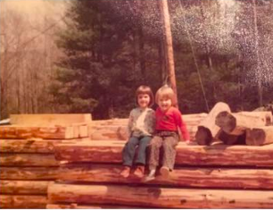

Slide 3
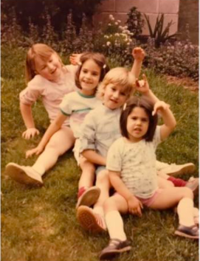

Slide 4
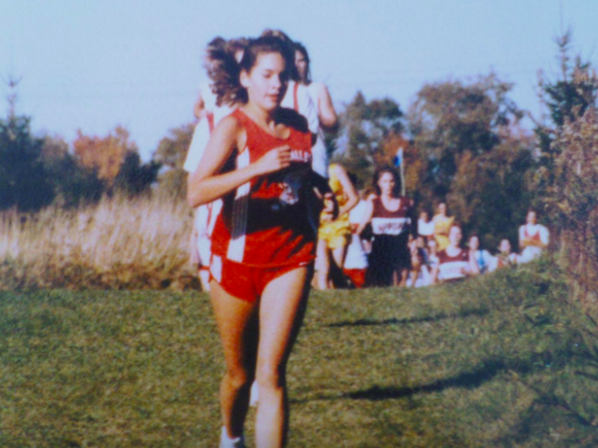

Slide 6
Agenda
What is K-12 Computer Science?
Goal: You will understand what is Computer Science at the K-12 Level
Introduction to the CSforAll Consortium
Goal: You will understand the #CSforAll movement and the Consortium’s role
Why CS?
Goal: You will understand why CS education is important for AHE
Sneak Peek: Planning Tool Beta
Goal: You will get a sneak peek at the new planning tool to help schools and districts set CSforAll goals!
Call To Action
Notes:
Introduction to CSforAll
History of CSforAll Grassroot Movement
CSforAll Consortium: National Needs Assessment & Resources
Examples and Cases
CS4RI: State & School/District Implementation
Self Assessment and Goal Setting
Stand up/Sit Down
Brainstorm
CSforAll Planning Activity For Your Setting
Q&A
Call To Action

Slide 7
K-12 Computer Science
Computer Science is the study of computers and ALL the phenomena that arise around them. - Herbert Simon

Slide 8
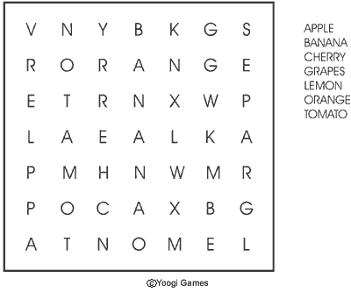
Activity: Algorithmic Thinking

Slide 9
K-12 Computer Science
Concepts:
Computing Systems
Networks and the Internet
Data and Analysis
Algorithms and Programming
Impacts of Computing
Practices:
Fostering an Inclusive Computing Culture
Collaborating around Computing
Recognizing and Defining Computational Problems
Developing and Using Abstractions
Creating Computational Artifacts
Testing and Refining CA
Communicating About Computing

Slide 10
Our Activity
Algorithms:
Grade 2: People follow and create processes as part of daily life. Many of these processes can be expressed as algorithms that computers can follow.
Grade 5: Different algorithms can achieve the same result. Some algorithms are more appropriate for a specific context than others.
Grade 8: Algorithms affect how people interact with computers and the way computers respond. People design algorithms that are generalizable to many situations. Algorithms that are readable are easier to follow, test, and debug.
Grade 12: People evaluate and select algorithms based on performance, reusability, and ease of implementation. Knowledge of common algorithms improves how people develop software, secure data, and store information.

Slide 11
Our Activity
Practices:
Collaboration
Developing Abstractions
Testing and Refining
Communicating

Slide 12
Agenda
What is K-12 Computer Science?
Goal: You will understand what is Computer Science at the K-12 Level
Introduction to the CSforAll Consortium
Goal: You will understand the #CSforAll movement and the Consortium’s role
Why CS?
Goal: You will understand why CS education is important for AHE
Sneak Peek: Planning Tool Beta
Goal: You will get a sneak peek at the new planning tool to help schools and districts set CSforAll goals!
Call To Action
Notes:
Introduction to CSforAll
History of CSforAll Grassroot Movement
CSforAll Consortium: National Needs Assessment & Resources
Examples and Cases
CS4RI: State & School/District Implementation
Self Assessment and Goal Setting
Stand up/Sit Down
Brainstorm
CSforAll Planning Activity For Your Setting
Q&A
Call To Action

Slide 13
History of CSforAll Grassroot Movement
1985 First Advanced Placement CS Exam
’03-06 Sharp decline in post-secondary CS degrees
’04+ Broadening Participation in Computing fund at NSF
’05+ BPC alliances: NCWIT, ACCESS, ECEP, STARS, CAHSI
’06+ Stuck in the Shallow End + ECS, Bootstrap, GUTS, etc.
’08 The College Board began development of the new AP CS Principles course
’09 CSEdWeek established by Congress, Computing in the Core forms
’10 Running on Empty report on lack of K-12 CS
’11-12 CSEdWeek growth, congressional roundtables, advocacy efforts by Microsoft, Oracle, Google,
ACM, NCWIT, CSTA, CRA
’13 Code.org forms, Hour of Code launched, CSNYC formed
’14 Chicago PS announces CS4All students, CodeVA launches
’15 NYC announces CS4All NYC
’16 States and Federal Government support CSforAll with Policy
CSforAll Consortium launches

Slide 14
The CSforAll Consortium is a hub for the national Computer Science for All movement that works to enable all students in grades K-12 to achieve CS literacy as an integral part of their education experience.
Notes:
The site connects members of the national CS education community, provides an avenue for disseminating their work, and tracks our collective progress toward the goal of providing every student with the opportunity to learn CS.

Slide 15
Steering committee
CSforAll Consortium Chair

Slide 16
Strategy
The Consortium sets a collective agenda together with our membership of over 350 content providers, education associations, researchers, and supporters to:
Help schools and districts provide all students with rigorous K-12 computer science education
Serve as a platform for connecting diverse stakeholders
Provide support to new and developing initiatives
Track and share progress
Communicate about the work to local and national audiences

Slide 17
Consortium Members
383 Approved Members | 187 Content Providers
90 LEAs (States/Districts) or Aggregate Ed Groups (ECEP) | 106 Funders/Supporters & Researchers of CS Education

Slide 18
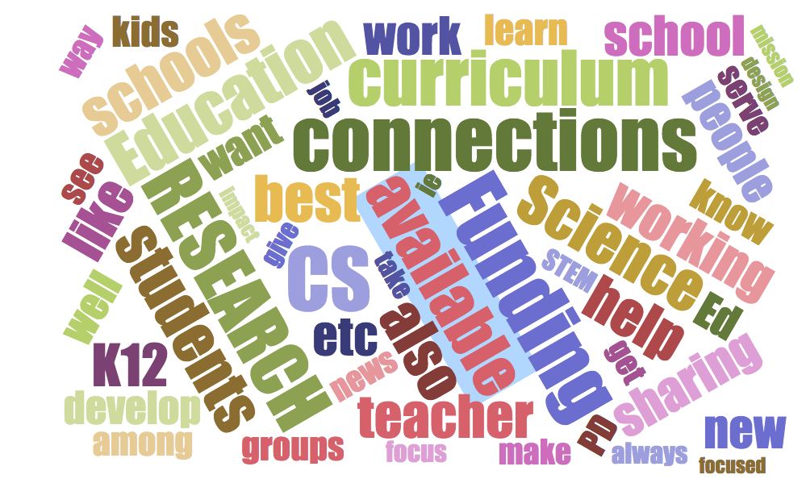
Needs Assessment: Overview
Goal: To understand each member’s activities and how we can align members’ goals and efforts to make more efficient and effective impact without recreating the wheel
Data Collected From:
Text Analysis of Membership Form
+350 responses
Focus groups & Interviews
150+ participants

Slide 19
Needs Assessment Data: Top Themes
Common Theme | CP | LEAs | R | F | Total
Connections to Other Orgs | 67 | 20 | 16 | 13 | 116
Funding Opportunities/Resources | 59 | 20 | 17 | 6 | 102
Curriculum (Identifying, resources) | 25 | 25 | 5 | 5 | 60
Connections to Schools/Teachers | 28 | 1 | 8 | 1 | 38
Information about Best Practices | 16 | 10 | 4 | 5 | 35
Info about Initiatives, Alignment | 11 | 9 | 9 | 3 | 32
Researcher Collaborations | 9 | 0 | 18 | 3 | 30
Defining K12 Scope/Sequence | 12 | 10 | 4 | 2 | 28
Communication (newsletter, calendar) | 14 | 4 | 5 | 2 | 25
Recent Research Findings | 9 | 2 | 10 | 4 | 25
Networking Opportunities | 11 | 4 | 4 | 3 | 22
Industry Partners | 10 | 7 | 4 | 0 | 21
Information about PD Opportunities | 6 | 10 | 0 | 3 | 19
What Others Need, Mapping | 5 | 1 | 2 | 7 | 15
Notes:
Shared vision doesn’t mean we have a vision and then get you all to “share” it.

Slide 20
What you said: Community
“Dating website”
for stakeholders to connect
Find both local and national partners who can help, who we can learn from.
Notes:
Convening for researchers AND practitioners
In-person convenings preferred
Get out of the silo and see the bigger picture
Connection to larger community

Slide 21
What you said: Community
Convenings for researchers
AND
practitioners
Notes:
Convening for researchers AND practitioners
In-person convenings preferred
Get out of the silo and see the bigger picture
Connection to larger community

Slide 22
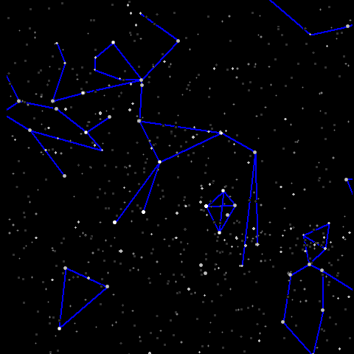
What you said: Community
Get out of the silo and connect to big picture
Notes:
Convening for researchers AND practitioners
In-person convenings preferred
Get out of the silo and see the bigger picture
Connection to larger community

Slide 23
What you said: Resources
Resources exist, but practitioners are unable to find them
Notes:
Research that supports advocacy and evaluation/assessment
Amplify and disseminate work
Indexed by state or school district
Disconnect from what practitioners need vs. what researchers are incentivized to do
Cases studies and real life examples of how all players (teachers to state level) implemented CS education
Data reporting and tracking progress

Slide 24
What you said: Resources
What researchers are incentivized to do is disconnected from what practitioners need.
Notes:
Research that supports advocacy and evaluation/assessment
Amplify and disseminate work
Indexed by state or school district
Disconnect from what practitioners need vs. what researchers are incentivized to do
Cases studies and real life examples of how all players (teachers to state level) implemented CS education
Data reporting and tracking progress

Slide 25
What you said: Resources
Request for cases studies and real life examples of how CS Education was implemented from state level to teachers
Notes:
Research that supports advocacy and evaluation/assessment
Amplify and disseminate work
Indexed by state or school district
Disconnect from what practitioners need vs. what researchers are incentivized to do
Cases studies and real life examples of how all players (teachers to state level) implemented CS education
Data reporting and tracking progress

Slide 26
What you said: Resources
Need for data reporting and tracking progress
Notes:
Research that supports advocacy and evaluation/assessment
Amplify and disseminate work
Indexed by state or school district
Disconnect from what practitioners need vs. what researchers are incentivized to do
Cases studies and real life examples of how all players (teachers to state level) implemented CS education
Data reporting and tracking progress

Slide 27
What you said: Implementation Assistance
Already lots of curriculum
Need consolidation, organization, and evaluation of existing material
Progressions and pathways
Examples of CS integrated with other subjects
Notes:
Curriculum
No need for more curriculum, but need consolidation and organization
“too much out there”, “it’s overwhelming”,“hard to find what I need so will create it myself”
Progressions and pathways
“I’ve finished this curriculum - what next?”
Integrated CS
Schools are unlikely to have CS only teachers, especially at elementary level
Assessment
Program quality matched to student type
“how do I know what curriculum/program is best for my students?”
Feedback on their own programs
lack of time & resources for evaluation
fear of negative feedback: don’t want to hurt the initiative by criticising others.

Slide 28
What you said: Implementation Assistance
Assessment
Program quality disaggregated by student factors
Feedback on your own work - how to do real-time evaluation
Safe places to report what doesn’t work in order to improve/grow
Notes:
Curriculum
No need for more curriculum, but need consolidation and organization
“too much out there”, “it’s overwhelming”,“hard to find what I need so will create it myself”
Progressions and pathways
“I’ve finished this curriculum - what next?”
Integrated CS
Schools are unlikely to have CS only teachers, especially at elementary level
Assessment
Program quality matched to student type
“how do I know what curriculum/program is best for my students?”
Feedback on their own programs
lack of time & resources for evaluation
fear of negative feedback: don’t want to hurt the initiative by criticising others.

Slide 29
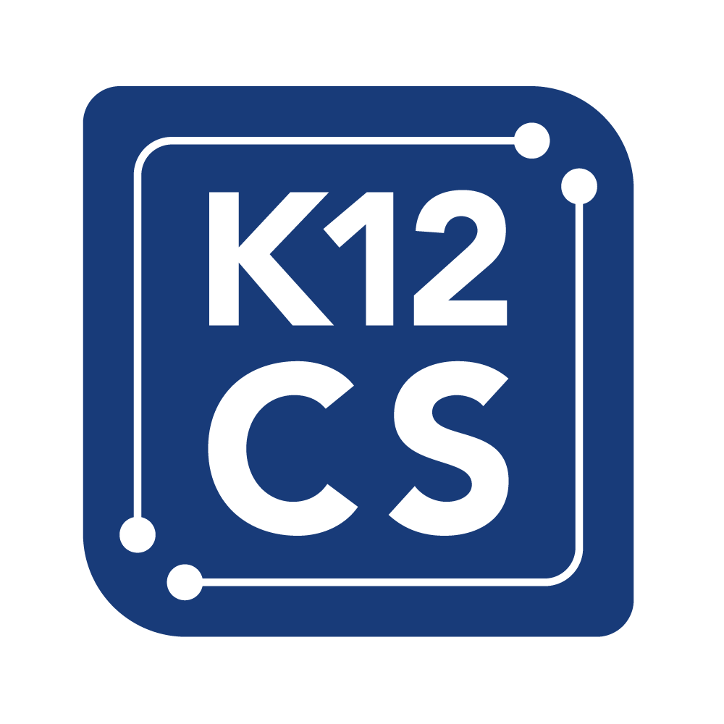
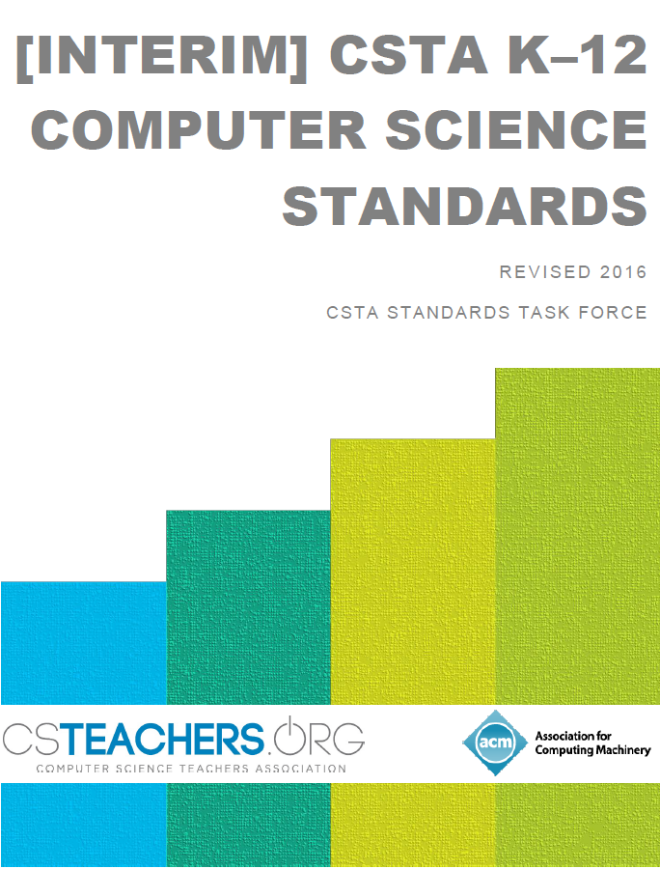
What you said: Implementation Assistance
Standards: Alignment in curriculum and assessment to national standards/framework
Notes:
K12 CS Framework/CSTA standards

Slide 30
What you said: Implementation Assistance
Teacher Support
Better ways to identify relevant resources
Identify peers to collaborate
Resources for CS teachers vs. teachers who teach CS
Notes:
K12 CS Framework/CSTA standards

Slide 31
What you said: Implementation Assistance
Need to be focused on sustainability
Engage/Connect to Schools of Education for teacher prep and research to support CS Education implementation
Notes:
K12 CS Framework/CSTA standards

Slide 32
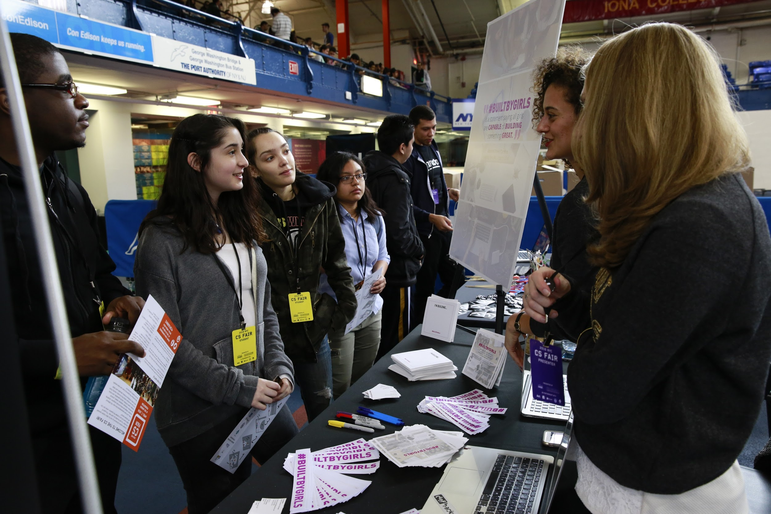
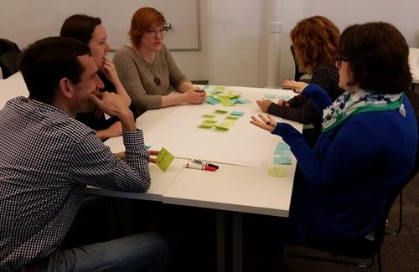
Priority Areas:
Strategic Connections
District Consultation and Support
Knowledge and Resource Dissemination
Notes:
Strategic Connections: Grow and connect the national CS education community
District Consultation and Support: Support local CSforAll initiatives to be sustainable, rigorous, and inclusive
Knowledge and Resource Dissemination: Collect and share high-quality resources and successful models

Slide 33
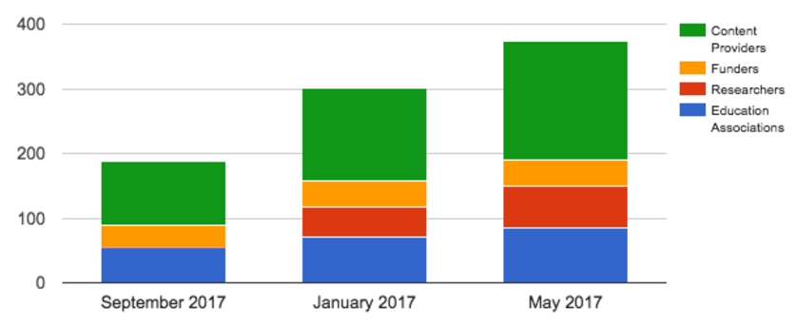
Impact - Strategic Connections
Our monthly community calls serve 100+ participants at a time
Our Slack channel averages 1,000 messages per week
The consortium has grown to 380+ members

Slide 34
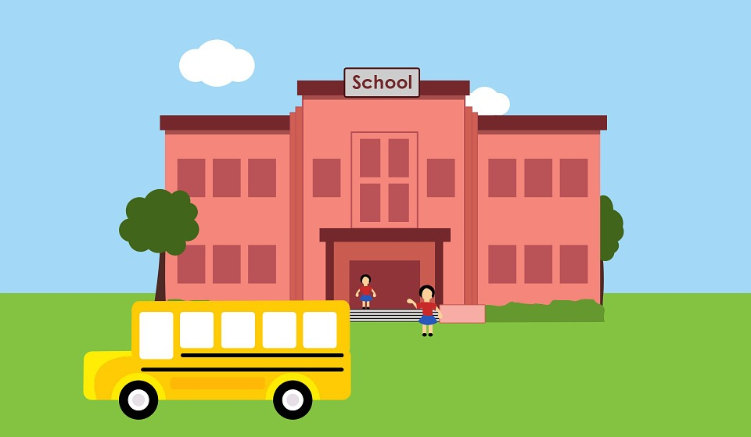
Impact - District Support
Our district members represent 30 states, 4,775 schools and 3 million students
More than 3,000 schools are represented in the signers of the CSforAll Pledge
www.csforall.org/
resources/pledge
We will pilot a new District Implementation Planning Tool in summer 2017

Slide 35
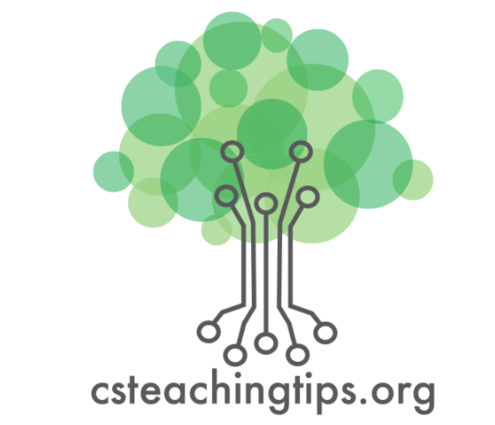
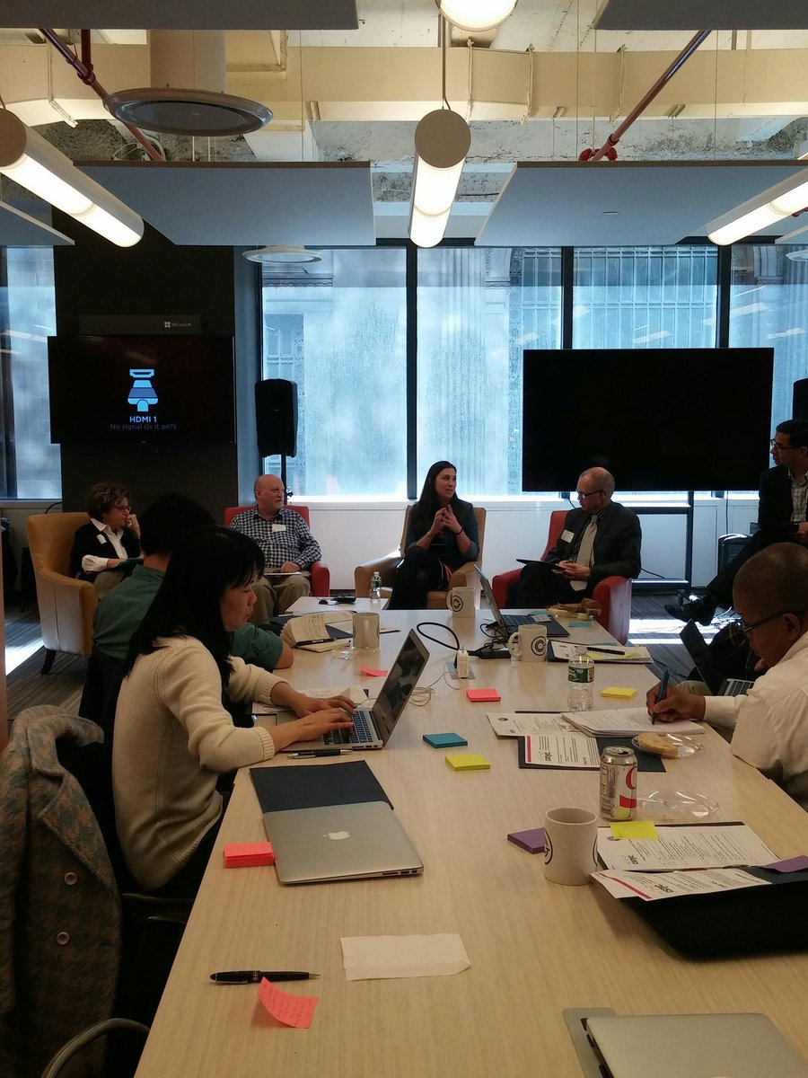
Impact - Resources
With NSF funding, we support meetings for schools of education and CS education researchers
In partnership with CS Teaching Tips, we are producing research-based practice documents for classrooms
The CSforAll.org website receives thousands of visits each month

Slide 36
What can YOU do? Join the Consortium
 | CALL TO ACTION | CONSORTIUM CAN HELP
Education Association | Request an office hour Encourage other school districts to join | Real time guidance Connections to other schools
Content Provider | Incorporate feedback mechanism | Host feedback focus groups Mapping to K12 CS Framework
Researcher | Research digestible for practitioners | Disseminate research to practitioners
Funder | Fund research/evaluation & teacher capacity initiatives Support opportunities for in person convenings | Provide in depth overview of national CS Edu landscape Identify and support collaborations focused on scale

Slide 37
Agenda
What is K-12 Computer Science?
Goal: You will understand what is Computer Science at the K-12 Level
Introduction to the CSforAll Consortium
Goal: You will understand the #CSforAll movement and the Consortium’s role
Why CS?
Goal: You will understand why CS education is important for AHE
Sneak Peek: Planning Tool Beta
Goal: You will get a sneak peek at the new planning tool to help schools and districts set CSforAll goals!
Call To Action
Notes:
Introduction to CSforAll
History of CSforAll Grassroot Movement
CSforAll Consortium: National Needs Assessment & Resources
Examples and Cases
CS4RI: State & School/District Implementation
Self Assessment and Goal Setting
Stand up/Sit Down
Brainstorm
CSforAll Planning Activity For Your Setting
Q&A
Call To Action

Slide 38
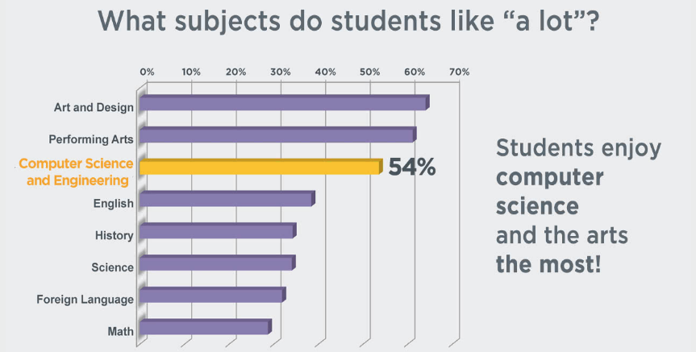
Computer Science Fosters Engagement
http://changetheequation.org/students-stem-methodology

Slide 39
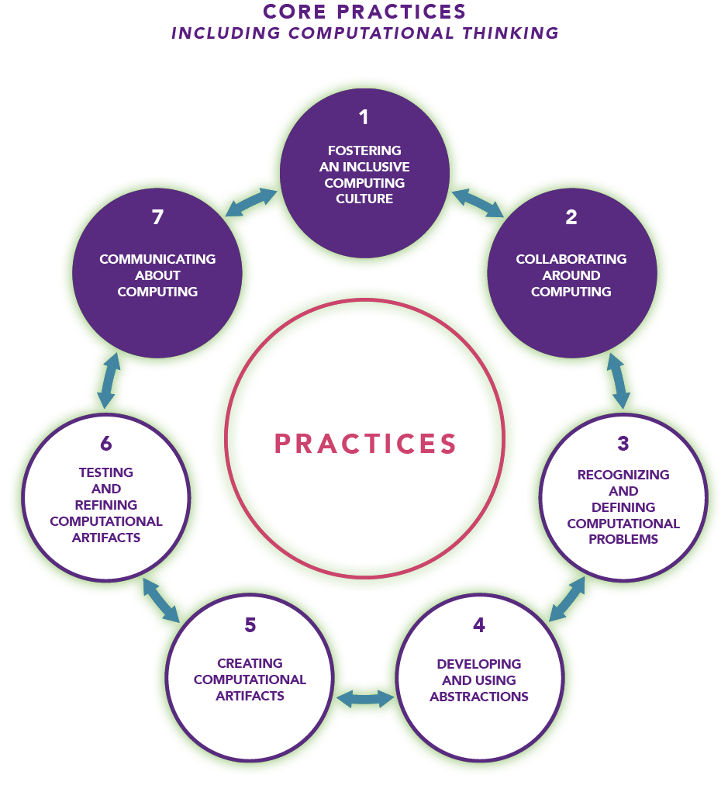
Computer Science Aligns with CTE
Computer Science teaches:
Collaborative Problem Solving
Simulated Workplaces (client designs)
Multi-disciplinary problem solving

Slide 40
CS Brings Capital Back to Communities

Slide 41
CS Brings Capital Back to Communities

Slide 42
Agenda
What is K-12 Computer Science?
Goal: You will understand what is Computer Science at the K-12 Level
Introduction to the CSforAll Consortium
Goal: You will understand the #CSforAll movement and the Consortium’s role
Why CS?
Goal: You will understand why CS education is important for AHE
Sneak Peek: Planning Tool Beta
Goal: You will get a sneak peek at the new planning tool to help schools and districts set CSforAll goals!
Call To Action
Notes:
Introduction to CSforAll
History of CSforAll Grassroot Movement
CSforAll Consortium: National Needs Assessment & Resources
Examples and Cases
CS4RI: State & School/District Implementation
Self Assessment and Goal Setting
Stand up/Sit Down
Brainstorm
CSforAll Planning Activity For Your Setting
Q&A
Call To Action

Slide 43
Sneak Peek: Planning Tool Beta
Notes:
Similar to other planning tools common to schools, help you think through the multi-level, multi-stakeholder engagements. Offer in-time case studies to give you examples of what is working.
Leigh Ann to describe the planning tool “big idea” and where we are in the process… “giving you a sneak peek and chance to weigh in”

Slide 44
Sneak Peek: Planning Tool Beta
Turn and Talk:
Where is your school/district on the marathon of CSforAll?
What is your biggest challenge to moving forward?

Slide 45
Sneak Peek: Planning Tool Beta
Districts need tools that are:
Modular
Customizable
Useful for Setting Individual Goals

Slide 46
Sneak Peek: Planning Tool Beta
Planning Areas:
Leadership
Infrastructure
Teacher Capacity
Partners
Community
Materials and Curricular Development

Slide 47
Sneak Peek: Planning Tool Beta
Planning Areas:
Leadership
Infrastructure
Teacher Capacity
Partners
Community
Materials and Curricular Development

Slide 48
Planning: Partners
“I can just write the whole curriculum from scratch…”
-said no new teacher ever

Slide 49
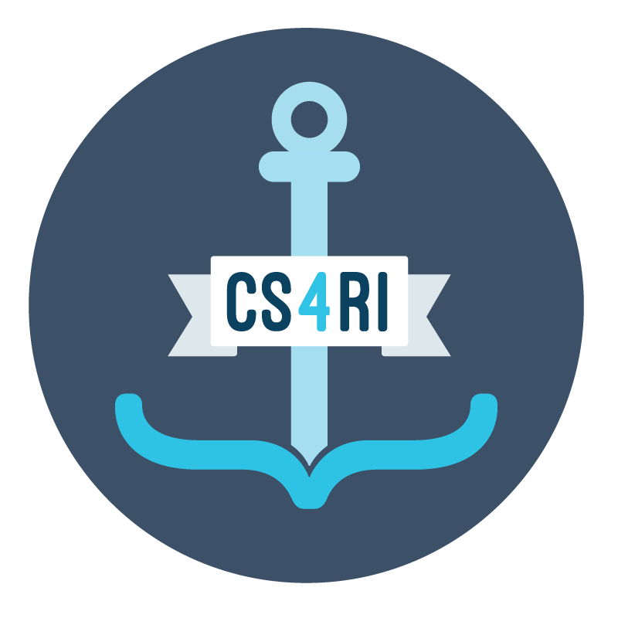
Planning: Partners
Case Study 1 : CS4RI (Rhode Island)
University of Rhode Island:
Teacher Training and Support
New minor in CS education: bit.ly/2te8QRD
Brown University:
Consultants
Notes:
for education majors and a minor in education for CS majors in partnership with the School of Education and Computer Science department.
Practicum: Students support CS4RI teachers in the classroom
Consultants: University of Rhode Island & Brown University
Leverage faculty expertise and existing capacity under NSF STEM + C grants

Slide 50
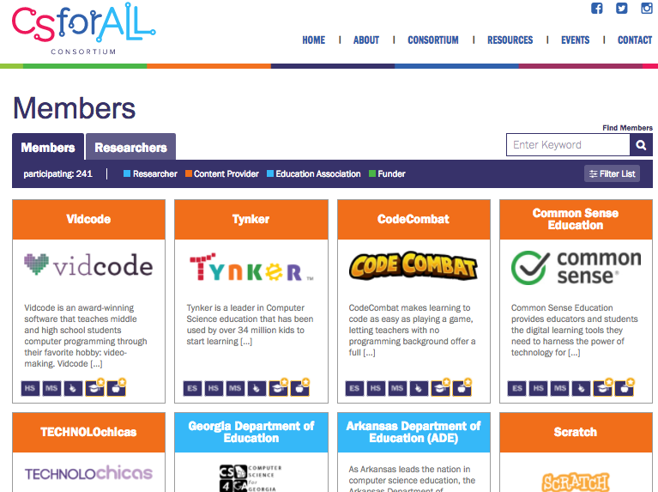
Planning: Partners

Slide 51
Planning: Community
A collaborative community is essential.
Families, local businesses, and educational leaders MUST be engaged.

Slide 52
Planning: Community
Case Study 2: CodeVA (Virginia)
Local trucking company for internship
Engaging community leaders to get high band internet
CodeVA Eureka Workshops

Slide 53
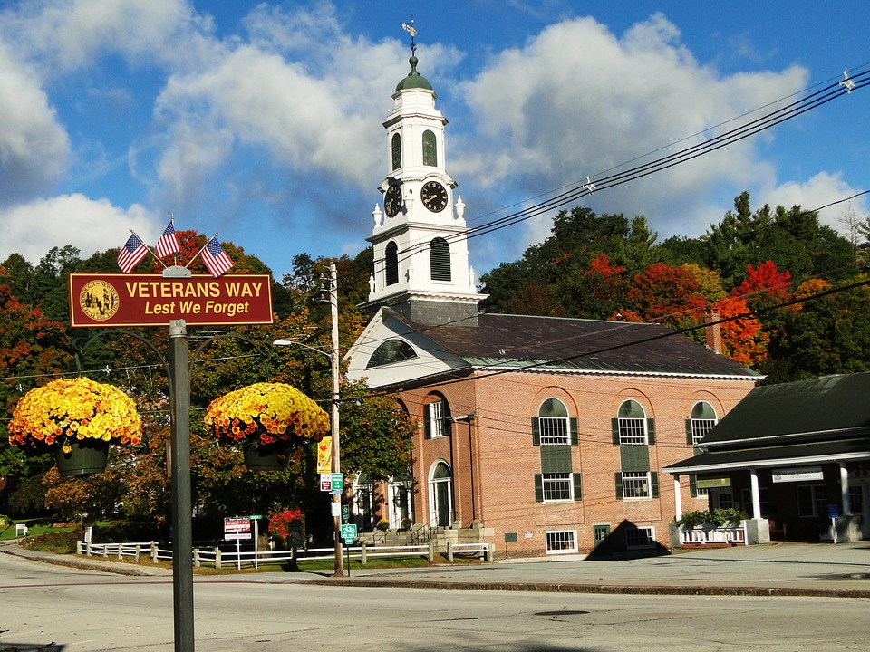
Planning: Community & Workforce
What are the major/minor employers in town?
2. What are the community organizations who operate in your area?

Slide 54
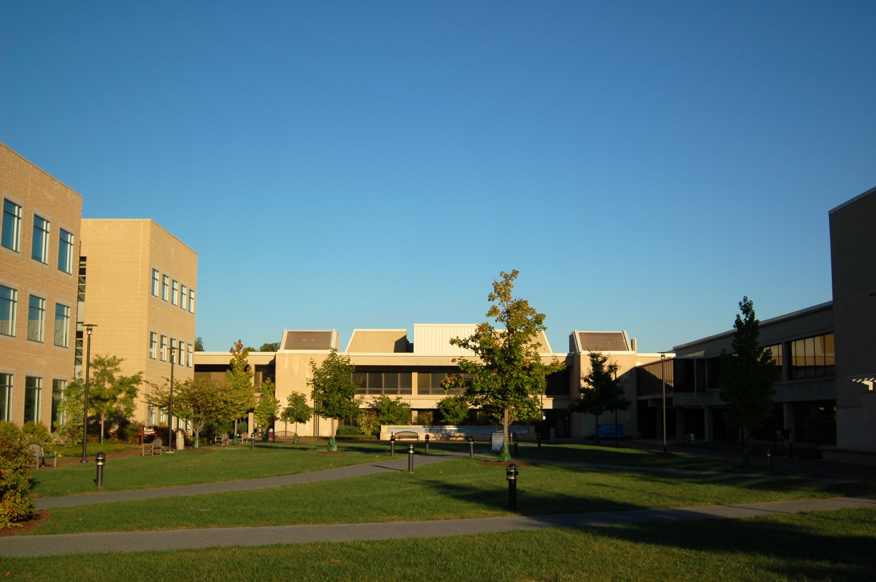
Planning: Community and Workforce
3. What are your workforce development goals?
4. What post secondary partners are near you?

Slide 55
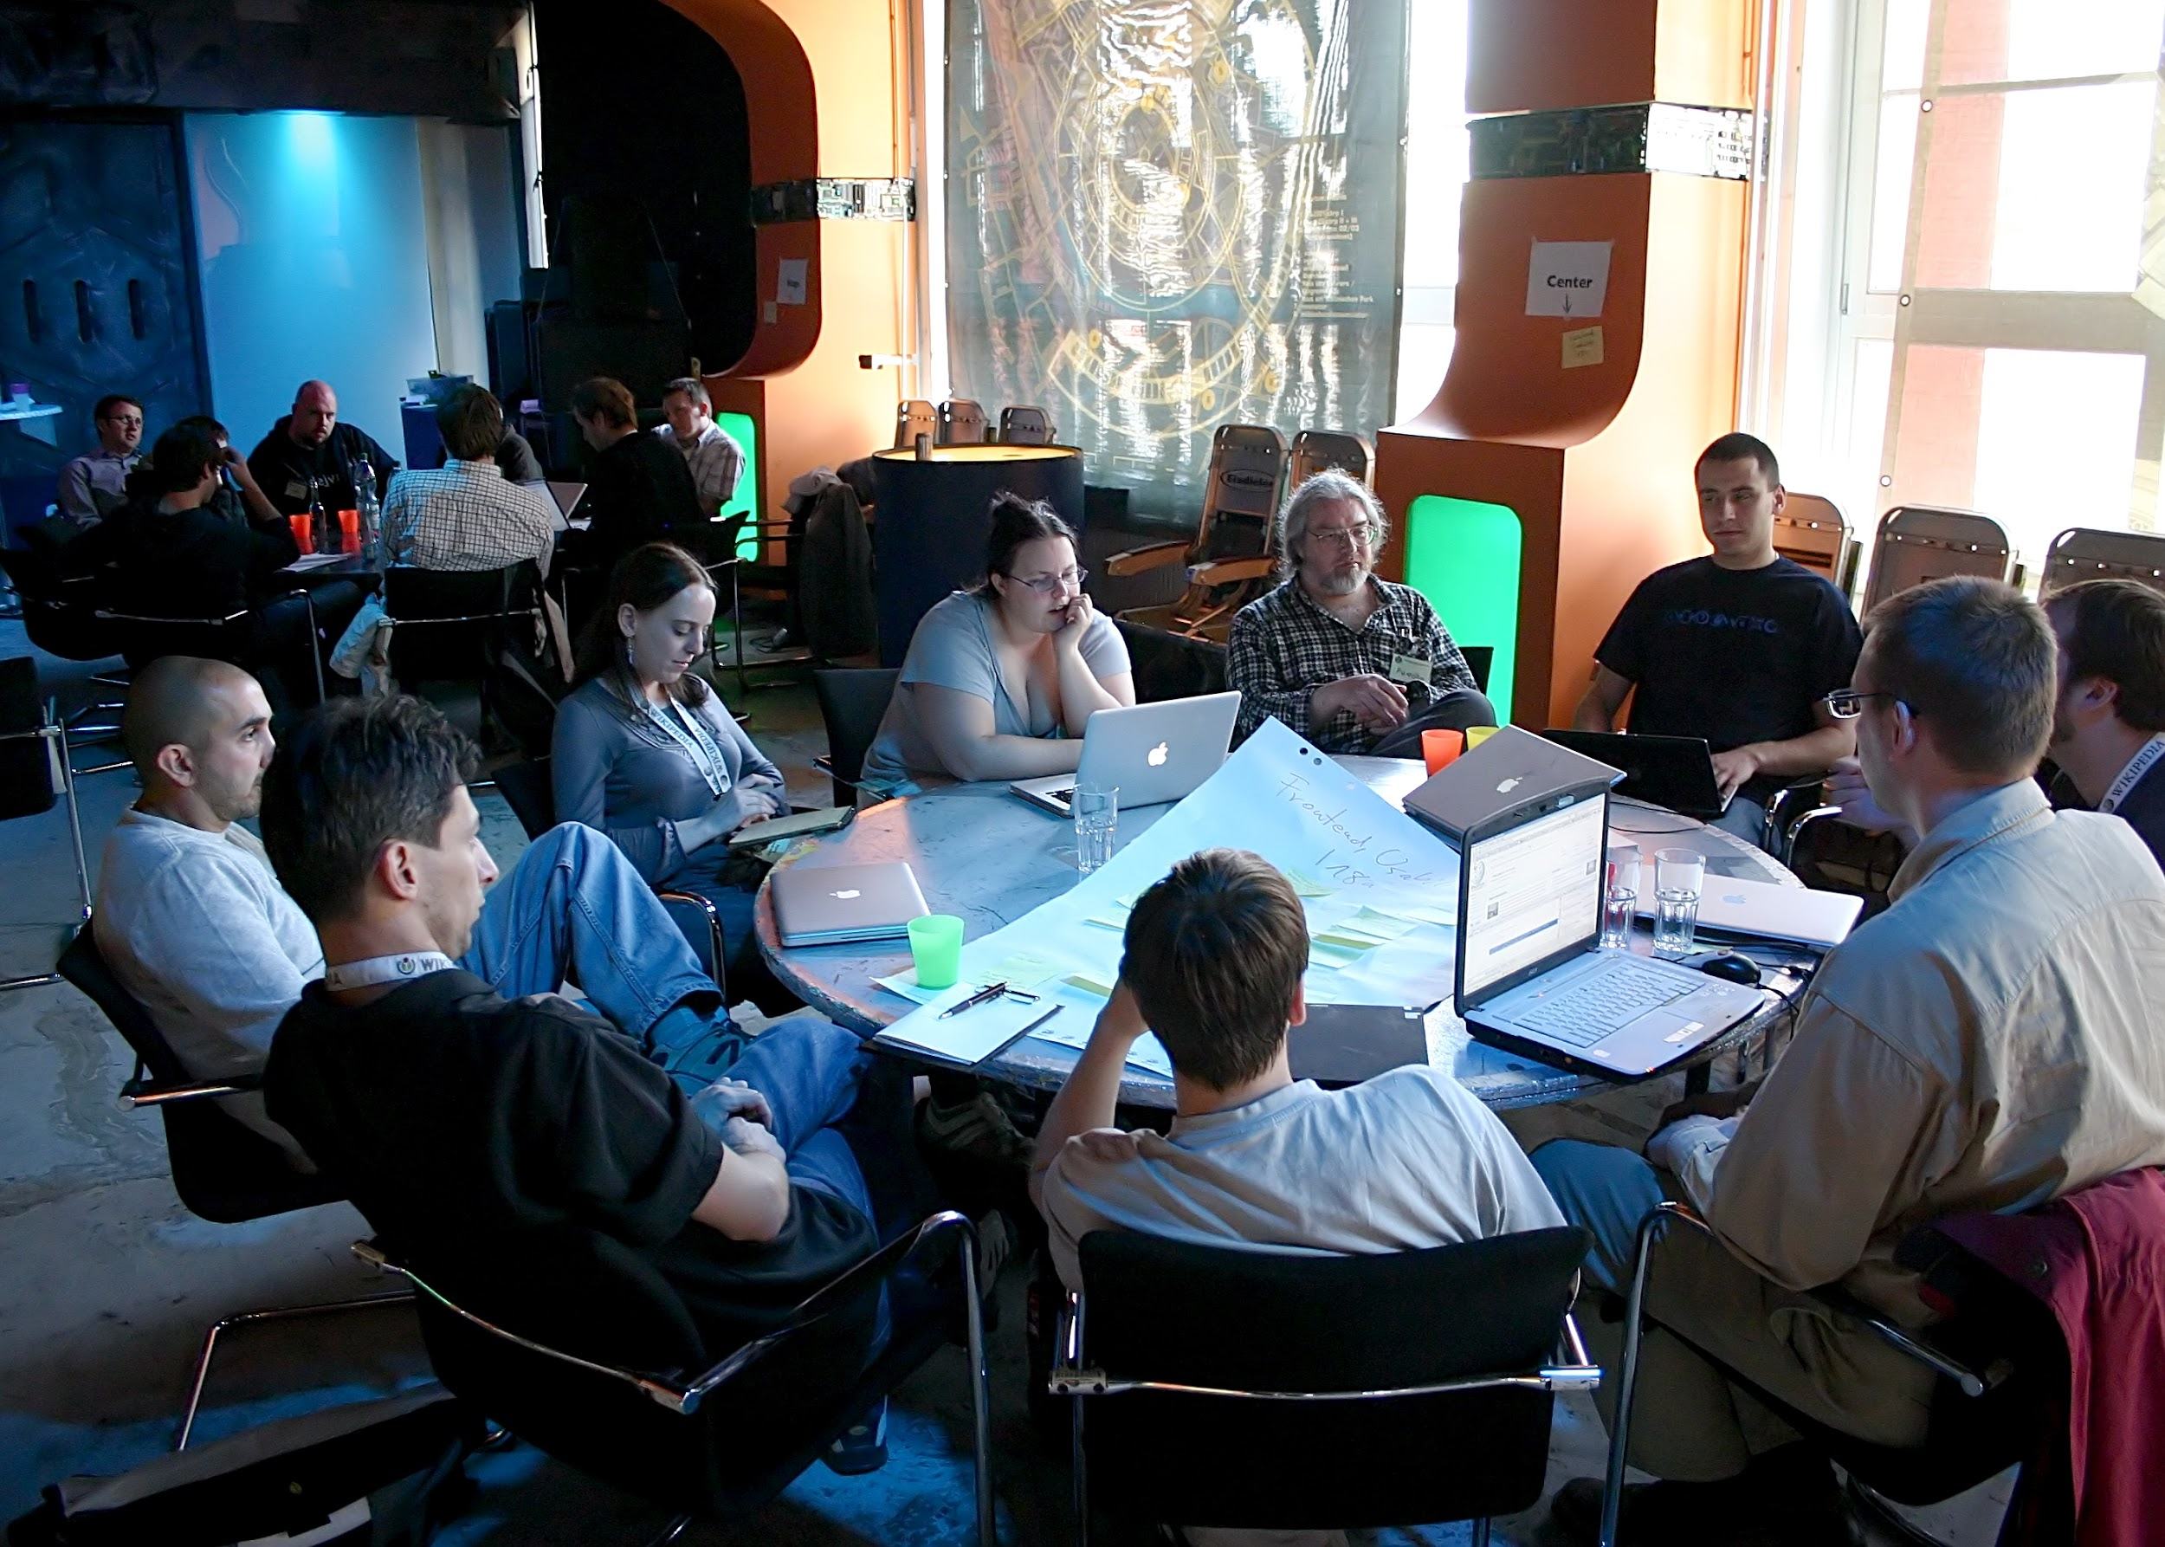
Planning: Community and Workforce
Goal Setting: What can you do to engage those partners you’ve listed in a conversation?

Slide 56
Planning: Share

Slide 57
Questions & Answers

Slide 58
Resources from CSforAll Members
Parent/Student Engagement Activity:
Family Code Night Event Kit
http://www.familycodenight.org/download.html
Online Tool with resources to help:
LeadCS.org
CSforAll Case Study Community Calls:
CSNYC (csnyc.org) x NYC Department of Education: July 2017
http://bit.ly/2tmBVu0

Slide 59
Feedback Welcome!

Slide 60
Become a member!
Visit www.csforall.org

Slide 61
Thank you!

