Slide 1
The Opportunity for Community Schools
Reuben Jacobson Deputy Director, Coalition for Community Schools
June 22, 2016
www.communityschools.org
Notes:
-welcome, glad to be here

Slide 2
Coalition vision and mission
Vision: Schools are centers of flourishing communities where everyone belongs, works together, and thrives.
Mission: To unite school, community and family for young people’s success.
Notes:
About the Coalition

Slide 3
Discussion Questions
How are you currently working with schools? With school districts?
What are your educational outcomes?
What challenges are you facing?
Notes:
Write down the challenges

Slide 5
Core Principles
Shared vision and accountability
Sustainable results-driven partnerships
Alignment of school and community assets
High expectations for all
Community strengths
Respect for diversity
Local decision making
Notes:
Schools are the last great institution. Sustainability: Reason to support.

Slide 6
COMMUNITY SCHOOLS FRAMEWORK
Opportunities & Supports
Expanded Learning
Family & Community Engagement
Results-focused Partnerships

Slide 7
Key Ingredients at the School Site
Supportive Principal
Involved Teachers
Engaged Partners
Community School Coordinator
Needs and Assets Assessment
School Site Leadership Team
Results Focus

Slide 8
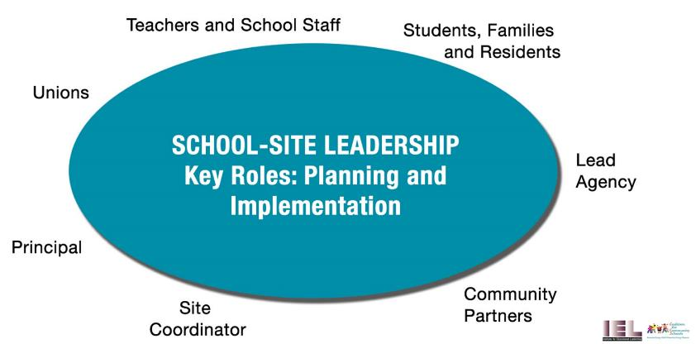
School Leadership Teams
Notes:
Community Engagement

Slide 9
Community engagement
Community Leadership Group
Steering Committee
Public Forums
School Site Outreach

Slide 10
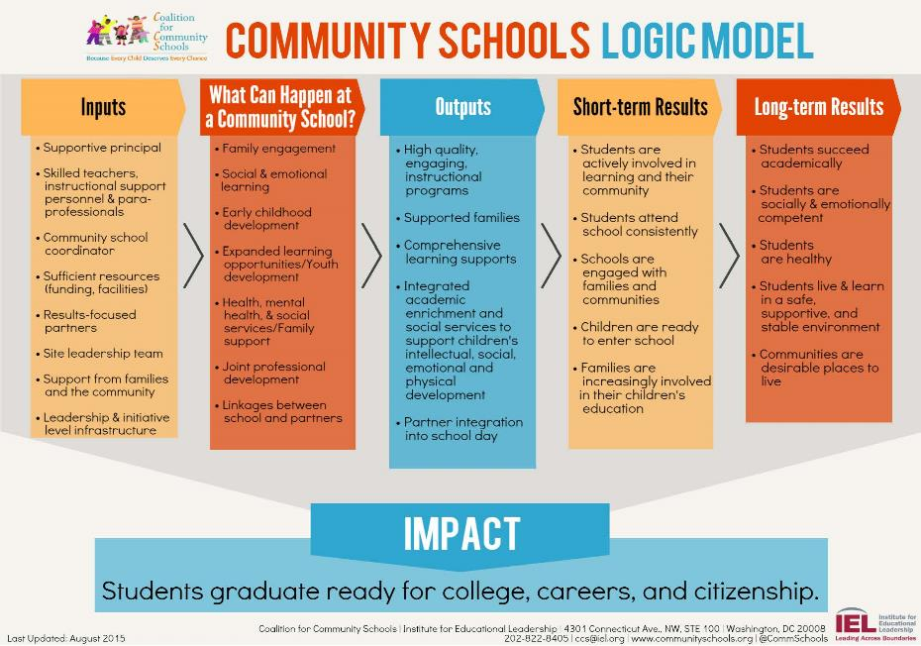

Slide 11
Key Dimensions: Systems Level

Slide 13
Collaborative Leadership Structure

Slide 14
Key Systems Functions
Nurturing Shared Vision
Focus on Results
Alignment and Integration
Data Systems
Monitoring and Evaluation
Technical Assistance
Professional Development
Supportive Policy
Communications
Notes:
Community engagement and buy in around a shared vision is the first key step on the scale up spiral.

Slide 15
INTERMEDIARY STRUCTURE
Types of Intermediaries: Local Government, School Districts, United Ways, Higher Education Institutions.
Intermediary Teams
Cross-Agency Mid-Level Management Support Groups
Catalytic, Bold Leadership

Slide 16
EXPLORING THE community school VISION
What stands out to you?
How are these visions different from how you have been working with schools?
What questions do you have?

Slide 17
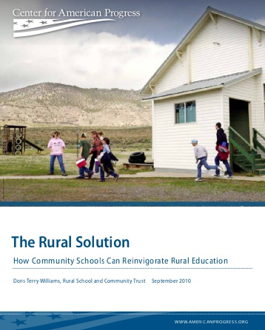
Challenges & Opportunities in Rural Settings: Developing a Plan for action
The partnerships and approach of “full-service community schools” may hold the greatest potential for addressing rural education’s challenges and ensuring that every child has at least a near-equal opportunity to succeed…Full-service community schools may well provide the greatest opportunity for quality education and success in rural communities where resources are few.
-Center for American Progress and Doris Terry Williams

Slide 18
Lessons from Rural Examples
Preparing children to learn
Early childhood (co-location, integration)
Family and community engagement
Expanded learning opportunities
Freeing teacher time (wrap around supports)
Out of school time
Learning from place – CBL
Relationship building
Leadership development/ownership
Share culture and power
Family support services (health, adult education)
Families are assets: Volunteering
Economy of scale
Address consolidation by making use of shared space
Purchasing power

Slide 19
Challenges & YOUR solutions
Challenges
Solutions
Teacher effectiveness, recruitment, and retainment
Family and community engagement
Better use of facilities
Partnership development and maintenance
Community support and ownership
Your ideas?

Slide 21
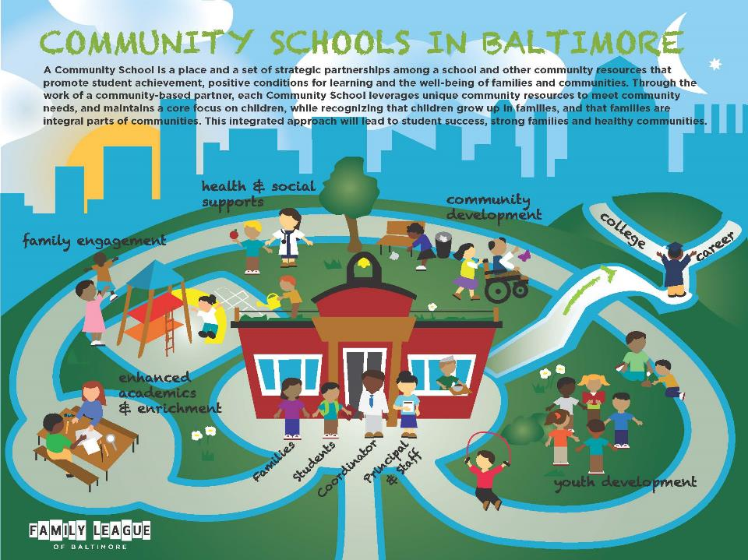

Slide 22
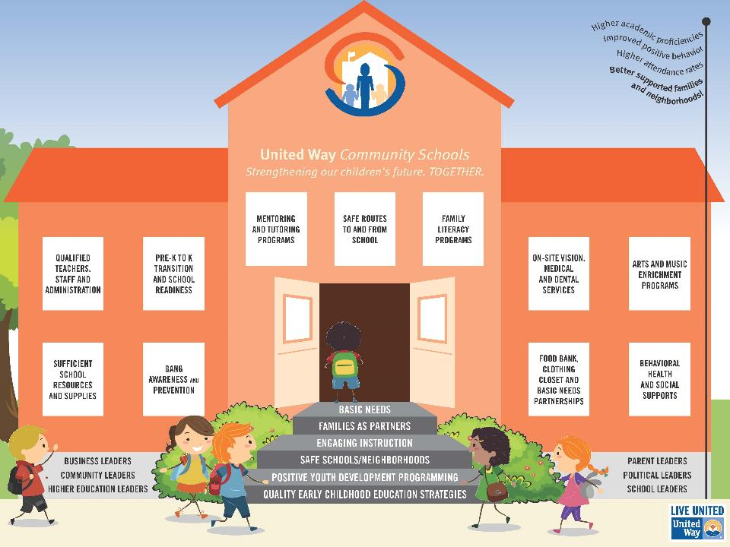

Slide 23
Community Schools
Watch the Video

Slide 24
RESULTS
Children are Ready to Enter School
Students Succeed Academically
Students are Actively Involved in Learning and their Community
Students Healthy: Physically, Socially & Emotionally
Families Actively Involved in Children’s Education
Community is a Desirable Place to Live

Slide 25
STUDENTS SUCCEED ACADEMICALLY
Reading on grade level by third grade
Daily attendance
Chronic absenteeism
Tardiness
Discipline – suspension, expulsion
Standardized test scores
Grades
Graduation rate
Dropout rate

