Slide 1

ENTREPRENEURIAL MINDSETS FOR WESTERN NORTH CAROLINA YOUTH
Bradley J. Tunstill
GEAR UP NC Appalachian Partnership
Appalachian State University

Slide 2

What does this mean?

Slide 3




Under College Access Partnerships

Slide 4
Overall Mission of GEAR UP
We are a data-driven college access program that aims to improve students who:
  Are informed about college options, planning and financial aid
  Graduate high school
  Enroll and succeed in post-secondary education
We target low-income schools and establish a strong college-going culture for ALL students
Create transition programs from:
  Middle School → High School → College

Slide 5
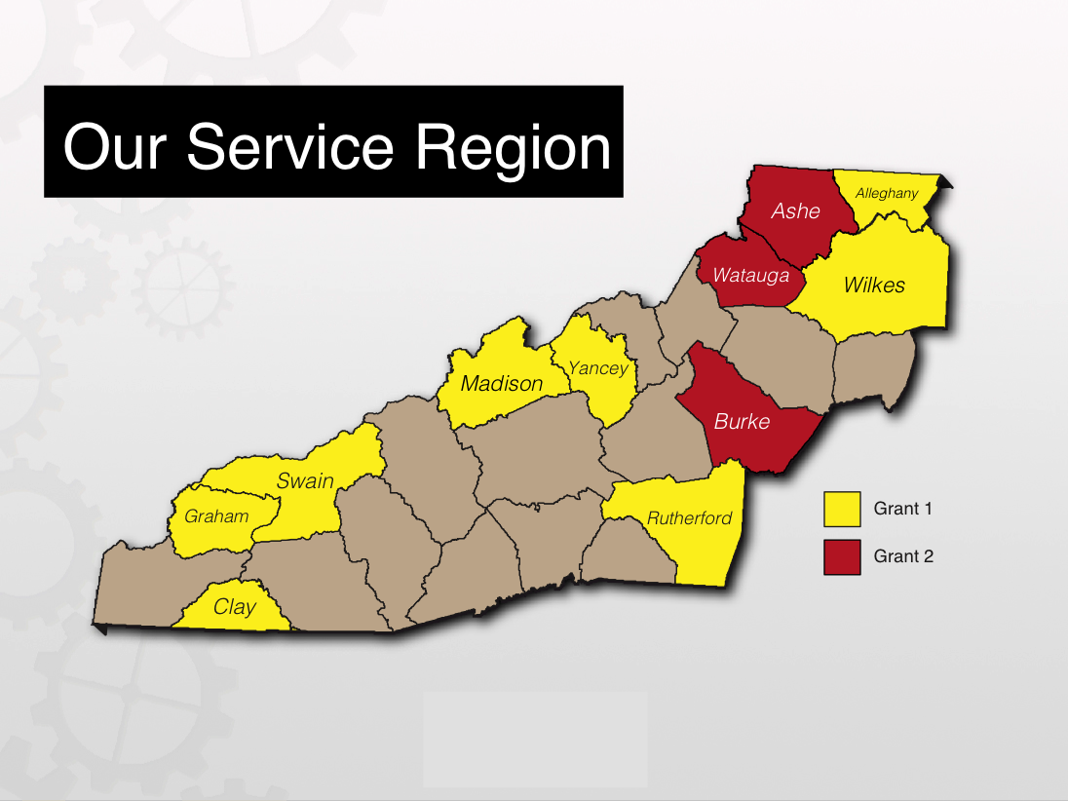

Slide 6
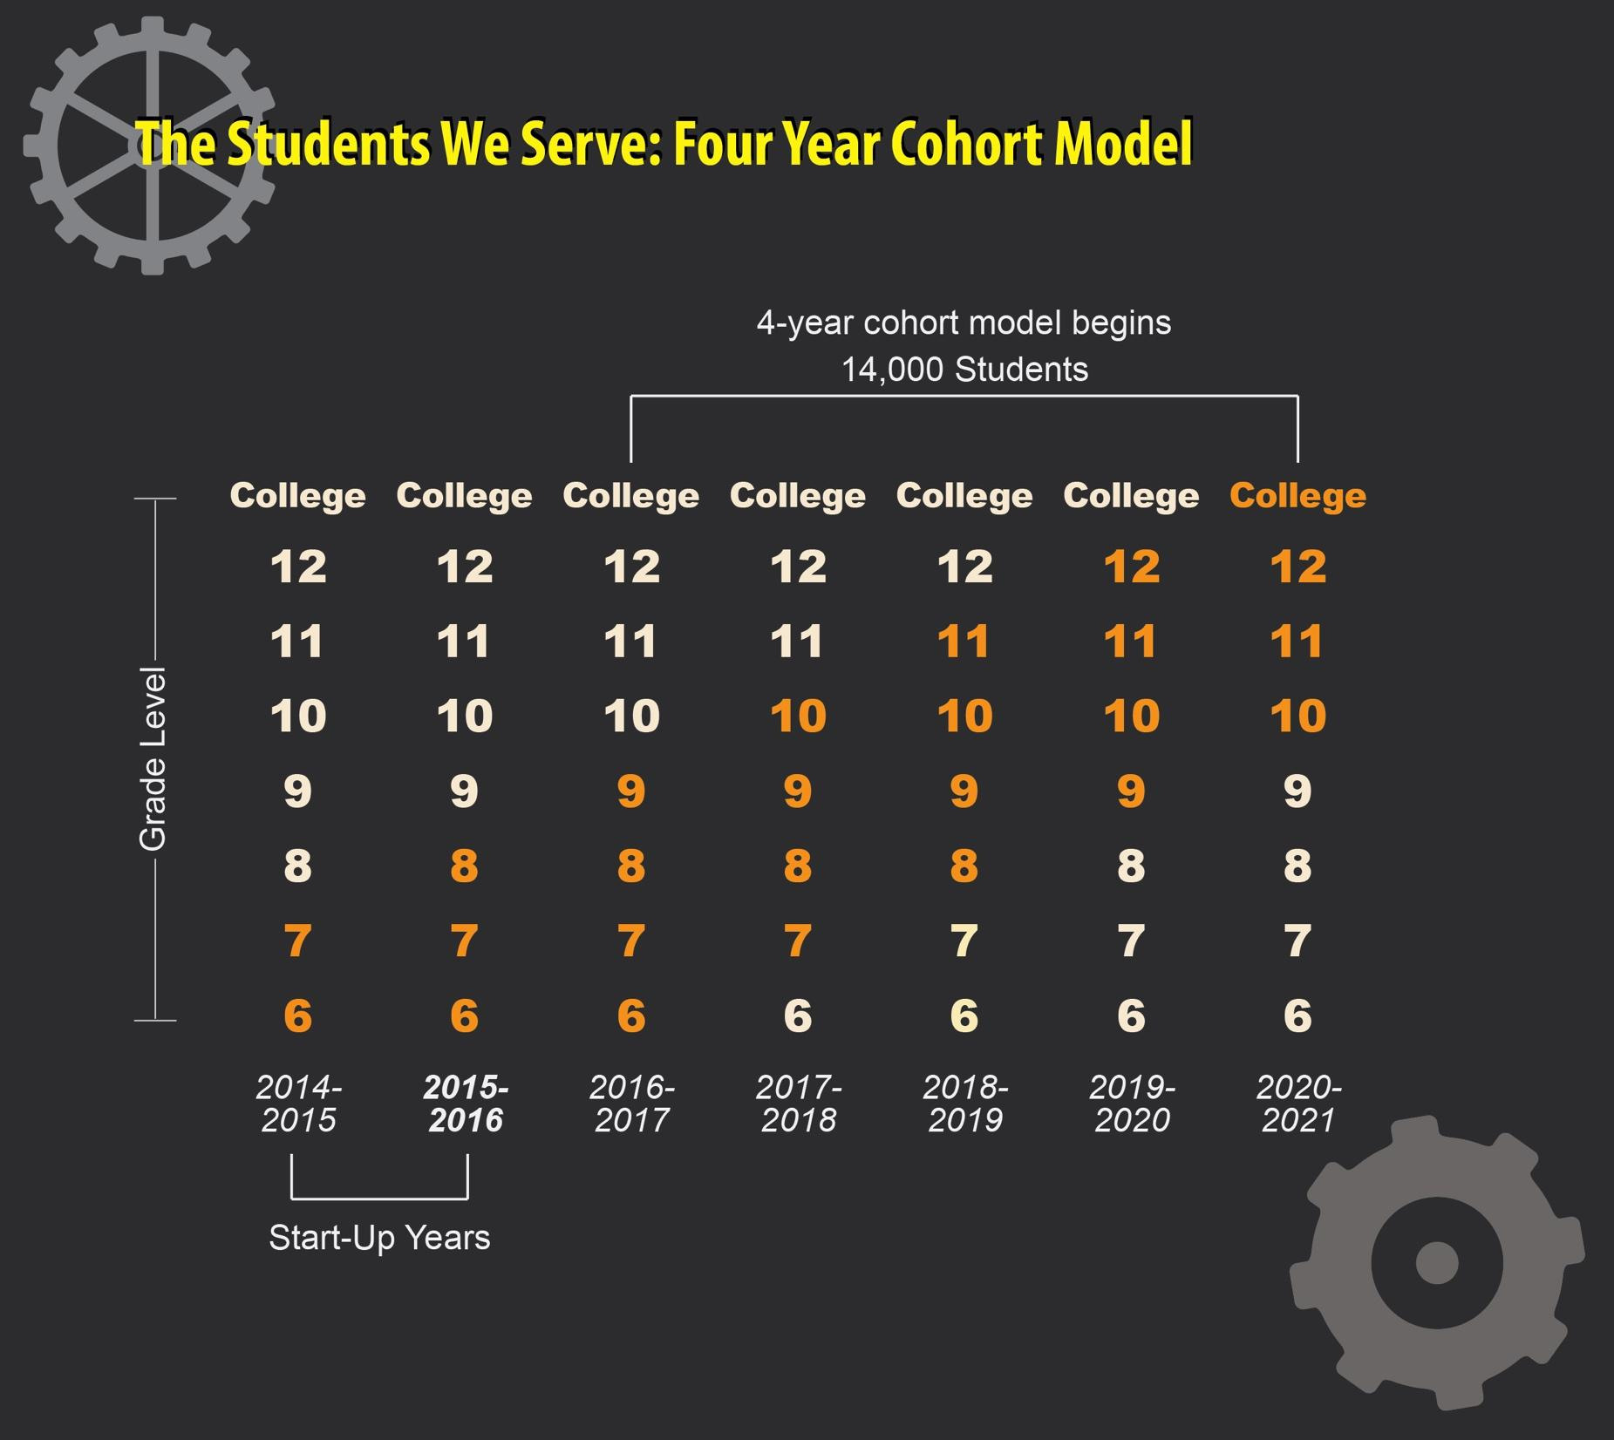

Slide 7
Why Entrepreneurial Education?

Slide 8
Hope Index 2015

Slide 9
Hope Index 2015

Slide 10
Hope Index 2015

Slide 11
Hope Index 2015

Slide 12
Why Entrepreneurial Education?
Regional Difficulties
Economic Development
Well-Rounded Students

Slide 13
Regional Difficulties
(NC)
Textiles
Furniture
Tobacco
Timber

Slide 14
Entrepreneurship focused economic development strategies seen as “a critical element in the establishment of self-sustaining communities that create jobs, build local wealth, and contribute broadly to economic and community development”
(ARC, Creating an Entrepreneurial Appalachian Region, 2008)

Slide 15
Economic Development
MORE SMALL BUSINESS
Jobs
Competition
Attracting New Residents/Tourists
Boost Tax Revenue
More Money For Schools

Slide 16
Well-Rounded Students/Citizens
Creating an Entrepreneurial Mindset:
Aware of Culture and Surroundings
Able to better assess situations and come up with solutions
Skills learned translate into more productive students and citizens

Slide 17
HOW?

Slide 18



Data
Programming
Partnerships

Slide 19
D
A
T
A

Slide 20
Interest
Momentum
Quality
DATA-DRIVEN DECISIONS
STUDENT SELECTION FOR AsU GUIDE

Slide 21
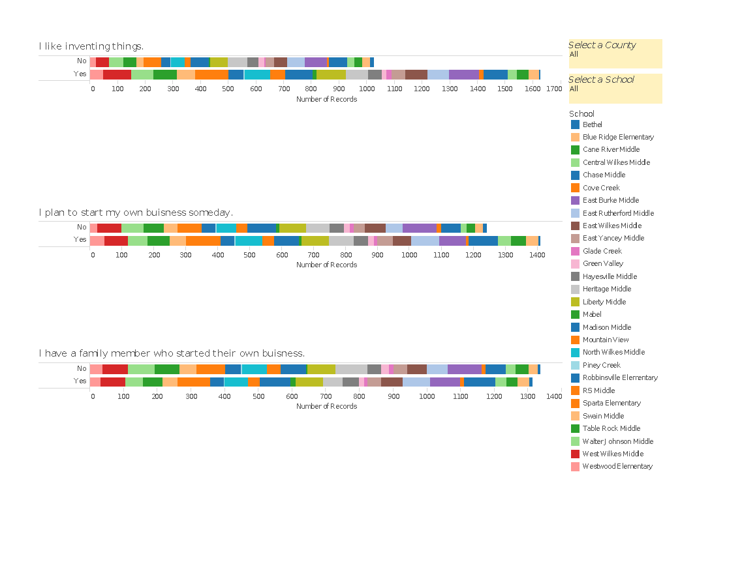
Entrepreneurship Scale
Entrepreneur questions allowed GEAR UP to hand select potential participants for our GUIDE weekends
Our database allows us to narrow down overall results by county → school → student success

Slide 22
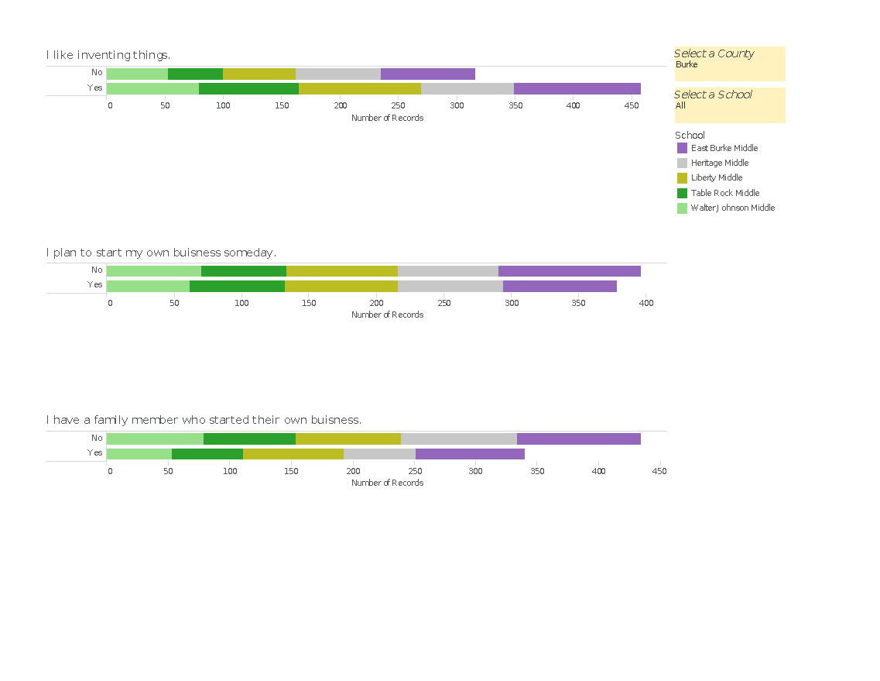
Entrepreneurship Questions
Taken from the Gallup-HOPE Index
48% of GEAR UP students envisioned starting their own business
  42% for the United States
51% had someone in their family who owned a business
  32% for the United States*
56% indicated that they “like to invent things”
  42% for the United States
(2015 GALLUP-HOPE Index)
* 2013 Results; Question was omitted from newest version of report

Slide 23
PRE
POST
FOLLOW UP
DATA-DRIVEN DECISIONS
ASSESSMENTS

Slide 24
      “Entrepreneurial Test” –SBA
      Scoring
          48-59- You have potential, but need to push yourself to become an entrepreneur
          60-75 – Start a Business! You have the earmarks of an entrepreneur
          2.17 Point Increase
            Took group from “having potential” to being able to succeed as entrepreneur
            OVERALL GROWTH!!
*35 students were given both pre and post assessments

Slide 25
PROGRAMMING

Slide 26
Entrepreneurial Mindsets
Passion
Story Telling
Initiative
Grit
Observance
Adventure
Team Diversity
.

Slide 27
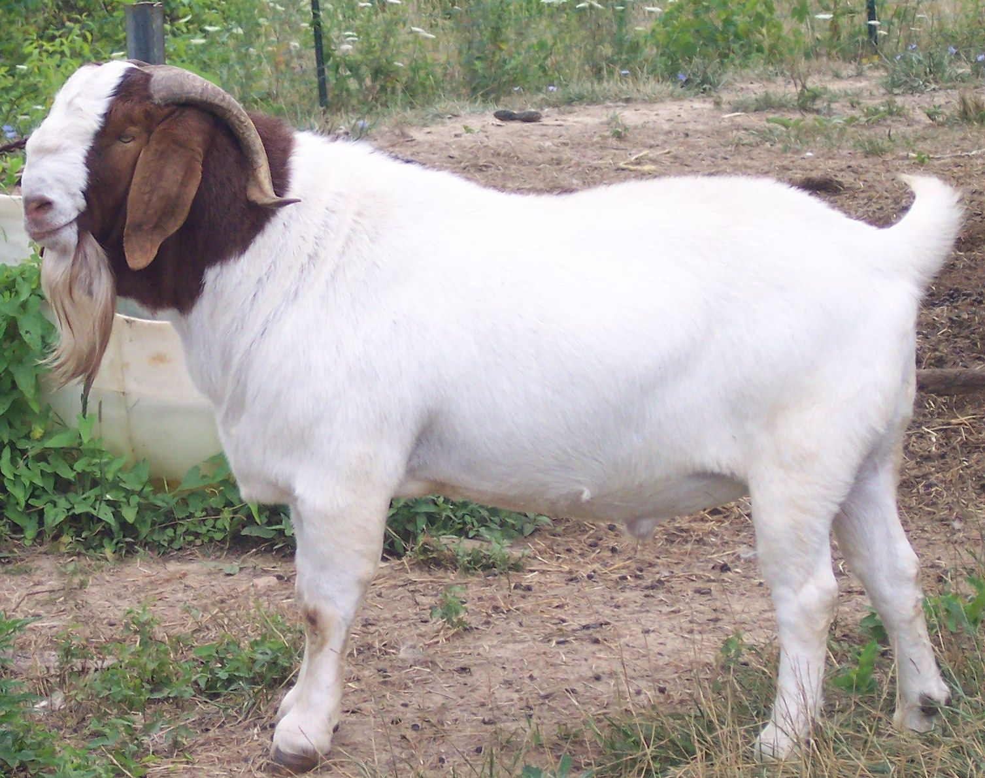
3.14

Slide 28
 |  | GUIDE WEEKEND SCHEDULE
Time Beginning | Time Ending | Event | Location | Presenter/Leader | Details | Mindsets Key:
Friday
12:00 PM | 1:00 PM | Optional Lunch to Attendees | BRCC
1:00 PM | 1:30 PM | Check In, Drop Stuff in Cabins, Agenda | Cabins | Leaders |  | Team Diversity
1:30 PM | 2:00 PM | Shark Tank Clip; Introductions | BRCC | Leaders |  | Passion
2:00 PM | 4:00 PM | GIC | BRCC | Broadstone Staff |  | Observent
4:00 | 5:00 AM | Marshmallow/Failure Challenge | BRCC | GEAR UP
5:00 PM | 6:30 PM | True Colors | BRCC Lodge | GEAR UP |  | Persistence
6:30 PM | 7:00 PM | Dinner | BRCC Cafeteria | Lodge |  | Story Telling
7:00 PM | 7:15 AM | Creative Field Presentation | BRCC Lodge | ASU Faculty |  | Adventure
 |  |  |  |  |  | Initiative
7:15 PM | 9:30 PM | Idea Creation Include Pitch Prep | BRCC Lodge | GEAR UP/ASU FACULTY
10:00 PM | 11:00 PM | Cabins/Lights Out |  | Leaders
Saturday
8:00 AM | 8:35 AM | Breakfast | BRCC Cafeteria | Leaders
8:35 AM | 9:00 AM | Review of Previous Days Learning | BRCC | Bradley/Jonathan
9:00 AM | 12:00 PM | Indoor Climbing | BRCC Gym | BRLC
12:00 PM | 12:30 PM | Travel to ASU |  | Leaders | Katherine Harper
12:45 PM | 1:30 PM | Lunch | Roess Dining Hall | Leaders
1:30 PM | 1:45 PM | Walk to Harper | Katherine Harper Hall | Group
1:45 PM | 2:00 PM | Tour of Katherine Harper ID Space | Katherine Harper Hall | ASU FACULTY
2:15 PM | 4:15 PM | Presentation Creation | Katherine Harper Hall Rm 11 | GEAR UP/ASU FACULTY
4:15 PM | 5:00 PM | Downtown Small Biz Tour | Art Mart/Anna Bananas/Wine 2 Water | Group | Split students /Park Downtown
5:00 PM | 5:45 PM | Dinner | Roess Dining Hall | Group
6:00 PM | 8:15 PM | Presentation Creation/Dry Run of Presentations | Katherine Harper Hall Room 11 | Leaders
8:15 PM | 8:30 AM | Travel To Campground | BRCC | Leaders
9:00 PM | 10:00 PM | Campfire | BRCC | RAs Facilitate Activities | GYM also reserved
10:00 PM | 11:00 PM | Cabins and Lights Out | BRCC | Leaders
Sunday
8:00 AM | 8:35 AM | Breakfast |  | Leaders
8:35 AM | 9:00 AM | Pack/ Load up Vans | BRCC | Group
9:00 AM | 9:30 AM | Review Presentations | ASU | Leaders
9:30 AM | 10:00 AM | Travel to ASU | ASU | Leaders
9:00 AM | 10:00 AM | PARENT PROGRAMMING | Campus Tour/ Q&A for Parents | ?
10:00 AM | 10:45 AM | Business Presentations | Peacock Hall 2nd Floor | Panel/ Students
10:45 AM | 11:15 AM | Business Panel Breakout | Peacock Hall 2nd Floor | Leaders
11:15 AM | 11:30 AM | Discussion about Club | Peacock Hall 2nd Floor | Leaders
11:30 AM | 12:00 PM | Closing Activity/Reflection & Graduation | Peacock Hall 2nd Floor | Leaders
12:15 PM |  | Grab Bag Lunch and Depart | Raley Circle | Leaders

Slide 29
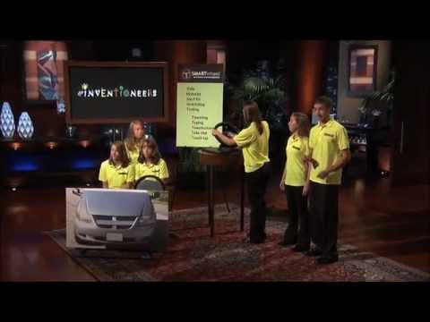
PROGRAMMING SCHEDULE
DAY 1
Shark Tank Introduction
Introduce Weekend
Relate students to kids their age
Build Excitement!!
PASSION

Slide 30
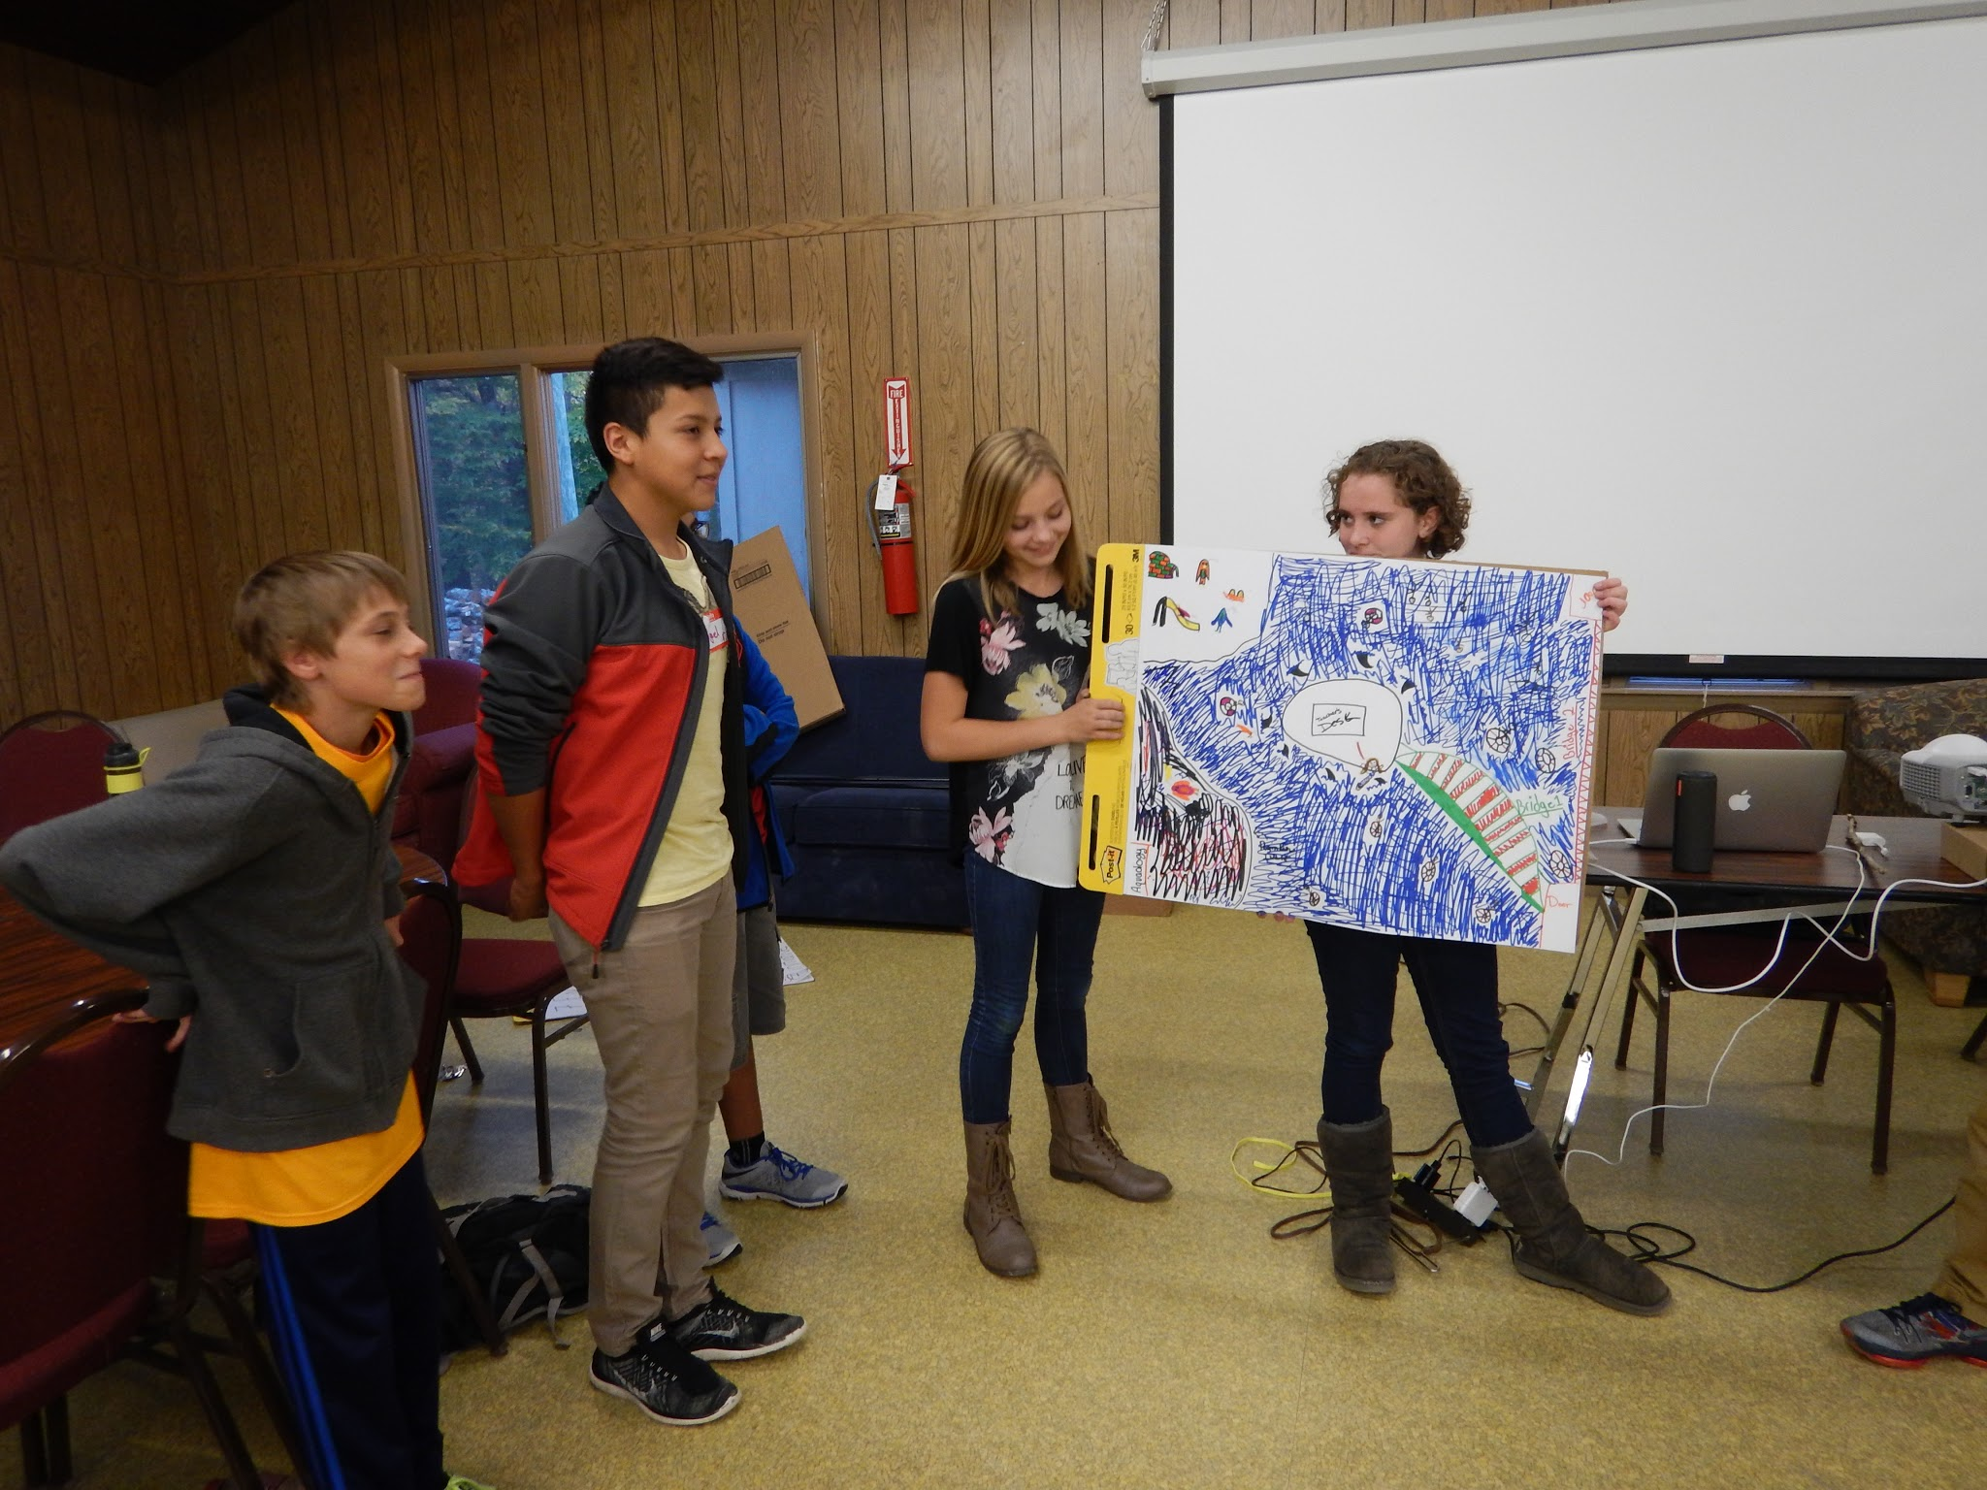
PROGRAMMING SCHEDULE
DAY 1
True Colors
Personality inventory
Students learn about themselves
Used to split up groups
TEAM DIVERSITY

Slide 31

BRAINSTORMING

Slide 32
PROGRAMMING SCHEDULE
TECHNOLOGY
Creative Field Presentation/Idea Creation
Brainstorm a problem
Narrow it down to top 3
Decide what problem will be
Brainstorm solutions, Repeat

Slide 33
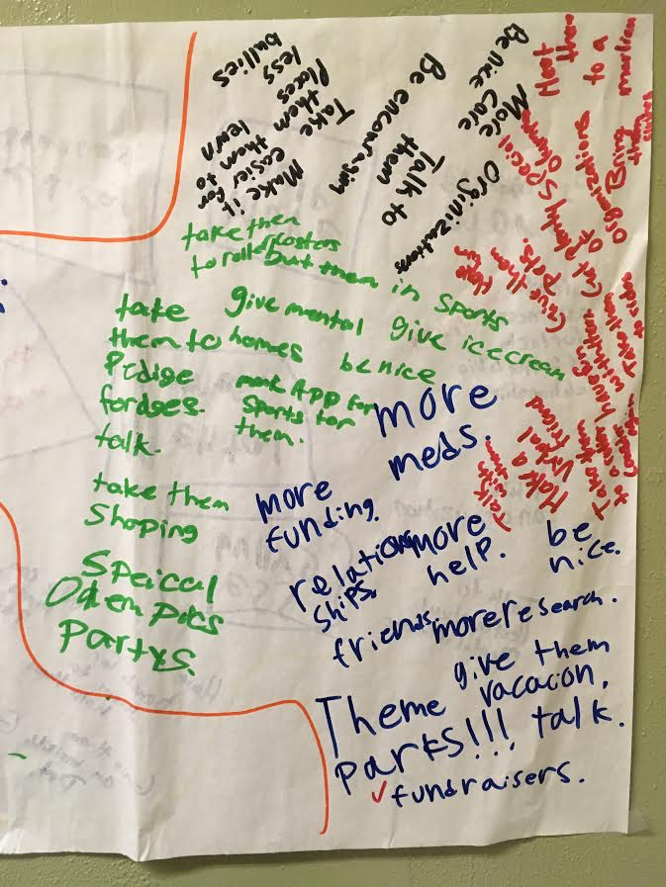
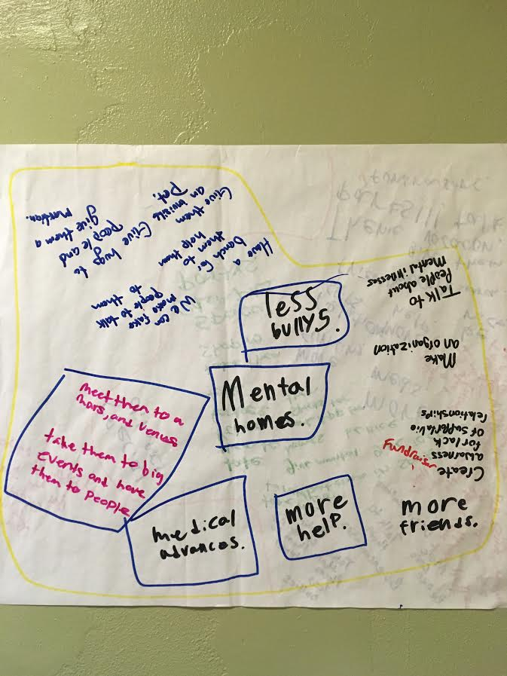
PROGRAMMING SCHEDULE

Slide 34
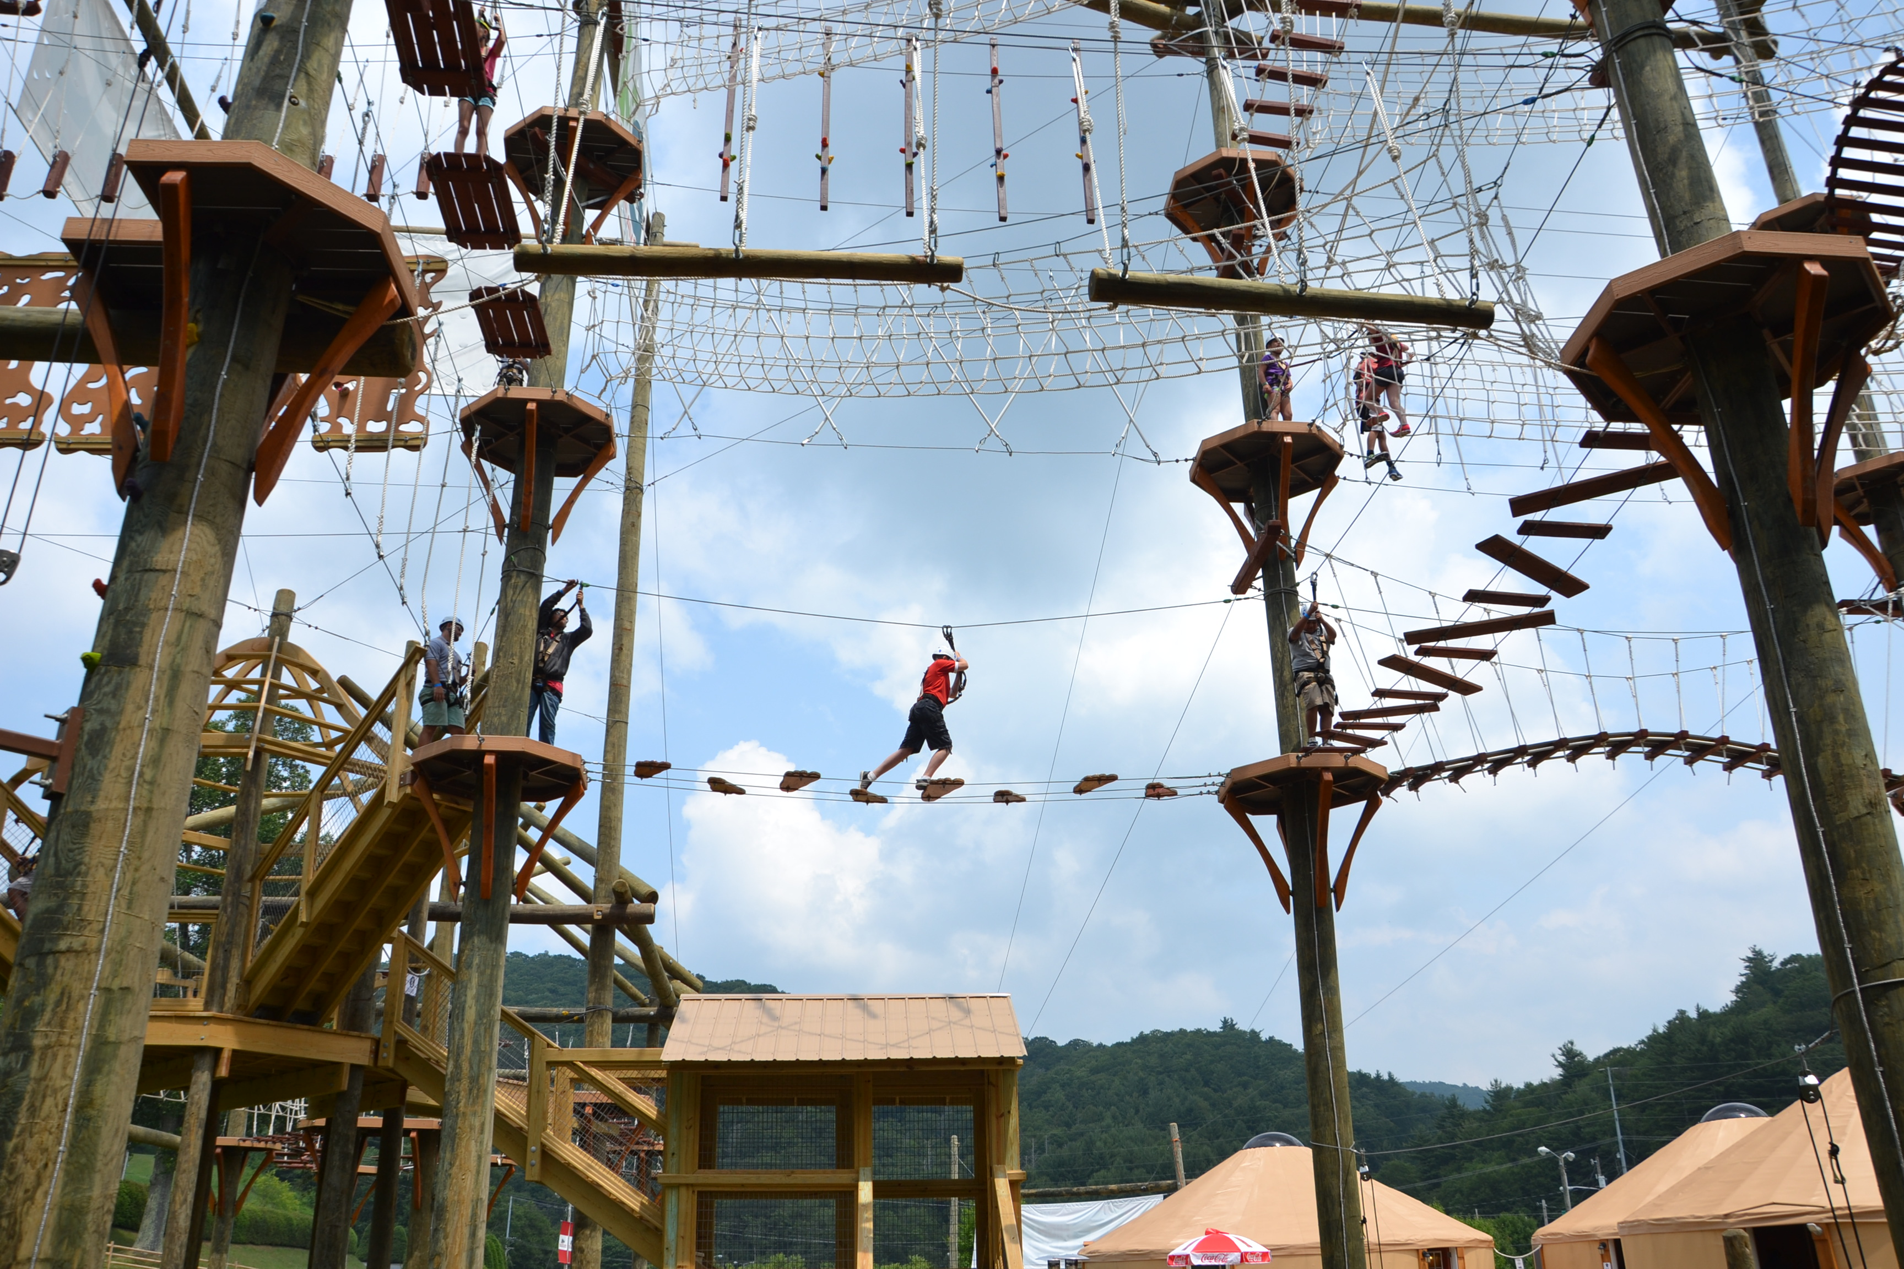
PROGRAMMING SCHEDULE
Day 2
Adventure Activity
Team Building
Risk Taking
Tied back to entrepreneurship

Slide 35
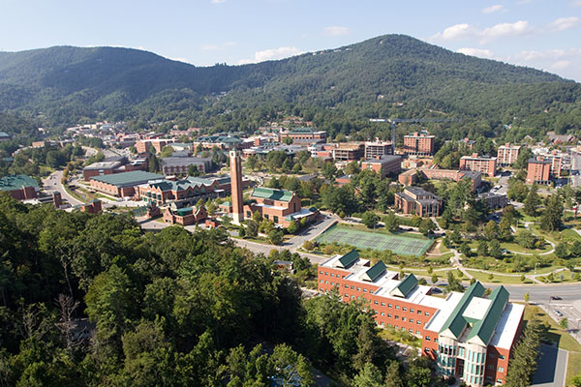
PROGRAMMING SCHEDULE
Day 2
ASU EXPERIENCE
Lunch
Tour of Industrial Design Department

Slide 36
PRESENTATION CREATION

Slide 37
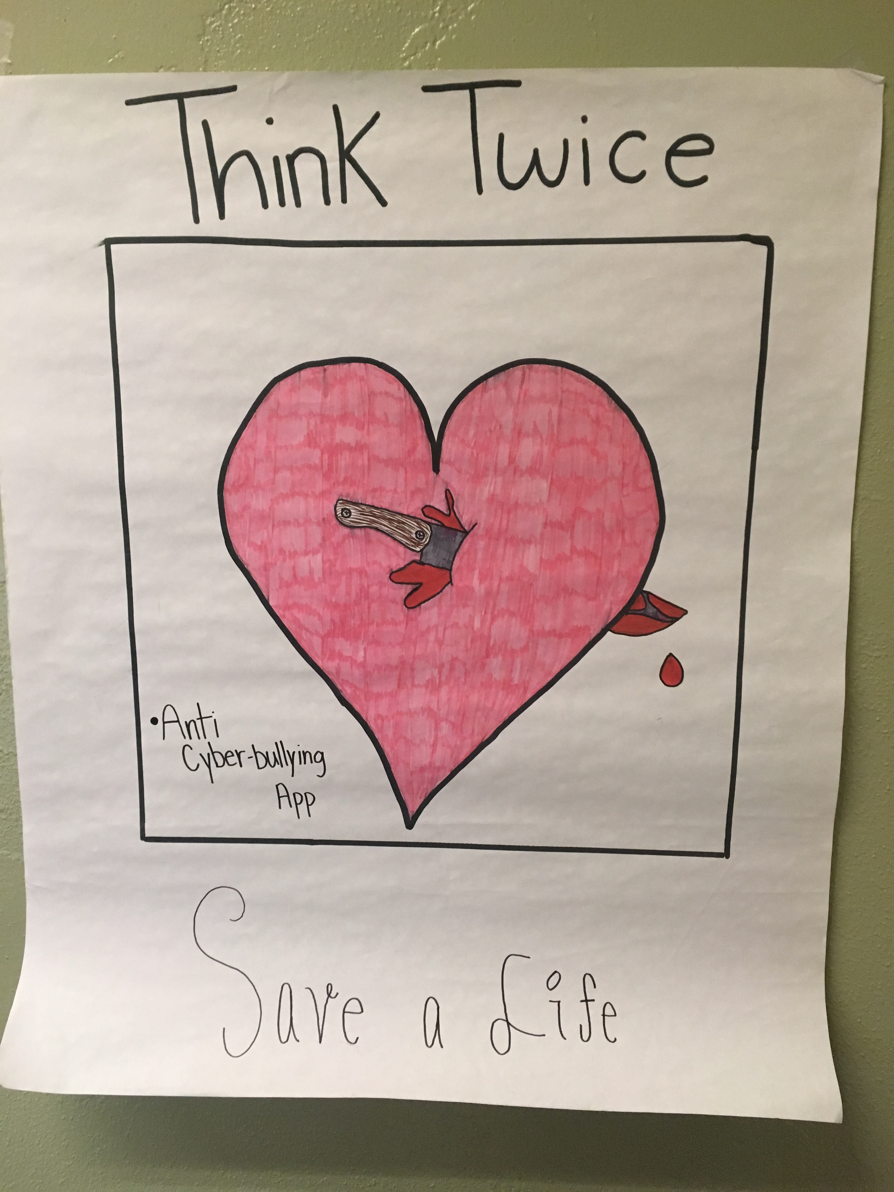
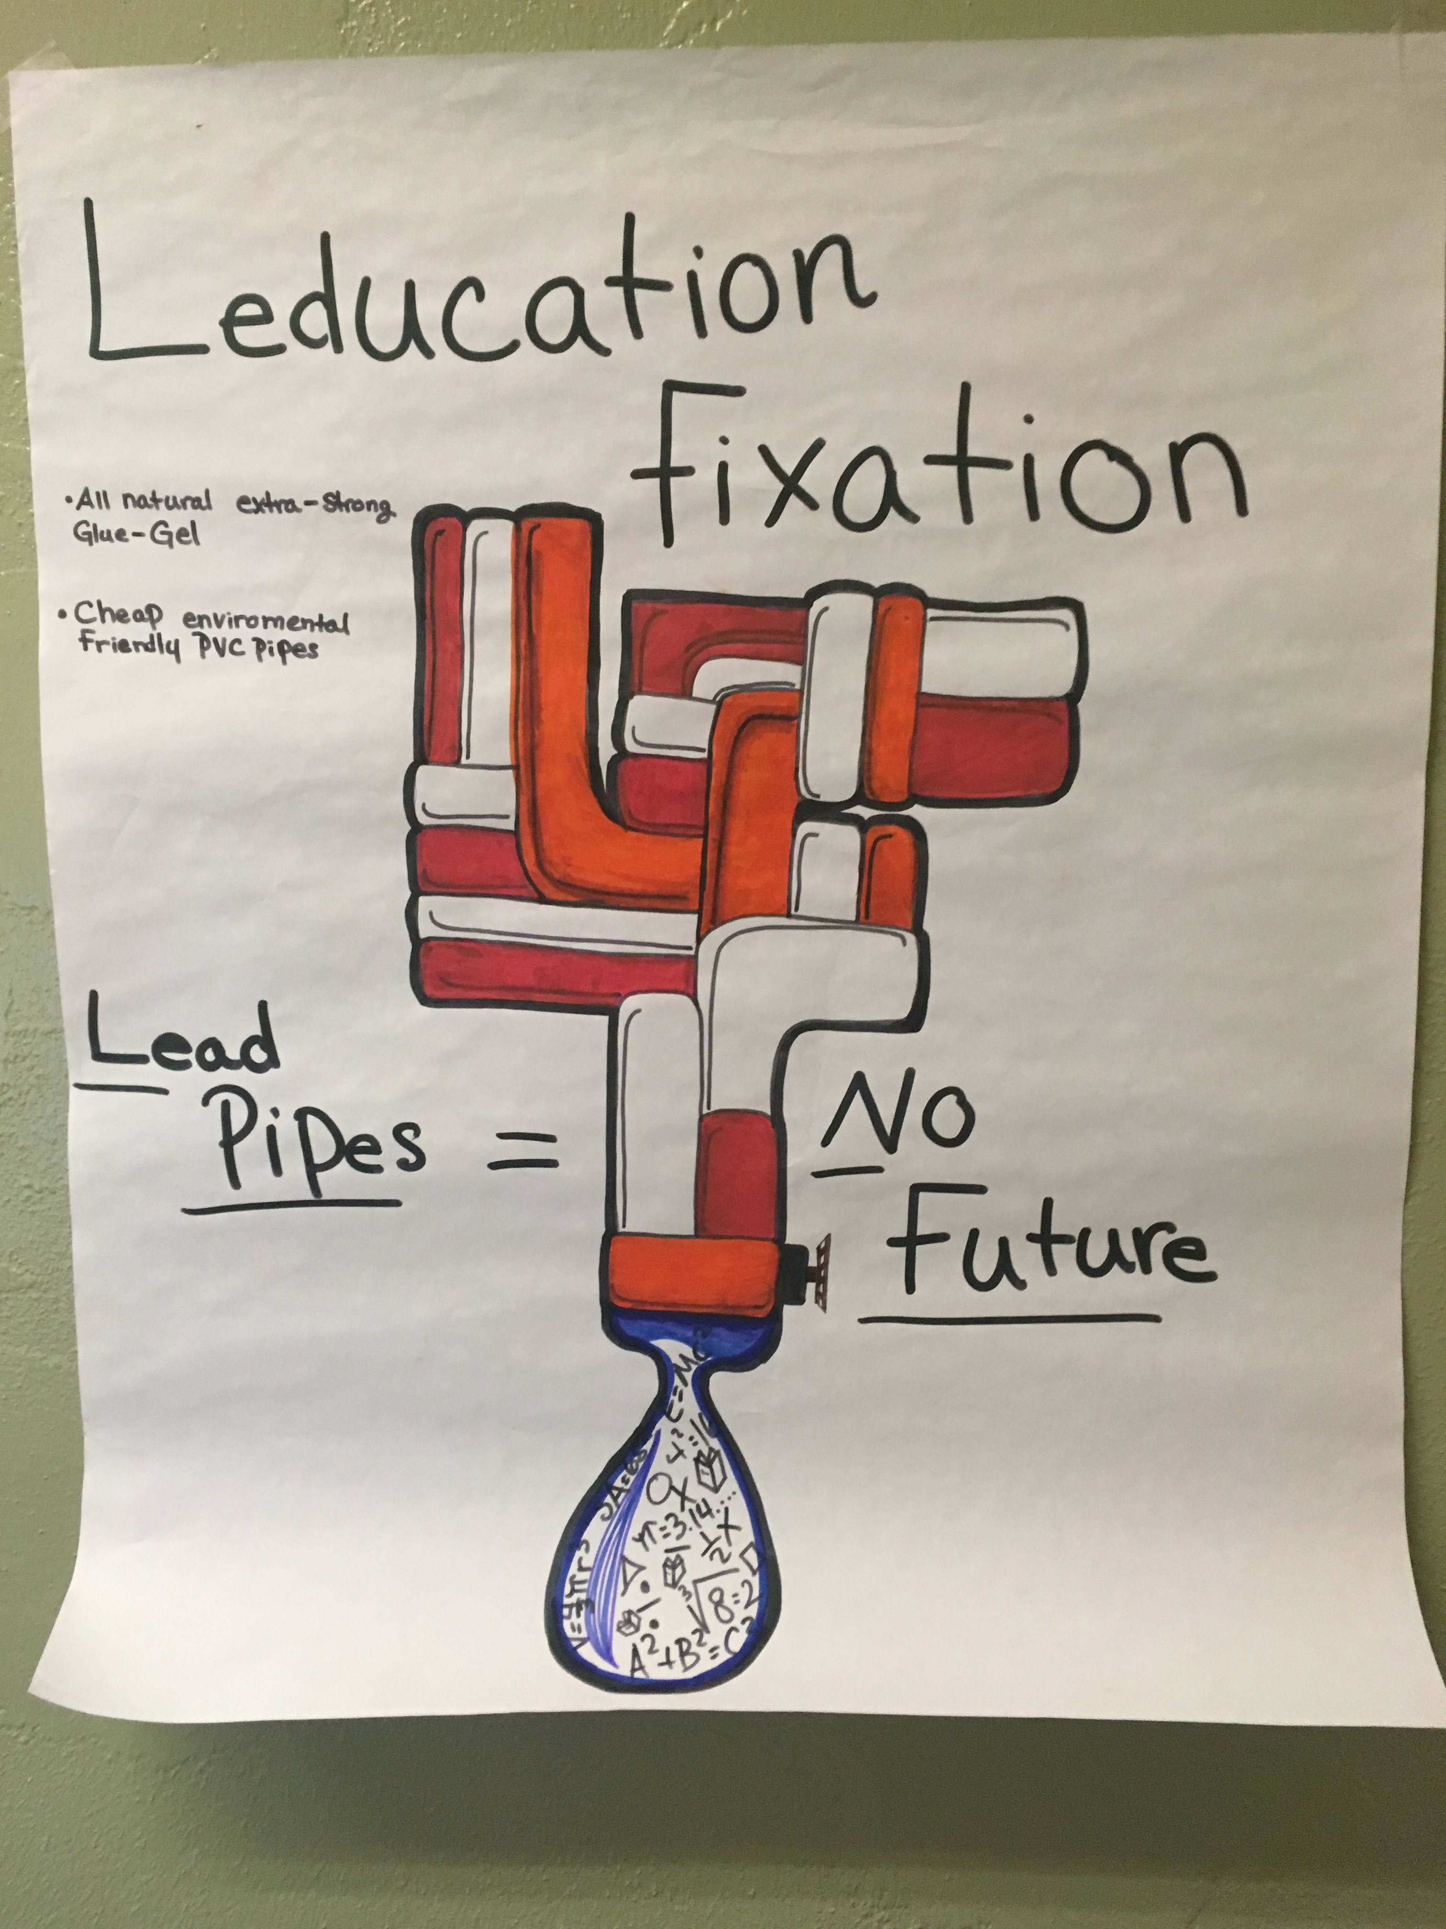

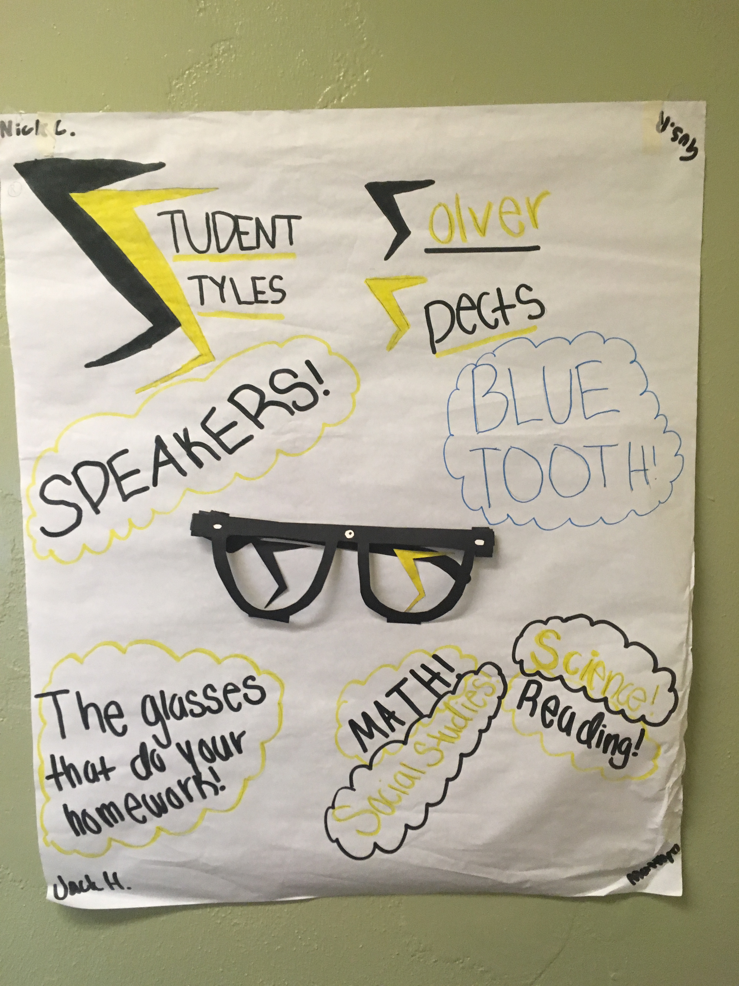
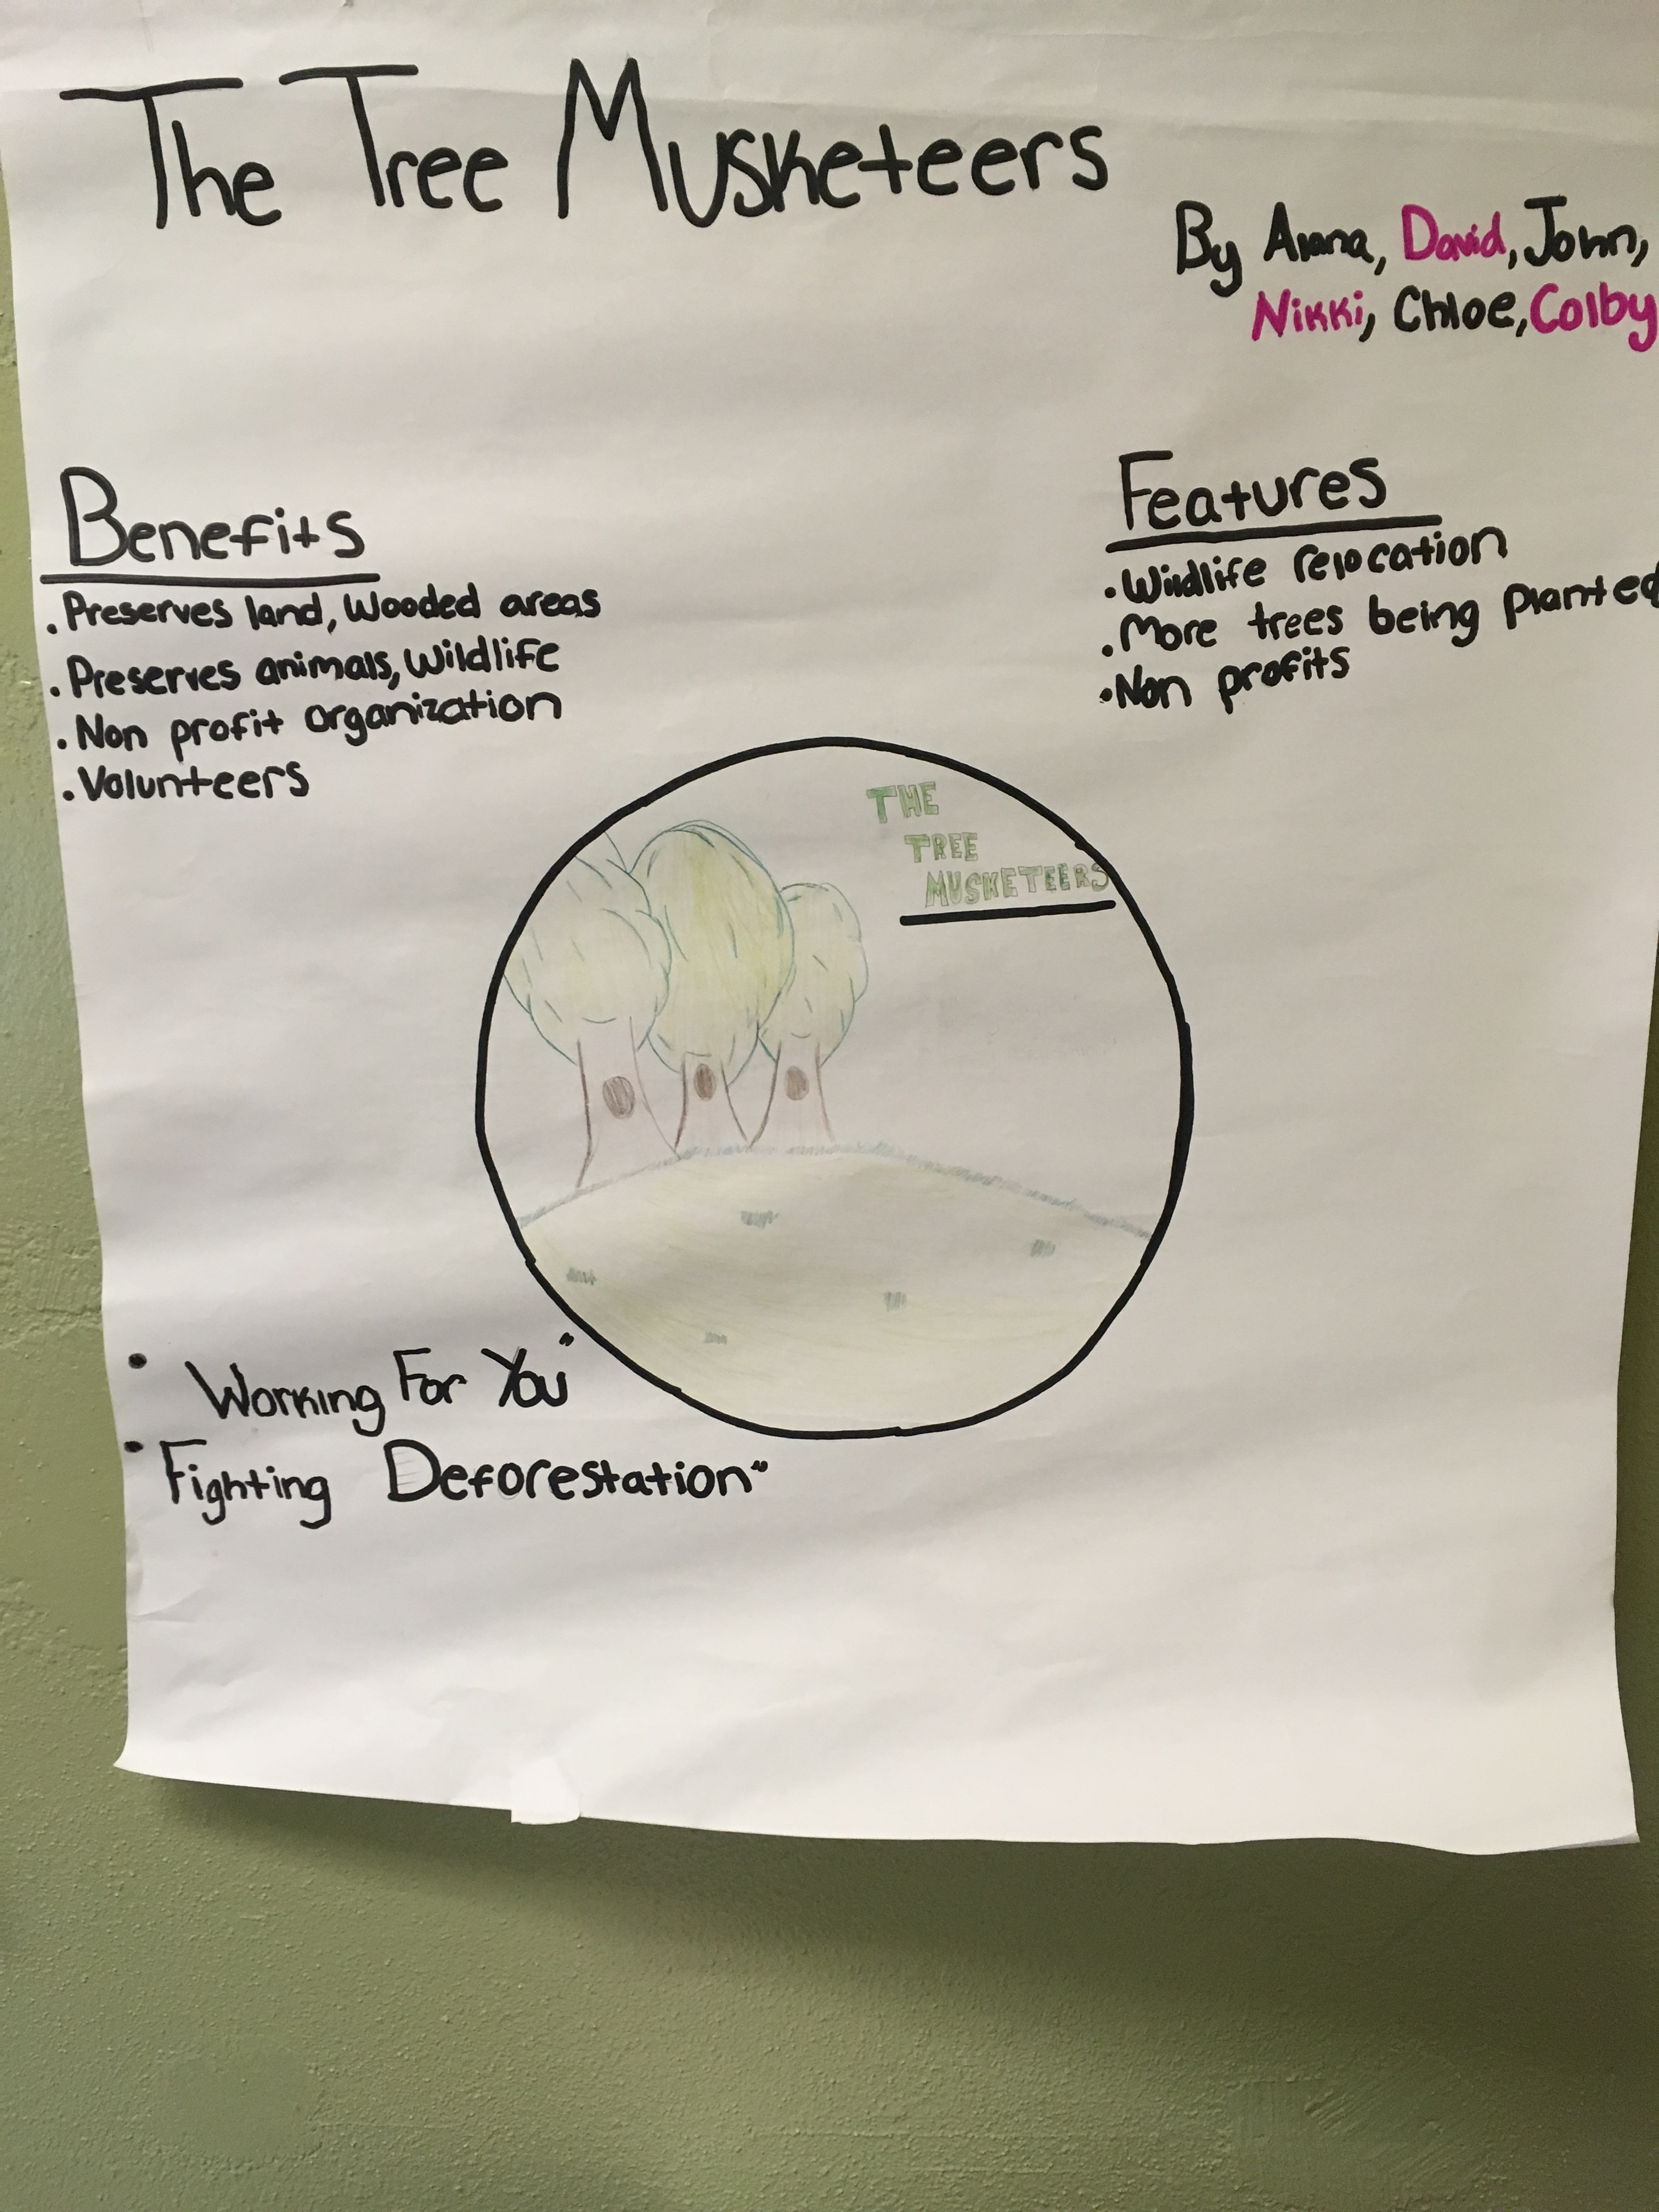
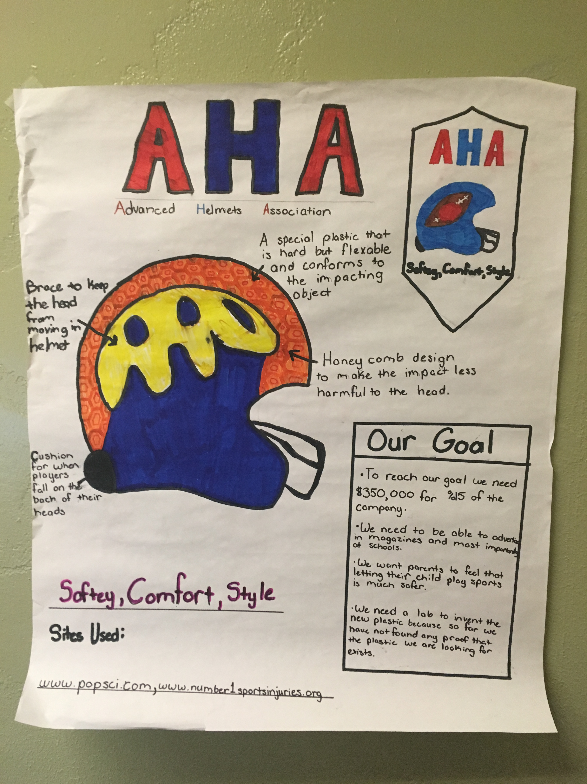

Slide 38
DOWNTOWN BUSINESS TOUR

Slide 39
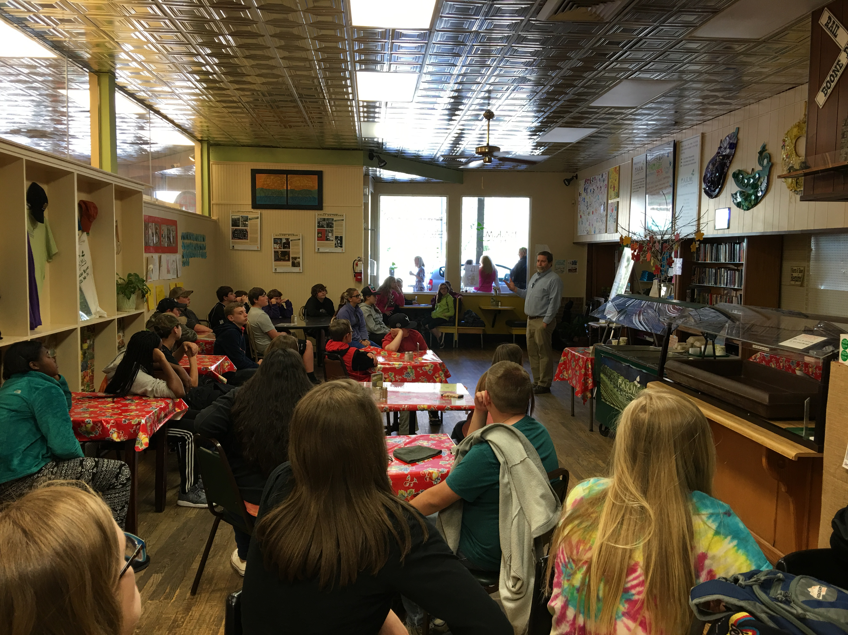

Slide 40
PRESENTATION PREP/ DRY RUN

Slide 41
ELEVATOR PITCH
Introduce Yourself
Drop the Hook
Introduce the Problem
Present the Solution
Benefits and Features
Target Audience
Marketing Strategy
“The Ask”
Tagline

Slide 42
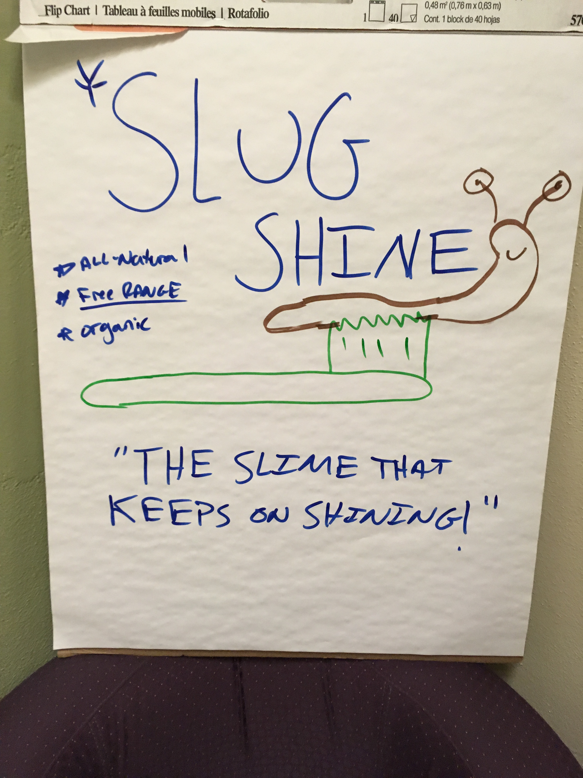

Slide 43
PRESENTATIONS

Slide 44
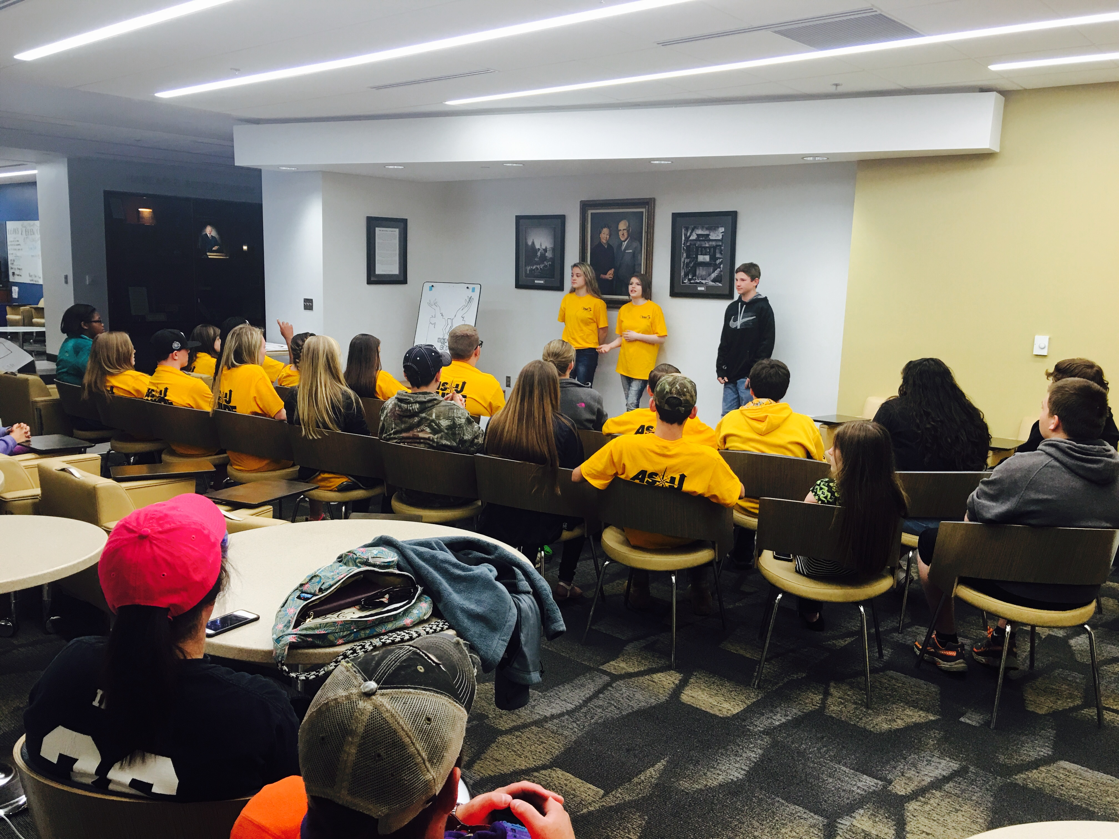

Slide 45
PARTNERSHIPS

Slide 46
University Partnerships
Community Partnerships
Sustainability

Slide 47
UNIVERSITY
GEAR UP/ Center for Entrepreneurship
GEAR UP/ ASU Faculty
GEAR UP/ASU Students

Slide 48
COMMUNITY
Local Businesses
  15 Local Businesses Participated
  Student Panel, Small Business Tours
  Donations to Appalachian Youth Local Fund
  Free Stuff!!

Slide 49
SUSTAINIBILITY
Appalachian Youth Local Fund
Connecting businesses and local school systems
Curriculum for GUIDE to give to teachers
Programming that grows with students

Slide 50
ENTREPRENEURIAL EDUCATION FUTURE CROSSWALK
14-15 GY01 AsU GUIDE Grades 6,7 | 15-16 GY02 AsU GUIDE (7,8) BizWorld (6,7,8) Grades 6,7,8 | 16-17 GY03 AsU GUIDE (7,8) REAL World (9) BizWorld (6,7,8) Grades 6,7,8,9 | 17-18 GY04 AsU GUIDE (7,8) REAL World (9) ASU Pitch Competition (10) Entrep. Summit (9-10) BizWorld (7,8) Grades 7,8,9,10 | 18-19 GY05 AsU GUIDE (8) REAL World (9) ASU Pitch Competition (10,11) Entrep. Summit (9-11) BizWorld (8) Grades 8,9,10,11 | 19-20 GY06 REAL World (9) ASU Pitch Competition (10, 11) Entrep. Summit (9-12) Martha Guy (12) Grades 9,10,11,12 | 20-21 GY07 ASU Pitch Competition (10,11) Entrep. Summit (9-12) Martha Guy (12) FYOC Grades 10,11,12, C

Slide 51
Thank You!!
Contact Information
Bradley Tunstill
GEAR UP Coordinator, Entrepreneur Education and Programming
Appalachian State University
tunstillbj@appstate.edu
(828) 262-8016 ext. 113

