Slide 1
Elizabeth Grant
Jobs for the Future | June 23, 2016
Pillars and partnerships

Slide 2
Increasing postsecondary attainment
Four Pillars of Success
~Dr. Aaron Thompson
Family
Institutions
Community
Student Self

Slide 3
About jff
Jobs for the Future works to ensure that all lower-income young people and workers have the skills and credentials needed to succeed in our economy.
To achieve our mission, we focus on three goals:
All lower-income young people graduate high school on a clear path to college completion and career success.
All underprepared students gain the skills they need to earn postsecondary credentials with high labor market value.
All lower-skilled workers obtain the education and training required to move into family-supporting careers with clear paths for advancement.
The promise of education and
economic mobility in America is
achieved for everyone.

Slide 4
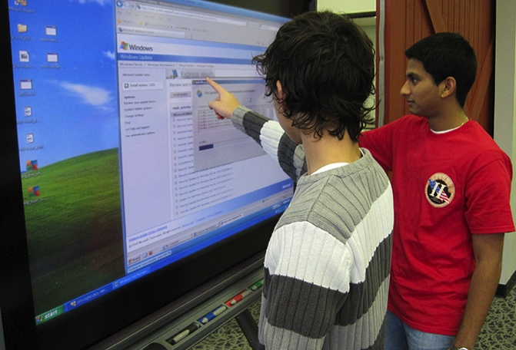
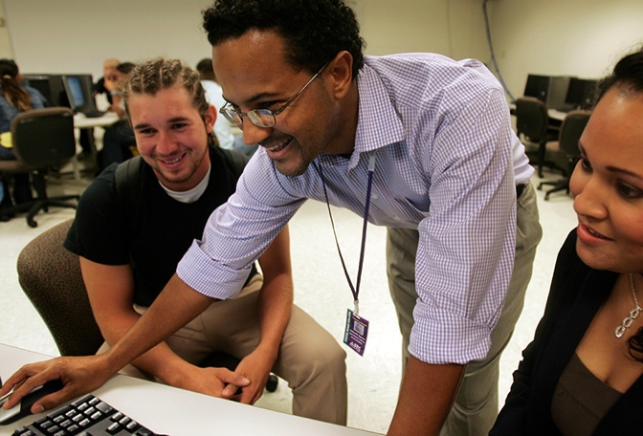

HOW WE WORK
BUILD THE EVIDENCE BASE
  Pilot, test, evaluate, document, and disseminate the strongest education and workforce development strategies
TRANSLATE RESEARCH INTO ACTION
  Building tools and resources that bring the evidence to life and spark local innovation
PROVIDE IMPLEMENTATION SUPPORT
  Assist partners in the field to apply the evidence to change policy and practice
ACROSS: SECONDARY, POSTSECONDARY, WORKFORCE

Slide 5
Rethinking the 12TH GRADE
Proposal:
That the 12th grade be restructured to make college and career readiness a reality for all young people

Slide 6
Rethinking the 12TH GRADE
Proposal:
That the 12th grade be restructured to make college and career readiness a reality for all young people
Solution:
Creation of a shared transition zone from senior year into the first year of college through the co-design, co-delivery, and co-validation of strategies by K12 and college partners

Slide 7
Principles of partnership in the shared transition zone…
CO-DESIGN
Deciding on and designing together courses, curricular pathways, and support systems, as well as professional development opportunities and data platforms, that impact what and how students learn.
CO-DELIVERY
Sharing and coordinating faculty and staff, facilities, and other resources to carry out the co-designed learning experiences and supports.
CO-VALIDATION
Accepting agreed-upon assessments, successful completion of performance tasks and experiences, and other indicators of learning as evidence of proficiency, including for placement in credit-bearing, college-level courses.

Slide 8
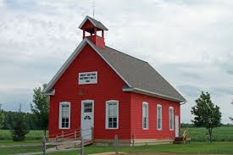
Context of schooling

Slide 9

Context of schooling

Slide 10
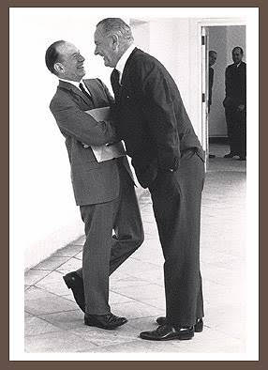
Influencing policy

Slide 11
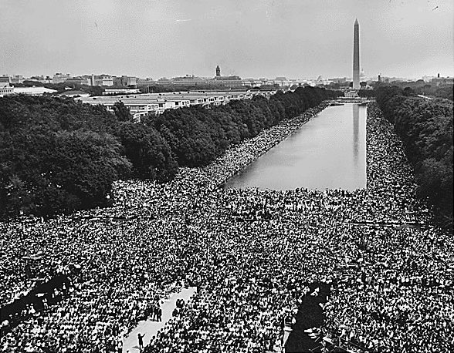
Influencing policy
Notes:
The 1963 March on Washington for Jobs and Freedom on the National Mall

Slide 12
Finding and solving the problems
“The quality of the problem that is found is a forerunner of the quality of the solution that is attained…”
Jacob Getzels
*from To Sell is Human, Daniel Pink

Slide 13
Principles of partnership in the shared transition zone…
CO-DESIGN
CO-DELIVERY
CO-VALIDATION

Slide 14
Q & A

Slide 15
Elizabeth Grant
egrant@jff.org
TEL 617.728.4446 FAX 617.728.4857 info@jff.org
88 Broad Street, 8th Floor, Boston, MA 02110 (HQ)
122 C Street, NW, Suite 650, Washington, DC 20001
505 14th Street, Suite 900, Oakland, CA 94612
WWW.JFF.ORG

