Slide 1
AEW Network Conference
Learning and Earning: Pathways to Prosperity
Workforce, Education, and Business Connections – Together Building a Stronger Workforce

Slide 2
Overview of Presentation
Who is Workforce Solutions?
What are we doing to connect Workforce, Education, and Business?
Specific examples/initiatives
How can you replicate?
Key partners
Funding

Slide 4
Who Is Workforce Solutions? Workforce Development Board (WDB) serving the counties of Cameron, Clearfield, Elk, Jefferson, McKean and Potter
MISSION: The North Central Workforce Development Board serves as the premier facilitator of an innovative workforce development system that meets the changing human capital needs of our employers and provides resources for our job seekers that maximizes their career potential and focuses on the customers’ needs.
VISION: The North Central Workforce Development Board will be a strategic workforce development leader focused on promoting economic prosperity and self-sufficiency of individuals by creating a workforce that is competitive in the global marketplace.

Slide 5
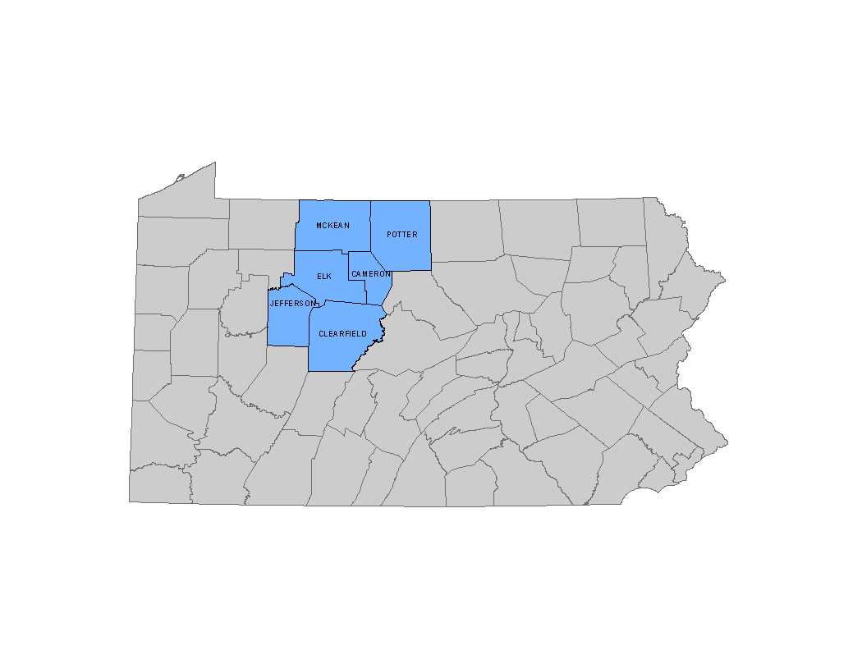

Slide 6
Goals
Enhancing Public-Private Partnerships
Engaging in Sector Strategies
Designing Innovative Workforce Strategies
Identifying Career Pathways
Maintaining a Customer-Centered Approach

Slide 7
Our Role in the Region
Develop the Regional Strategic Plan for the Workforce System
Policy and Administration
Recipient of Workforce Innovation and Opportunity Act (WIOA) funding
Procure for Title I Services
Charter/Certify the PA CareerLink® (One-Stop) system
Provide support to the system
Provide Labor Market Information (LMI)
Implement Sector Partnerships
Business and Education Connect Initiative
Maintain Eligible Training Provider List
Collaboration – Connector – Intermediary Services
Collaborate with county/regional economic development entities and other stakeholders

Slide 8
Creative Collaboration
Workforce, Education, & Business

Slide 9
Creative Collaboration
Meeting Business’ Needs
Next Generation Industry Partnerships
Ready Set Work website – https://readysetworkpa.com
Customized Employer Training
Die Setter Training with Penn State DuBois
CNC Training with Clearfield County Career and Technology Center and Penn State DuBois
Electronics and Instrumentation Training with Penn College of Technology
Registered Apprenticeships/Registered Pre-Apprentice
Regional Action Plan

Slide 11
Discuss one creative approach that you/your organization uses to engage business.

Slide 12
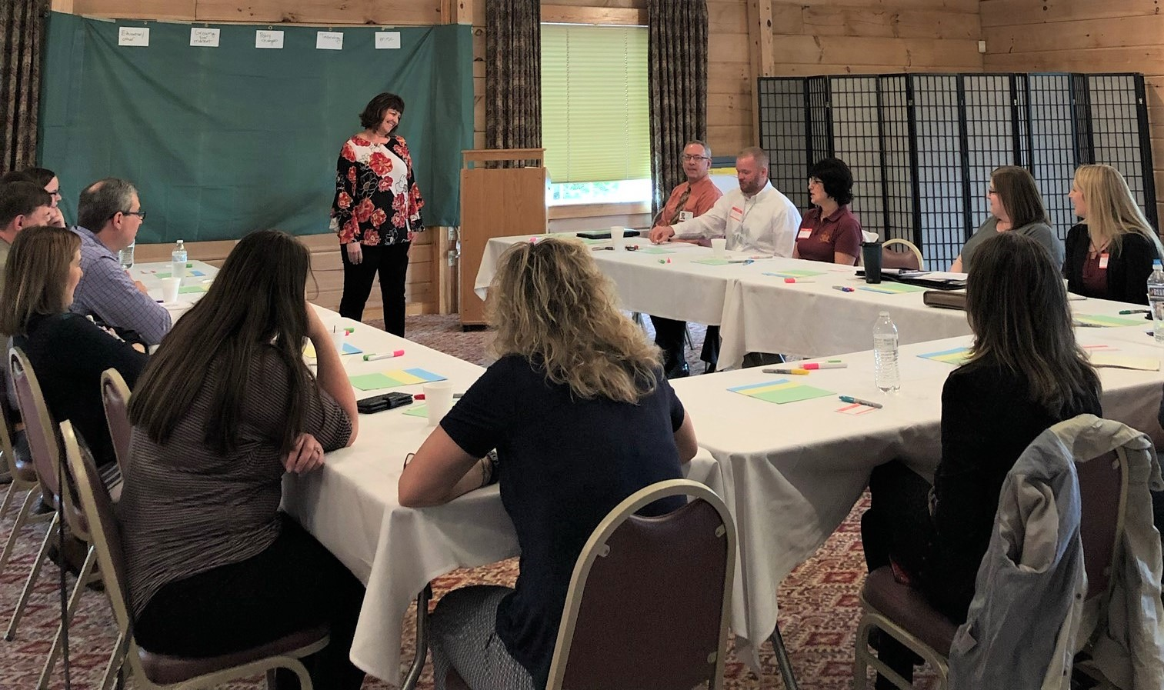
Next Generation Industry Partnerships

Slide 13
readysetworkpa.com

Slide 14
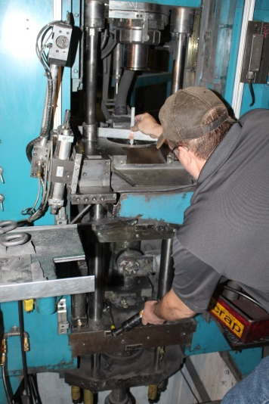
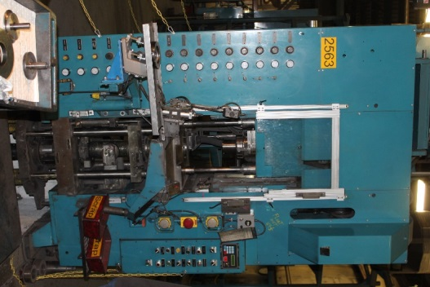
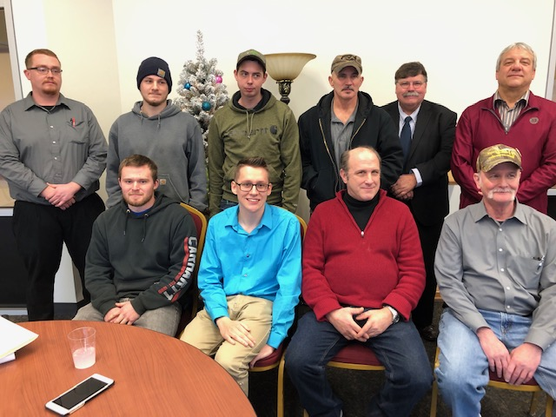
Customized Employer Training
Die Setter Training
CNC Training
E & I Training
Assess Needs
Develop Criteria
Issue Request for Quotes
Collaborate with
Training Providers

Slide 15
Registered Apprenticeship

Slide 16
Registered Pre-Apprenticeship
Partnership with a Registered Apprenticeship sponsor
Partnership approved training and curriculum
Voluntary hands-on training
Industry-recognized credentials
Support services

Slide 17
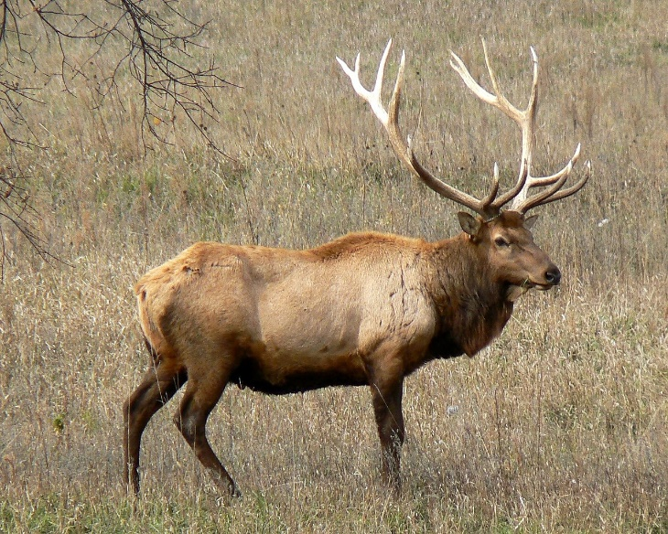
Regional Action Plan
Regional Talent Attraction & Retention
Attract people to commute to work in
NC Region
Attract people to live and work
NC Region
Attract young people to return
to live and work in NC Region

Slide 19
Is your region experiencing a workforce shortage? What is one thing that is being done to correct this?

Slide 20
Creative Collaboration
Bridging the Gap – Employers with Education
Business and Education Connect
PA State Local Internship
Program (PA SLIP)
What’s So Cool About Manufacturing
Video Contest

Slide 21
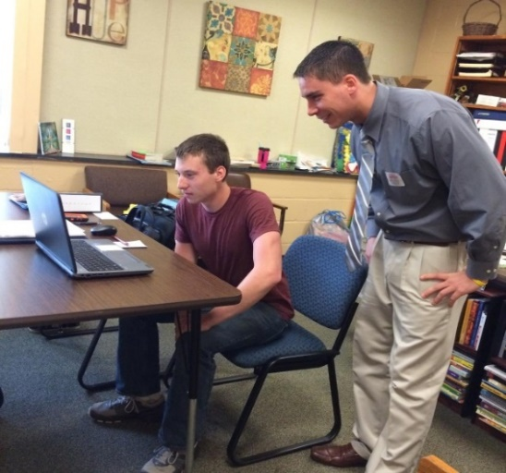
Connecting Business and Education
Programs for Elementary,
Middle and High Schools
Career Cruises, Teacher in the
Workplace, Industry Days, Career Camps, Tours, Job Shadowing…
Carl the Career Bear
Elementary School Program www.carlthecareerbear.com

Slide 22
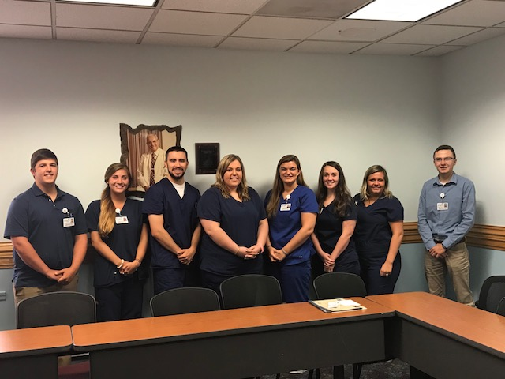
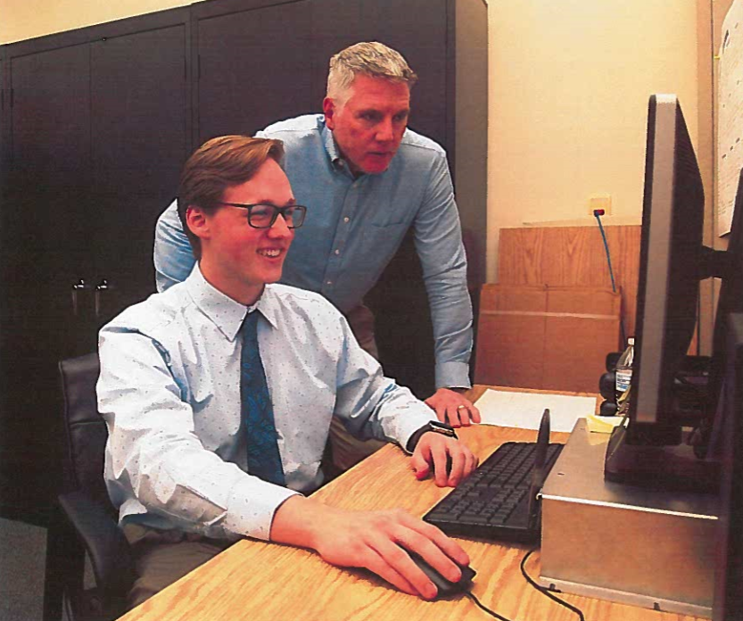
PA State Local Internship Program

Slide 23
Dream It Do It PA –What’s So Cool About Manufacturing Video Contest

Slide 25
What is something you/your organization is doing to better prepare our youth to make informed career decisions?

Slide 26
Contact Information
Susie Snelick, Executive Director
ssnelick@ncwdb.org
425 Old Kersey Road
Kersey PA 15846
814-245-1835 ext. 102

