Slide 1
Rethinking School: Preparing Rural Students for College and the Workforce in the 21st Century Learning and Earning: Pathways to Prosperity Appalachian Education & Workforce Network Conference June 2019

Slide 2
Rethink school
What do you think when you hear the phrase “Rethink School”?
What were your thoughts about what to expect when you read the title of this breakout?

Slide 3
Rethink school
Secretary DeVos: “Question everything to ensure nothing limits students from being prepared for what comes next.”
Ask fundamental questions
Why limit educators?
Why assign kids to schools based on their address?
Why group kids by age?
Why force all students to learn at the same speed?
Why measure learning by hours and days?
Why suggest a college degree is the only path to success?
Why believe education stops at graduation?
Rural families, rural teachers and rural leaders must answer these questions and more
What do you see as the major challenges or obstacles rural students face in finding or following their pathways to prosperity?

Slide 4
What is rural?
Different things to different people
What’s left
Federal definitions
USDA Economic Research Service
Census Bureau
Others

Slide 5
What is rural?

Slide 6
What is rural?

Slide 7
What is rural?
If you’ve seen one rural school…
“Rural” is not a monolith but a compilation of thousands of unique communities and circumstances. – ED’s Rural Report
Differences between states and among states

Slide 8
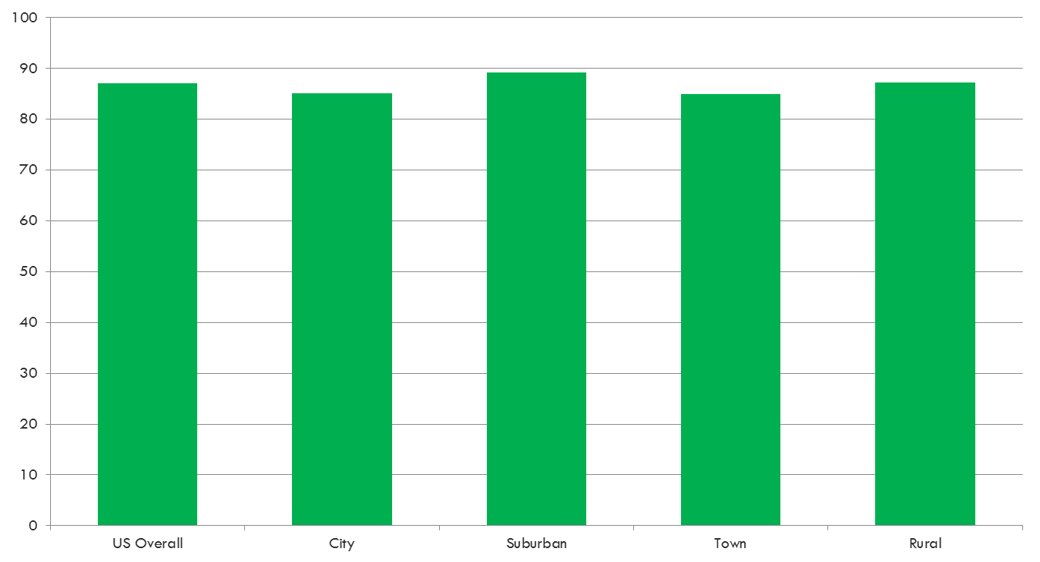
Percentage 25 Years and Older Who Completed High School
https://nces.ed.gov/surveys/ruraled/tables/b.3.c.-1.asp

Slide 9
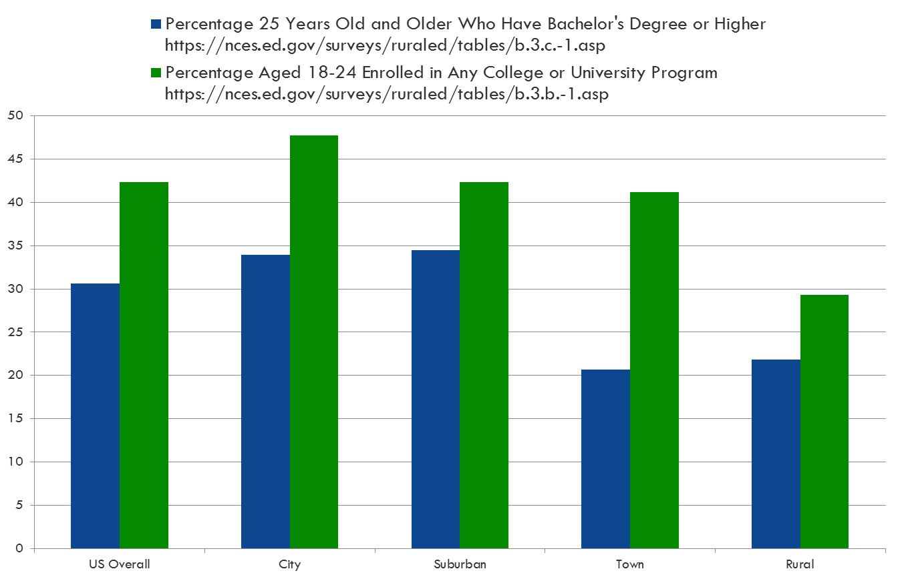
Postsecondary attainment

Slide 10
Rural matters

Slide 11
Rural matters

Slide 12
Rural matters

Slide 13
Rural matters
Trends in Rural America
Traditional rural industries waning (ag, mining, manufacturing)
Population, employment, poverty trends
Brain drain
“Graying” of rural areas
Opioid crisis
Rural residents wondered if their voices were being heard
What do you believe are the biggest challenges facing rural students?

Slide 14
Education freedom scholarships (EFS)
“All students need to be freed to pursue the education that will unlock their potential and unleash their creativity so they—and our country—can achieve unlimited success.”
– Education Secretary Betsy DeVos
Among the obstacles rural students can face
Access to advanced and specialized coursework
Distance to training centers/community colleges
Secretary’s EFS proposal can help students overcome these obstacles

Slide 15
Education freedom scholarships (EFS)
States identify Scholarship Granting Organizations (SGOs)
Individuals and businesses receive Federal tax credit for donating
SGOs award scholarships to students
States determine structure and allowable expenses
Participation is voluntary
Not about choosing different school buildings

Slide 16
Education freedom scholarships (EFS)
Designed to work hand-in-hand with students’ existing public education options
Could cover expenses for:
AP and IB courses
Elective courses
Credit recovery and remedial courses
Tutoring services
Education technology purchases
Fees for summer and specialized after-school programs
Others

Slide 17
Education freedom scholarships (EFS)
Designed to work hand-in-hand with students’ existing public education options
Close the skills gap
Align vision and strategies with Perkins V and WIOA
Could cover certain expenses for career training options:
Dual enrollment
Apprenticeships
Industry certifications
Transportation
Tools, supplies and PPE costs
Others

Slide 18
ED’s Rural Report

Slide 19
Rural Report Recommendations
Create intra-agency rural working group
Expand rural listening sessions
Explore simplifying applications, documents, and processes
Develop training for rural schools and districts
Explore increased collaboration with other Federal agencies and commissions
Develop a comprehensive communications plan
Enhance rural education data

Slide 20
Supplemental priorities
Priority 1–Empowering Families and Individuals to Choose a High-Quality Education that Meets Their Unique Needs.
Priority 2–Promoting Innovation and Efficiency, Streamlining Education with an Increased Focus on Improving Student Outcomes, and Providing Increased Value to Students and Taxpayers.
Priority 3–Fostering Flexible and Affordable Paths to Obtaining Knowledge and Skills.
Priority 4–Fostering Knowledge and Promoting the Development of Skills that Prepare Students to be Informed, Thoughtful, and Productive Individuals and Citizens.
Priority 5–Meeting the Unique Needs of Students and Children with Disabilities and/or those with Unique Gifts and Talents.
Priority 6–Promoting Science, Technology, Engineering, or Math (STEM) Education, with a Particular Focus on Computer Science.
Priority 7–Promoting Literacy.
Priority 8–Promoting Effective Instruction in Classrooms and Schools.
Priority 9–Promoting Economic Opportunity.
Priority 10–Protecting Freedom of Speech and Encouraging Respectful Interactions in a Safe Educational Environment.
Priority 11–Ensuring that Service Members, Veterans, and Their Families Have Access to High-Quality Educational.

Slide 21
Rural priority areas
Priority 1(b)(i): “Increasing access to educational choice …for …[c]hildren or students in communities served by rural local educational agencies.”
Priority 6(d): “Expanding access to and participation in rigorous computer science …coursework for traditionally underrepresented students such as racial or ethnic minorities, women, students in communities served by rural local educational agencies.”
Priority 6(h): “Utilizing technology for educational purposes in communities served by rural local educational agencies or other areas identified as lacking sufficient access to such tools and resources.”
Priority 8(c)(ii): “Promoting innovative strategies to increase the number of students who have access to effective educators in …[s]chools that are located in communities served by rural local educational agencies.”
Priority 8(d)(ii): “Promoting innovative strategies to increase the number of students who have access to effective principals or other school leaders in…[s]chools that are located in communities served by rural local educational agencies.”

Slide 22
Stem strategic plan
Vision
Strengthens Federal commitment to
Equity and diversity
Evidence-based practice
Engagement with national STEM community
“North Star”
Ensure all Americans have access to quality STEM education

Slide 23
Stem strategic plan

Slide 24
Stem strategic plan
What innovative means are you using to expand students’ access to STEM education?

Slide 25
American broadband INITIATIVE

Slide 26
American broadband INITIATIVE
Lack of access is a barrier for many rural students
Expanding connectivity is essential to expanding education freedom and opportunities for rural students
Recommendations to
Streamline Federal permitting
Leverage Federal assets
Maximize the impact of Federal funding
ED commitments
Create an interagency working group and develop and test strategies to increase broadband access for students in and outside of school
Measure equity in technology access in upcoming Civil Rights Data Collection survey
Work with DOI's BIA, IMLS and Native American communities to develop and convene a Tribal Broadband Summit.

Slide 27
American broadband INITIATIVE
Status of school connectivity
OET listening sessions
Connectivity is not the end goal
Increasing access to additional course choices
Incorporating more advanced technology into the classroom, improving the learning environment
Creating more options and more opportunities for students
What is the status of connectivity in your school and your area?

Slide 28
Rethink cte
Nimble, demand-driven talent development system
Multiple pathways
Perkins V
Provides funding for CTE
Workforce needs in manufacturing
Good news for employers, communities and others worried about the skills gap
Promotes better alignment with economic needs
Helps students and families make better-informed decisions
Gives states, school districts and community colleges greater freedom
Discretionary grants
Pathways to STEM Apprenticeship
Innovation and Modernization

Slide 29
Rethinking cte

Slide 30
Rethinking cte

Slide 31
Rethink school (rural innovation)
ESSA shifts much of the power and control of education from the Federal government to state and local governments and education agencies.
Revisit fundamental questions
Why limit educators?
Why assign kids to schools based on their address?
Why group kids by age?
Why force all students to learn at the same speed?
Why measure learning by hours and days?
Why suggest a college degree is the only path to success?
Why believe education stops at graduation?
Rural schools may be the best places to rethink these questions, and more

Slide 32
links
Rural Report: https://www2.ed.gov/about/inits/ed/rural/rural-education-report.pdf
EFS information: https://sites.ed.gov/freedom/
White House STEM Strategic Plan: https://www.whitehouse.gov/wp-content/uploads/2018/12/STEM-Education-Strategic-Plan-2018.pdf
American Broadband Initiative Report: https://www.ntia.doc.gov/files/ntia/publications/american_broadband_initiative_milestones_report.pdf
Broadband USA Funding: https://broadbandusa.ntia.doc.gov/funding-list

Slide 33
Michael Chamberlain
Office of Rural and Community Engagement
Michael.Chamberlain@ed.gov

