Slide 1
Non-academic Support for Rural Students’ Successful Transition
Appalachian Education & Workforce Network Conference
June 19, 2019
Notes:
Welcome to your afternoon plenary. My name is Kerry Friedman and I am the Deputy Director of the Regional Educational Laboratory Appalachia at SRI International.

Slide 2
During our time together…
Learn about the REL Program and the United Way
Explore non-academic supports for postsecondary transition
Questions and answers with our panel
Subtask 3.2
Notes:
During our time together today, we’ll share information about the regional educational laboratory program and one of our partners in the region, the United Way of Southwest Virginia, explore our work in supporting postsecondary transitions for students in the region, focusing on those non-academic supports – such as supporting students in logistical, financial, and social-emotional preparation for postsecondary education, as well as developing career ready students, and leveraging community and industry partners to build bridges between high school and college and careers.
We’ll end with Q&A

Slide 3
Subtask 3.2
Notes:
I’ll allow each panelist to tell you more about their work, but first, just to provide primer or refresher on the REL program. The REL Program is administered by the U.S. Department of Education, Institute of Education Sciences.
The 10 RELs work in partnership with stakeholders to fulfill our mission of mission of supporting a more evidence-reliant education system. The RELs carry out 3 main activities:
Disseminate findings from research in ways that educators and policymakers can use in practice.
Provide educators and other stakeholders with training, coaching, and technical support needed to use research findings and evidence in the classroom—to improve teaching and learning.
Conduct a wide variety of applied research studies to answer critical questions.

Slide 4
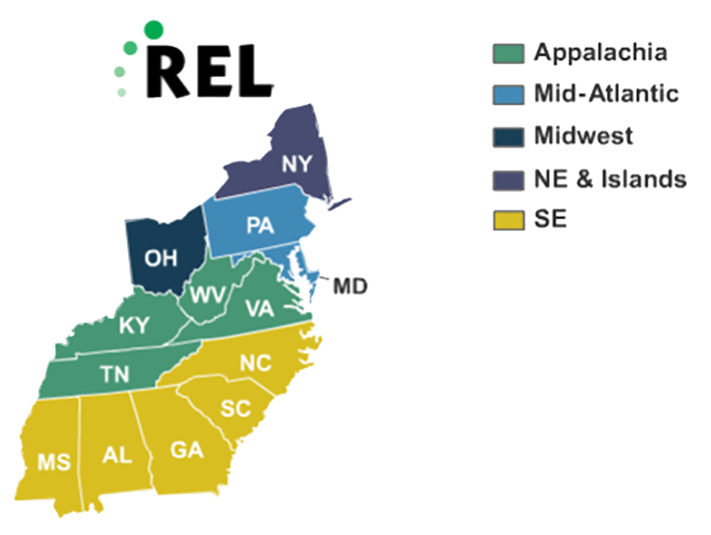
Subtask 3.2
Notes:
We have two of the five RELs that work in the Appalachian region here today to share how they are partnering with educators throughout the region to support successful postsecondary transition.
REL Appalachia covers just four states in the Appalachian region – Kentucky, Tennessee, Virginia, and West Virginia.
REL Southeast, which Kevin represents, includes the Appalachian states of Alabama, Georgia, Mississippi, North Carolina, and South Carolina.
Other RELs in the region include:
REL Mid-Atlantic includes the Appalachian states of Pennsylvania and Maryland.
REL Mid-West partners with education stakeholders in Ohio.
REL NEI supports New York state.

Slide 5
Terminology
Postsecondary Success
Postsecondary Transition
Postsecondary
College and Career Readiness
K-12
Subtask 3.2
Notes:
This is a graphical representation of how we’re thinking about “college and career readiness” and “postsecondary transitions.”
College and career readiness refers to the knowledge, skills, and competences that students should possess by the end of high school to ensure they are prepared to transition to college or career (most careers that offer a living wage now require at least some postsecondary training or certificate).
Postsecondary transition is making that leap from secondary to postsecondary education. Supports for a successful postsecondary transition can be provided during high school (counseling, help navigating the college and financial aid application process, etc.), early postsecondary (college orientation, financial support, college counseling), or target that gap in between where so many students who have the knowledge, skills, and competencies to succeed in postsecondary nonetheless fall of track (summer bridge, nudge). Supports early in the postsecondary process that take place once students arrive in college can also be part of the transition, such as college knowledge courses, counseling, mentoring, support courses, etc.

Slide 6
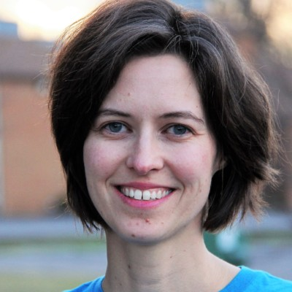
Meet the panel
Deborah Jonas, REL Appalachia
SRI International
Kevin Smith, REL Southeast
Florida State University
Robyn Raines, United Way of Southwest Virginia
Subtask 3.2
Notes:
Each panelist will introduce their organization and its role in facilitating postsecondary and career success.

Slide 7
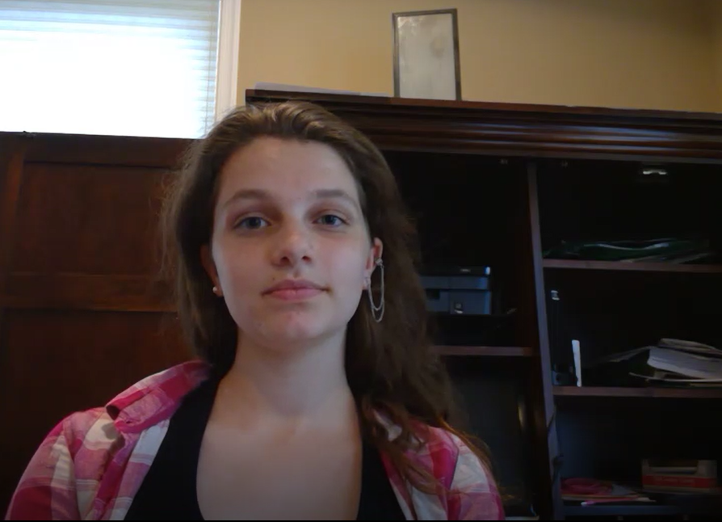
Meet Carlie!
Subtask 3.2
Notes:
To get us thinking about strategies to support postsecondary transition and applying them,
We will now show a short student scenario. This is Carlie, a student meeting her new 10^{th-}grade counselor. As you hear from Carlie, think about her strengths and challenges. After the video, we’ll hear from our panelists about different ways they might support Carlie in her transition to college and career.

Slide 8
Support Carlie in preparing for postsecondary
Think about what non-academic or career counseling supports you would recommend for Carlie (1 min).
Share at your table (4 min).
Subtask 3.2
Notes:
Now that you’ve heard from Carlie, we’d like you to take a few minutes to think independently and jot down any thoughts about what strategies you might recommend for her in relation to the socio-emotional, logistical, or financial supports she may need to have a successful postsecondary transition. Then we’re going to have you turn to someone at your table and do a quick pair-share.

Slide 9
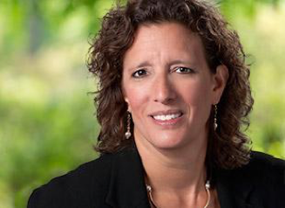
Subtask 3.2
Dr. Deborah Jonas
Director
Notes:
Now that you’ve had a few minutes to think about the non-academic and career couseling supports you might recommend for Carlie, Deborah Jonas, the director of REL Appalachia, is going discuss some research-based strategies for supporting a student like Carlie’s successful postsecondary transition, drawing on REL APs work with rural high school and postsecondary educators in the Appalachian region.
One of things we can do is equip students with college knowledge. Research suggests that this type of exposure can ease the transition. This exposure and knowledge are critical for first-generation students and students from underrepresented groups.
Creating high school-college partnerships is one way to provide this exposure.
Work with local and distant institutions to provide opportunities for your students to learn about what they offer.
Invite college representatives to visit your school(s).
Organize visits to the institutions.
Invite past students who are enrolled in college or postsecondary education to come back to your school.
Common process expectations
Common deadlines
Completing admissions tests
Completing financial aid applications including the FAFSA
Regional/district initiatives
Application essays units
School-wide admissions tests
Postsecondary research and application weeks
FAFSA information and completion days
Exposure to career options and postsecondary majors
Light-touch exposure strategies
Career inventories
College visits
Guidance counseling
More intensive exposure strategies
Career pathway programs like career academies
Job experiences through internships, service learning, and apprenticeships
Career-focused dual enrollment

Slide 10
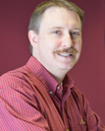
Subtask 3.2
Kevin Smith
Training, Coaching, and Technical Support Lead
Notes:
Now that you’ve had a few minutes to think about the career counseling supports you might recommend for Carlie, Kevin Smith, the training, coaching, and technical support lead for REL Southeast, is going discuss some research-based strategies for career counselors to consider in supporting Carlie’s successful postsecondary transition, drawing on REL SE’s work with rural career counselors in Florida.

Slide 11
Subtask 3.2
Robyn Raines
Director of Childhood and Youth Success
Notes:
Now that you’ve had a few minutes to think about the industry partnerships or work-based learning experiences you might recommend for Carlie, Robyn Raines, director of Childhood and Youth Success at United Way of Southwest Virginia, is going discuss how the United Way might approach partnering with industry to support a student like Carlie.

Slide 12
Question & Answer
What other supports did you discuss at your tables?
What questions do you have for the panelists?
Subtask 3.2

Slide 13
Thank you!
United Way of Southwest Virginia
http://unitedwayswva.org/
@unitedwayswva
info@unitedwayswva.org
REL Appalachia
https://ies.ed.gov/ncee/edlabs/regions/appalachia/
@REL_Appalachia
RELAppalachia@sri.com
REL Southeast
https://ies.ed.gov/ncee/edlabs/regions/southeast/
@REL_SE
rel-se@fsu.edu
Subtask 3.2

